Slide 1
Exploring the interrelated dynamics of land tenure, cropping systems and biodiversity through field types
Sarah Graf, Christine Bosch, Emmanuel Codjoe, Thomas Daum, Christianah Ojo, Temitope Ojo, Oyinbo Oyakhilomen
Sarah Graf
Christine Bosch, Emmanuel Codjoe, Christianah Ojo, Temitope Ojo, Oyinbo Oyakhilomen
Notes:
Thanks to participants!

Slide 2
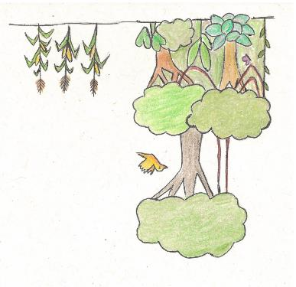
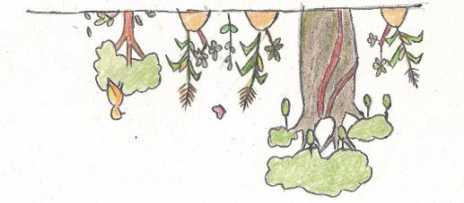
Land Sparing vs. Land sharing
Agriculture causes biodiversity loss through:
Converting ecosystems to farms
Intensified farming practices
Pollution, including CO₂
Open Access needs restrictions to avoid overexploitation (Ostrom, 1990)
Occupation establishes claims to land (Grigsby, 2004; Basset 2009)
Agricultural practices and social relations are mutually dependent (Cochet, 2015; Asaaga et al., 2020, Graf et al. 2023)
Labour key to adopting agroecological practices (Graf & Oya, 2021, Daum et al., 2023)
Notes:
NOT “either or” – we need to do both!
Land sparing:
1/3 of forest destroyed through expanding agricultural land
Habitat loss is #1 driver of biodiversity loss (Ritchie & Roser, 2021)
But: Existing social relations can hider or reinforce these strategies.
Open Access: Overexploitation of key species – restrictions: e.g. no hunting during upbringing of offspring
Occupation:
Agricultural practices & social relations: E.g. tree tenure vs. land tenure: Chiefs control interplanted timber trees (Asaaga)

Slide 3
Propositions
!
Field types combine tenure relations and cropping practices that may jointly create dynamics resulting in habitat loss.
Understanding these dynamics can inform more context specific strategies.
Research Questions
?
How are land tenure and field types connected to habitat loss?
How can land tenure and field types hinder or reinforce land sharing and land sparing approaches.
Notes:
Based on the literature and field observations I had two propositions:
Field types combine tenure relations and cropping practices that may jointly create dynamics resulting in habitat loss.
Understanding these dynamics can inform more context specific strategies.
→ conference as an occasion to think more about the topic! Engage with other disciplines

Slide 4
Village case studies
 | Ghana | Nigeria
Farming | Cocoa on secondary forest oil palm monoculture Food crops with young trees | Cocoa planted decades ago Natural oil palms Separate food crop fields
Biodiversity | Loss of secondary forest Little game (squirrels) Open access plants disappear | No virgin forest Destruction of farm land Much game (snakes, grasscutter, porcupines)

Slide 5
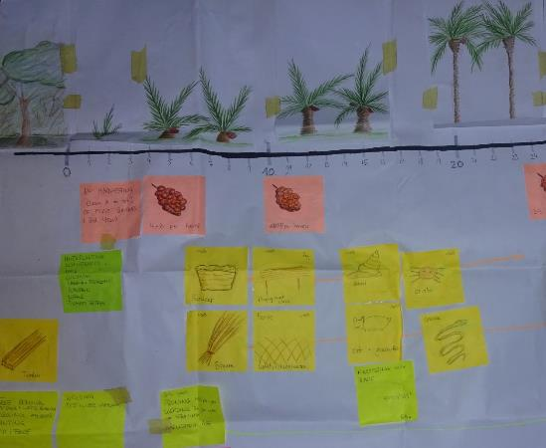
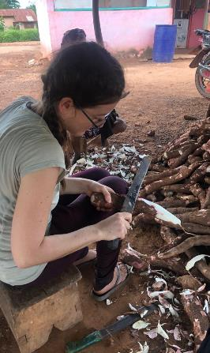
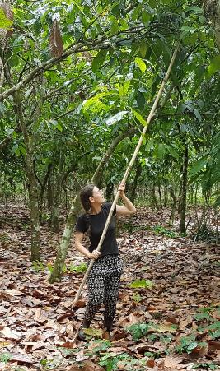
Data Collection

Slide 6
Field type
Defined as plot with:
Specific combination of plants
Sequence of plants
Cultivation method
Ecological context
(de Schlippe, 1956)
Useful concept, because:
Orders complex practices
Farmers use it
Combines social, technical and ecological aspects
Social relations manifest at plot level

Slide 7
Field Types in the Ghanaian Village
Are all the farming areas the same or there are different kinds of areas that are better for certain crops?
The land is not the same. There are some portions that are good for cocoa and others that are better for oil palm.
(Excerpt from focus group discussion)

Slide 8
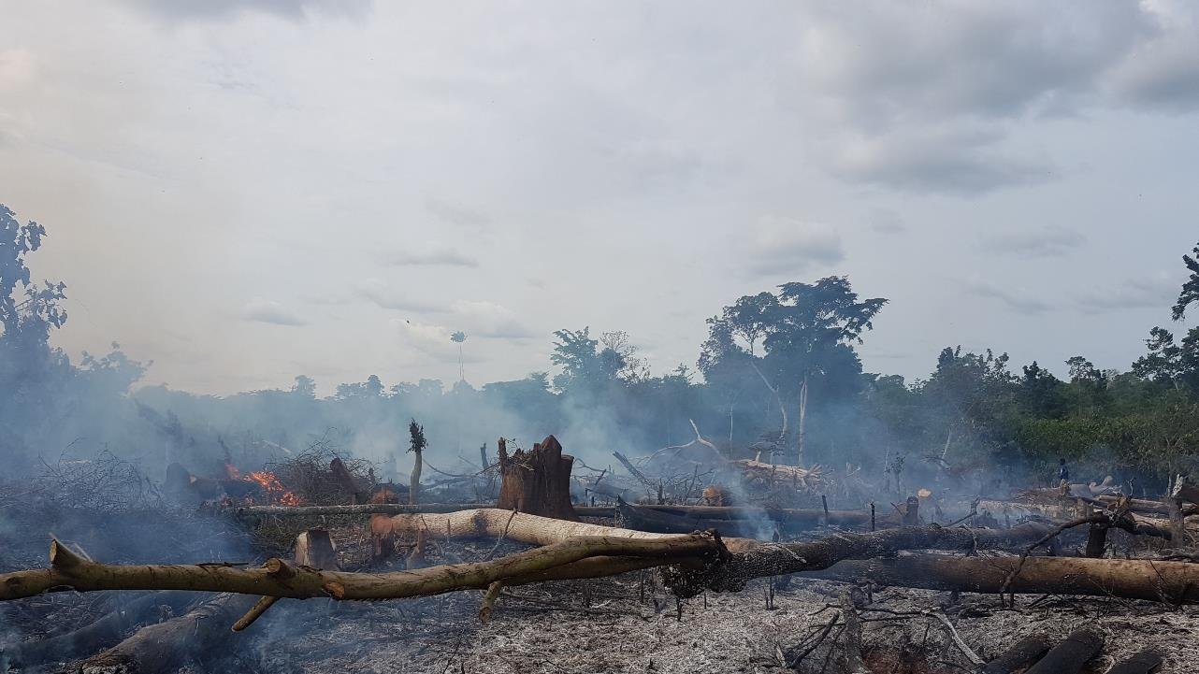
New Farms are established on secondary forest.

Slide 9
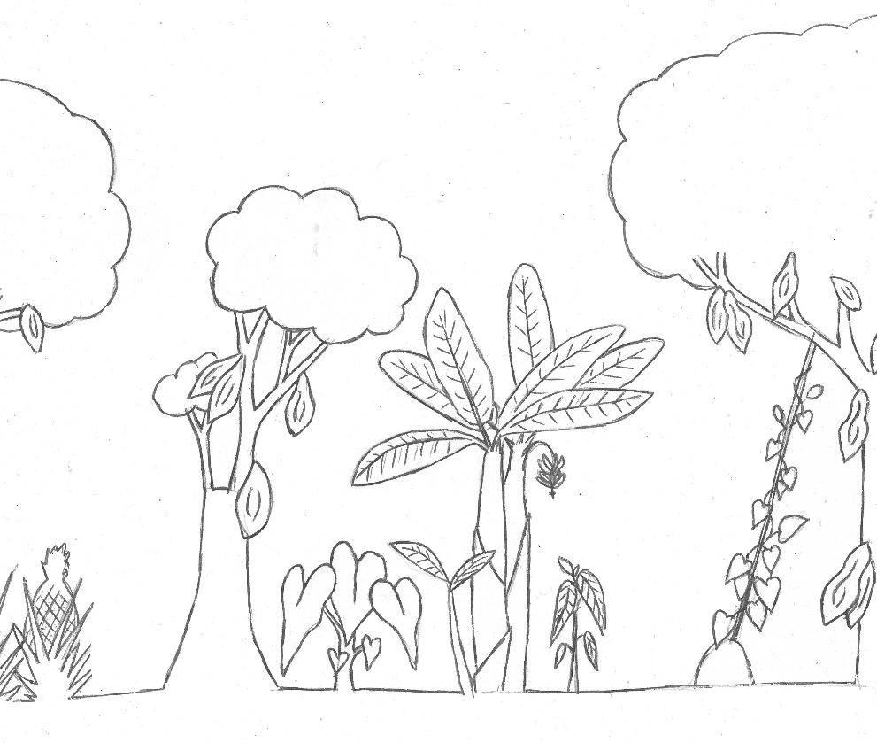
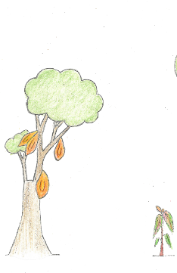
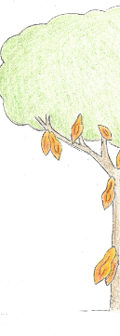
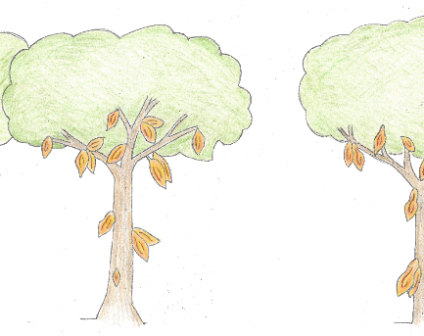
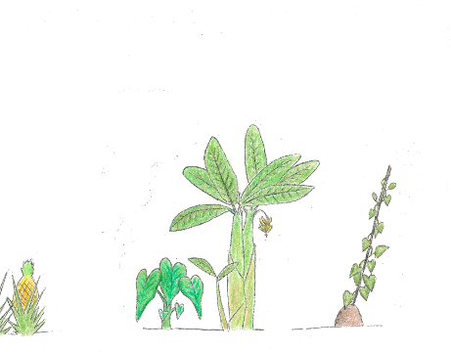
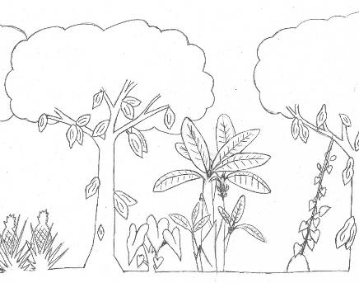
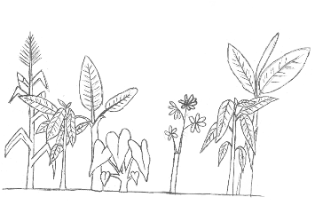
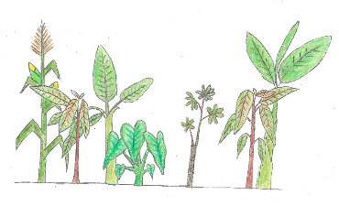
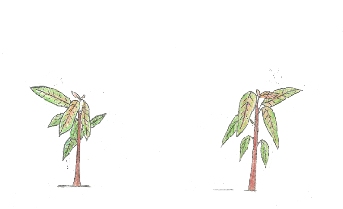
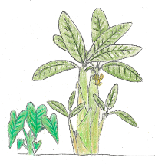
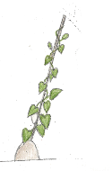
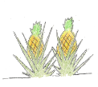
Cocoa Farm
0-5 years
$$1/2$$
5-30 years
>30 years
$$1/2$$
$$1/3$$
$$1/2$$
landowners push cocoa
Trees establish land rights
accumulation
property for wives
Once the canopy closes…
capital and labour available again.
proceeds can be reinvested.
Need for new land for food crops.
Gradual replanting (land tenure)
Can be inherited
→Forest conversion dynamic
Notes:
Not shown: Open access species (timber species, fufu stick, bark, tuckerberry) – often not encouraged

Slide 10
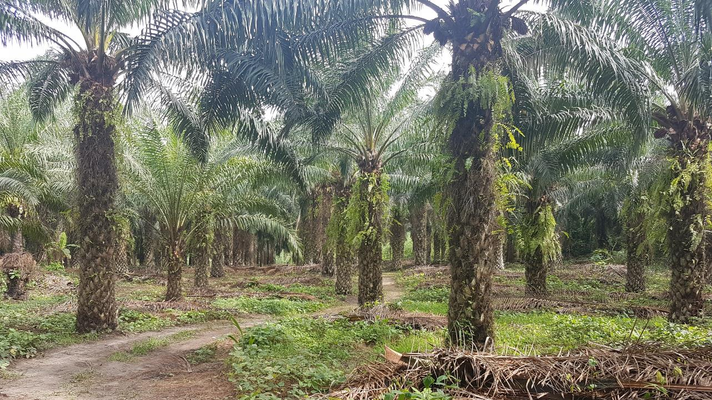
Oil Palm Farm
Notes:
Very open
Can withstand waterlogging
→intersects habitats and water access.

Slide 11
Ghanaian Village
Timeline:
Village establishment
Fully planted
Game species disappear
1983 fire
1993 oil palms
Open access plants
1993
Oil palms
1910
First settlement
1970
Chainsaws
1983
Bush fire
Where to look: village timeline;
Resource map
Expert: old lady
QGIS notes
1970s
Most land occupied
Game species disappear
Secondary forest regrows
2010s
Land rush

Slide 12
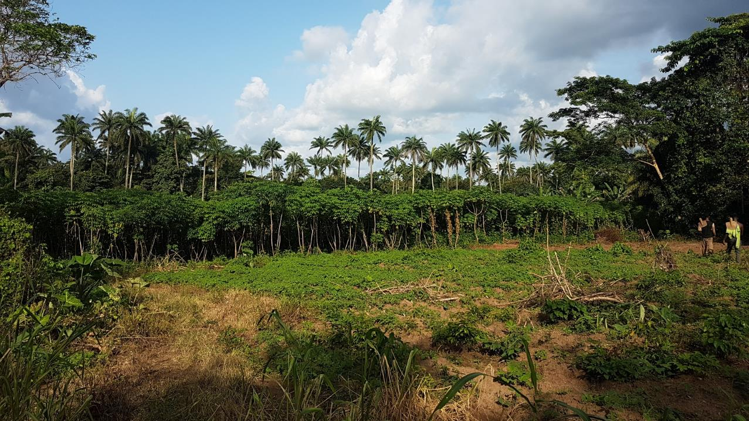
Field Types
Tree crop farm
‘papa’
12
Notes:
The image shows the two common field types.
Back: tree crop farms (structurally diverse), naturally occuring oil palms (hights)
Front: papa 1. cassava: 2. land to be planted → very open

Slide 13
Nigerian Village
Timeline:
Village establishment
Fully planted
Game species disappear?
Sand winning case! / urbanization-displacement (love has left!)
Forest reserve
Open access plants?
1980
Gara introduce heaping
1910
First settlement
2010s
Death of key landowners
1997
Goat ban
Where to look: village timeline;
Summary timeline
Resource map
QGIS notes
1990s
Most land occupied
Sand winning
urbanisation
Notes:
Heaping – Gara bring their cultivation practices: Perception – this makes land unsuited for cocoa…
Goat ban – planting density
Landowners – love has disappeared
→new generation has different ideas (sand-winning, urbanisation land sales → accumulate elsewhere = outside agriculture, virgin land)
But: despite being fully planted, there is more game around! (grasscutters, porcupine, snakes)

Slide 14
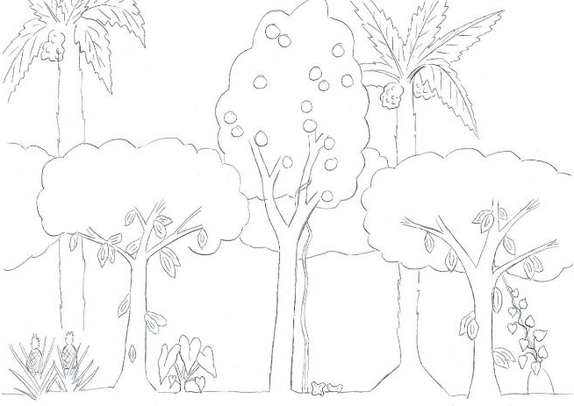
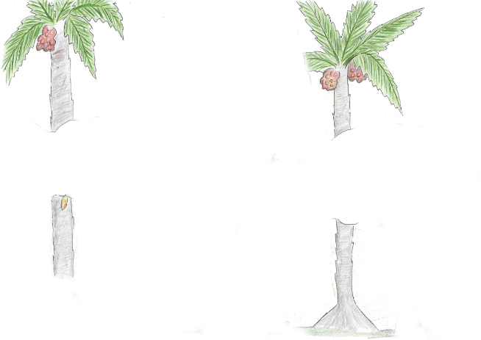
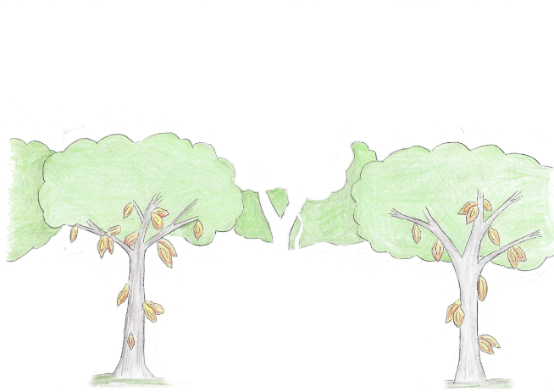
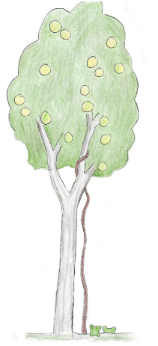
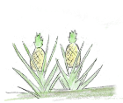
Nigeria – Tree Crop Farm
Intensification options without biodiversity trade-offs
rejuvenation of cocoa farms (challenge: property rights)
Better quality through fermentation (challenge: security/trust)
Degradation of papa?
Bush fallow in papa (challenge: occupation / long term contract)
Add: traps
Warra-warra?
Illustration: Sarah Graf
Notes:
Planted by parents / grandparents (rented for fixed sum)
3 layers – different relations:
Cocoa: main crop (farmer + wage labour)
Oil palms: naturally occurring: belong to landowners!
Tree crops (farmer or sublease)→harvesting period extends! Would also belong to tenants in Ghana!
Food crops – subsistence
Encouragement of naturally occurring species: breadfruit, warra-warra; traps
→Diverse crop & height mixture enables land sharing
Hunting: social relations
Bushy part for hunting (traps only on own farm) – (grasscutters, porcupine, snakes)
Anyone can shoot with a gun!
Offtake of protected species??
→Overstory used to be practiced in Ghana (kola), could be an option with orange boom?

Slide 15
Land Sparing vs. Land sharing?
Context determines which strategy has prospects of success:
Land sparing
Occupation = land rights
Social function of tree crops
Field types with inherent tree planting dynamic
Land sharing
Open Access species not encouraged
Oil palm monoculture & papa intersect corridors
Notes:
Land sparing:
Occupation – especially when land becomes scarce
Social function – accumulation, wives, income for landlords
Field type dynamic
Open access species: especially ‘timber’ trees
Corridors

Slide 16
Thank you for Listening!
Sarah Graf

