Slide 1
Liana community structure in relation to climatic, edaphic and physiognomic attributes of forests in Ghana
Bismark Ofosu-Bamfo
Department of Biological Sciences, University of Energy and Natural Resources (Ghana)
Department of Theoretical and Applied Biology, Kwame Nkrumah University of Science and Technology (Ghana)

Slide 2
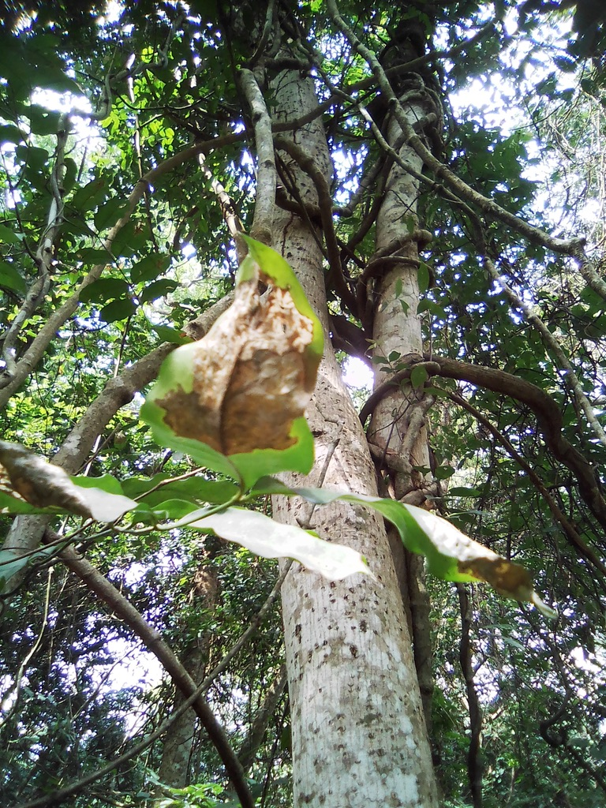
Introduction
Lianas are woody climbing plants rooted in the soil but require support to reach the canopy (Schnitzer and Bongers, 2011).
They contribute to biodiversity, help maintain microclimate but are generally antagonistic to trees (Schnitzer and Bongers, 2011; Stevens 1987).
Among others, they reduce tree growth rate, increase tree mortality, reduce tree fertility and can be detrimental to ecosystem processes (Schnitzer and Bongers, 2011).
Plate 1: A tangle of lianas on a host tree
Notes:
What is a liana?
What are their roles in tropical forests?

Slide 3
Introduction
Ecologists have been interested in factors responsible for the ecology and distribution of climbing plants (Schnitzer et al., 2015).
The leading hypothesis thus far is the seasonal growth advantage (SGA) hypothesis (Schnitzer, 2005; DeWalt et al., 2010, 2014).
SGA was based on synthesis with limited contribution from African forests. Does this hypothesis explain the drivers of liana ecology in tropical African forests?
Notes:
What do we know about their ecology since Darwin first decribed the climbing habit?
Does this reflect in the forests of Ghana? Uncertain?

Slide 4
Study objective and hypothesis
The objective of the study was to investigate the drivers of liana ecology and distribution in Ghana.
Liana density and diversity will decrease along a gradient of increasing rainfall and decreasing seasonality;
Liana density and diversity will be high in forests with low percentage canopy cover and high light intensity;
High liana density and diversity will be supported by nutrient-rich soils, high tree density and richness, lower slope and elevation.
Notes:
Objectives of the study

Slide 5
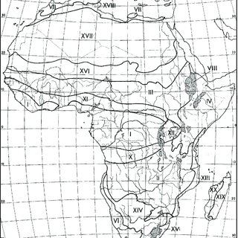
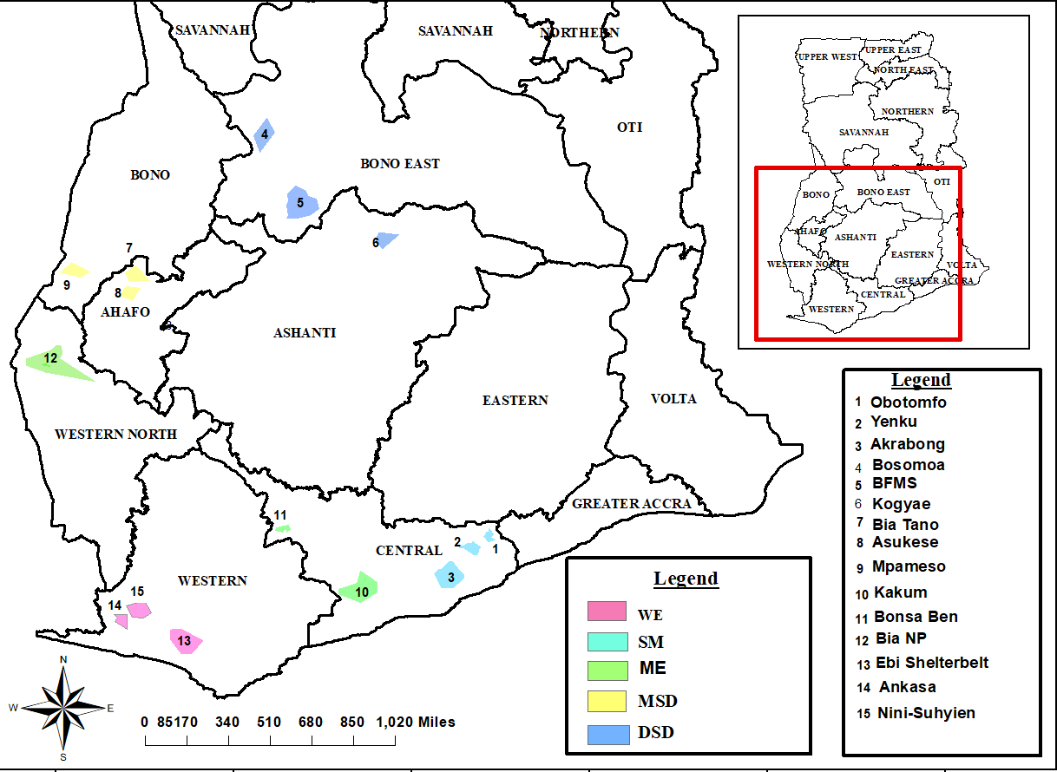
Methods – Study area
Southern Marginal (SM) – 700-900 mm MAP
Dry Semi-deciduous (DSD) – 900-1200 mm MAP
Moist Semi-decisuous (MSD) – 1200-1400 mm MAP
Moist Evergreen (ME) – 1700-1900 mm MAP
Wet Evergreen (WE) - > 2000 mm MAP
Figure 1. Map of study area
Notes:
Where was the study done? What is unique about each site?

Slide 6
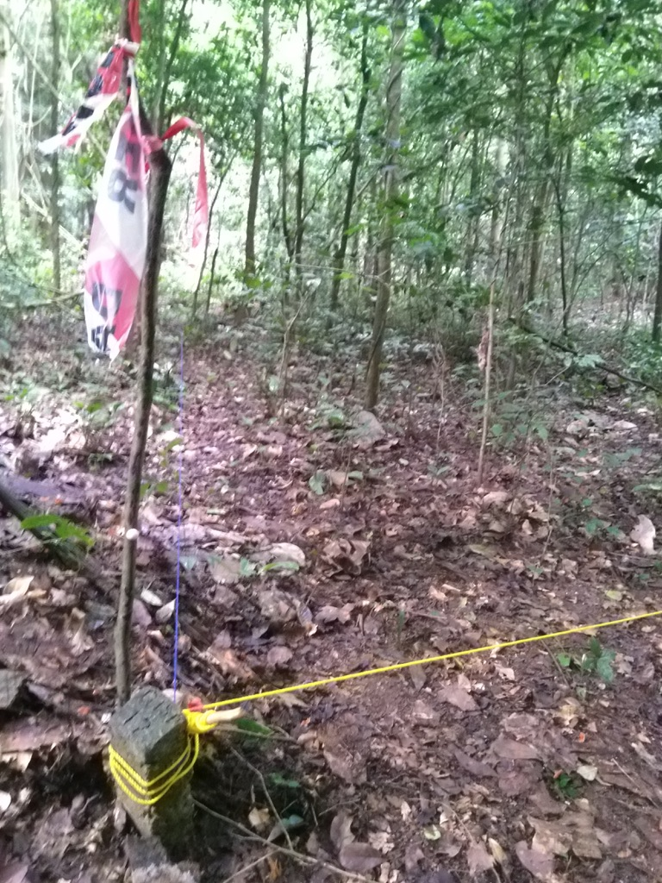
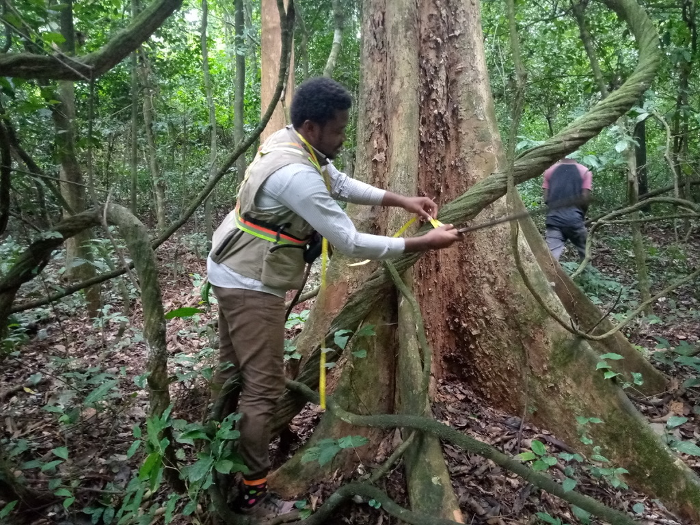
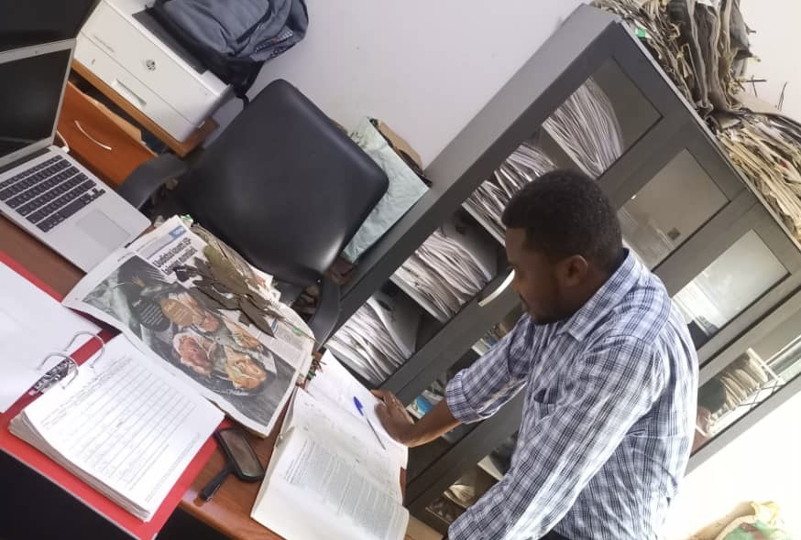
Methods – Data Collection
A) Plot lay out and sampling: Plot cordinates and elevation; clinometer, densiometer and light meter meansurements; and Liana and tree inventory.
B) Soil analysis: texture, Ca, Mg, K, and Na, total nitrogen, phosphorus, organic carbon, organic matter, effective cation exchange capacity (ECEC), exchangeable acidity, total exchangeable bases (TEB) and base saturation.
1
3
C) Climate data: Rainfall, Dry season length, Temperature, Relative humidity, Solar radiation (Ghana Met Agency and NASA LARC Power).
4
2
D) Data analysis: One way ANOVA, Diversity Permutation test, iNEXT, Cannonical Correspondence Analysis, Multivariate multiple regression.
Notes:
What methods were used for data collection?

Slide 7
Main findings and discussion
b
bc
a
Figure 2. Rainfall, dry season length, percentage canopy cover and light intensity among sites
Notes:
What were the findings for MAP, DSL, Canopy Cover and Light environment?

Slide 8
Main findings and discussion
c
c
c
a
a
b
Figure 3. Liana abundance and species richness among sites.
Notes:
What was the trend for liana abundance and richness?

Slide 9
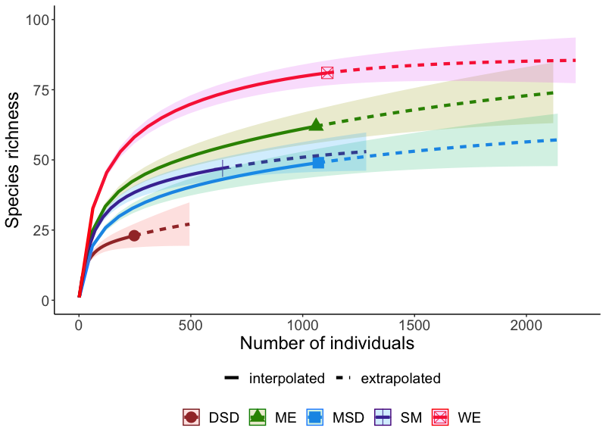
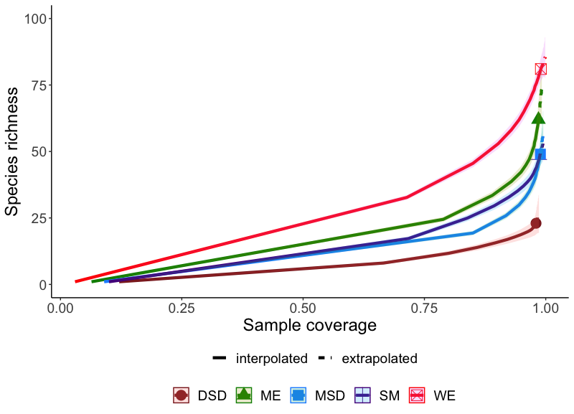
Main findings and discussion
Figure 4. Extrapolated species richness and saple coverage.

Slide 10
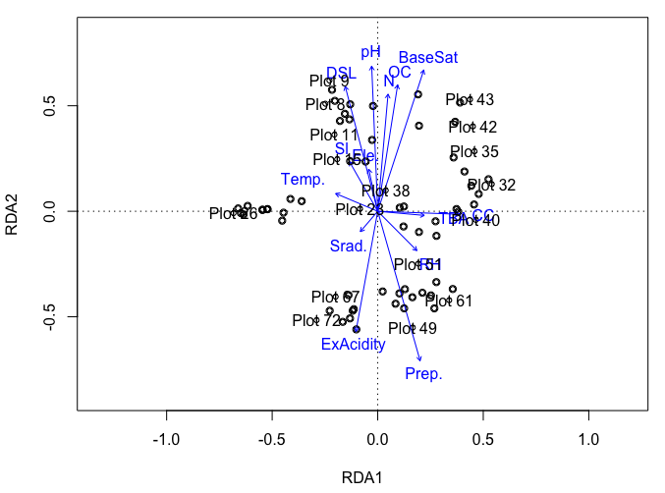
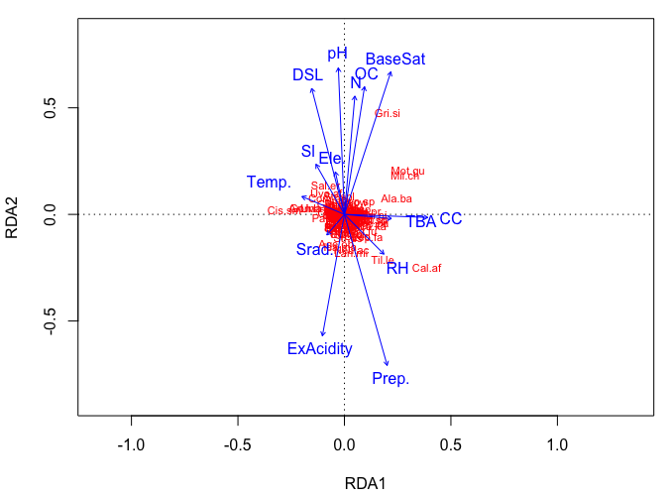
Main findings and discussion
SM
MSD
DSD
WE
ME
Figure 5. Canonical Correspondence Analysis showing plot and species distribution in relation environmenatal factors.
Notes:
How were plots and species associated with environmental gradients?

Slide 11
Main findings and discussion
Table 1. Relationship between liana abundance and environmental factors
Parameter | Coeff. | Std.err. | t | p
(Intercept) | 1933.000 | 1496.000 | 1.292 | 0.203
MAP | -0.021 | 0.042 | -0.509 | 0.613
Dry season length | -2.698 | 6.040 | -0.447 | 0.657
Relative humidity | 7.999 | 3.592 | 2.227 | 0.031
Solar radiation | -26.100 | 14.650 | -1.782 | 0.082
Temperature | 27.320 | 19.940 | 1.370 | 0.178
Slope | -0.319 | 0.384 | -0.829 | 0.411
Elevation | 0.020 | 0.110 | 0.181 | 0.857
Light intensity | -12.220 | 19.570 | -0.625 | 0.535
Canopy cover | -0.258 | 0.966 | -0.267 | 0.791
Tree abundance | 0.569 | 0.241 | 2.357 | 0.023
Tree basal area | -3.058 | 1.978 | -1.546 | 0.129
Tree species richness | 0.954 | 0.747 | 1.278 | 0.208
Notes:
What factors predicted liana abundance?

Slide 12
Main findings and discussion
Table 1. Relationship between liana abundance and environmental factors (continued)
Parameter | Coeff. | Std.err. | t | p
pH | -5.484 | 12.050 | -0.455 | 0.651
P | -0.331 | 0.579 | -0.571 | 0.571
N | -17.490 | 70.070 | -0.250 | 0.804
K | 14290.000 | 16310.000 | 0.876 | 0.386
Ca | 14300.000 | 16310.000 | 0.876 | 0.386
Mg | 14300.000 | 16310.000 | 0.876 | 0.385
Na | 14160.000 | 16320.000 | 0.868 | 0.390
ECEC | 42780.000 | 26290.000 | 1.627 | 0.111
TEB | -57080.000 | 31540.000 | -1.810 | 0.077
Base saturation | 1.673 | 1.998 | 0.837 | 0.407
Exchangeable acidity | -42730.000 | 26290.000 | -1.625 | 0.111
Organic carbon | -12150.000 | 11190.000 | -1.086 | 0.283
Notes:
Which environmental variables predict liana density?

Slide 13
Main findings and discussion
Table 1. Relationship between liana abundance and environmental factors (continued)
Parameter | Coeff. | Std.err. | t | p
Organic matter | 7054.000 | 6489.000 | 1.087 | 0.283
Sand | -2.927 | 4.396 | -0.666 | 0.509
Clay | -3.602 | 3.933 | -0.916 | 0.365
Silt | -2.414 | 4.676 | -0.516 | 0.608
Soil moisture | -0.247 | 2.634 | -0.094 | 0.926
Notes:
Which environmental variables predict liana density?

Slide 14
Main findings and discussion
Table 2. Relationship between liana species richness and environmental factors
Parameter | Coeff. | Std.err. | t | p
(Intercept) | 93.190 | 210.100 | 0.444 | 0.659
MAP | 0.016 | 0.006 | 2.662 | 0.011
Dry season length | 0.077 | 0.848 | 0.090 | 0.928
Relative humidity | 0.834 | 0.504 | 1.653 | 0.105
Solar radiation | -0.805 | 2.057 | -0.391 | 0.697
Temperature | 2.004 | 2.800 | 0.716 | 0.478
Slope | 0.065 | 0.054 | 1.211 | 0.232
Elevation | 0.005 | 0.015 | 0.308 | 0.759
Light | -2.510 | 2.747 | -0.914 | 0.366
Canopy cover | -0.014 | 0.136 | -0.103 | 0.919
Tree abundance | -0.001 | 0.034 | -0.025 | 0.980
Tree basal area | -0.105 | 0.278 | -0.377 | 0.708
Tree species richness | 0.141 | 0.105 | 1.344 | 0.186
Notes:
What factors predict liana richness?

Slide 15
Main findings and discussion
Table 2. Relationship between liana species richness and environmental factors continued
Parameter | Coeff. | Std.err. | t | p
pH | 0.373 | 1.692 | 0.220 | 0.826
P | 0.098 | 0.081 | 1.212 | 0.232
N | 8.142 | 9.839 | 0.828 | 0.412
K | 4182.000 | 2290.000 | 1.826 | 0.074
Ca | 4187.000 | 2290.000 | 1.828 | 0.074
Mg | 4187.000 | 2290.000 | 1.828 | 0.074
Na | 4200.000 | 2292.000 | 1.832 | 0.074
ECEC | 7269.000 | 3691.000 | 1.969 | 0.055
TEB | -11460.000 | 4428.000 | -2.587 | 0.013
Base saturation | 0.213 | 0.281 | 0.761 | 0.451
Exchangeable acidity | -7263.000 | 3691.000 | -1.968 | 0.055
Organic carbon | -2681.000 | 1571.000 | -1.707 | 0.095
Notes:
Which environmental variables predict liana diversity?

Slide 16
Main findings and discussion
Table 2. Relationship between liana species richness and environmental factors continued
Parameter | Coeff. | Std.err. | t | p
Organic matter | 1556.000 | 911.000 | 1.708 | 0.095
Sand | -1.589 | 0.617 | -2.574 | 0.013
Clay | -1.734 | 0.552 | -3.140 | 0.003
Silt | -1.389 | 0.657 | -2.115 | 0.040
Soil moisture | -0.584 | 0.370 | -1.580 | 0.121
Notes:
Which environmental variables predict liana diversity?

Slide 17
Conclusion
Liana density and diversity increased along a gradient of increasing rainfall and decreasing seasonality, opposite pantropical trend.
Liana density and diversity was low in forests with low percentage canopy cover (high canopy openness).
Relative humidity and tree abundance positively predicted liana density. Liana species richness was positively predicted by MAP but negatively by TEB, %Sand, %Clay and %Silt.
Notes:
Conclusion on each objective

Slide 18
References
Addo-Fordjour, P., & Rahmad, Z. B. (2015). Environmental factors associated with liana community assemblages in a tropical forest reserve, Ghana. Journal of Tropical Ecology, 31(1), 69–79. https://doi.org/10.1017/S0266467414000522
Addo-Fordjour, P., Kadan, F., Rahmad, Z. B., Fosu, D., & Ofosu-Bamfo, B. (2020). Wildfires cause shifts in liana community structure and liana-soil relationships in a moist semi-deciduous forest in Ghana. Folia Geobotanica, 55(4), 273–287. https://doi.org/10.1007/s12224-020-09380-6
Addo-Fordjour, P., Obeng, S., Addo, M. G., & Akyeampong, S. (2009). Effects of human disturbances and plant invasion on liana community structure and relationship with trees in the Tinte Bepo forest reserve, Ghana. Forest Ecology and Management, 258(5), 728–734. https://doi.org/10.1016/j.foreco.2009.05.010
Babu, K. N., & Parthasarathy, N. (2019). Assessment of liana diversity and carbon stock in differently disturbed tropical dry evergreen forests of southern India. Tropical Plant Research, 6(1), 74–89. https://doi.org/10.22271/tpr.2019.v6.i1.012
Bruy, D., Ibanez, T., Munzinger, J., & Isnard, S. (2017). Abundance, richness and composition of lianas in forest communities along an elevation gradient in New Caledonia. Plant Ecology and Diversity, 10(5–6), 469–481. https://doi.org/10.1080/17550874.2018.1430186
Campbell, M. J., Edwards, W., Magrach, A., Alamgir, M., Porolak, G., Mohandass, D., & Laurance, W. F. (2018). Edge disturbance drives liana abundance increase and alteration of liana–host tree interactions in tropical forest fragments. Ecology and Evolution, 8(8), 4237–4251. https://doi.org/10.1002/ece3.3959
Dewalt, S. J., Schnitzer, S. A., Alves, L. F., Bongers, F., Burnham, R. J., Cai, Z., Carson, W. P., Chave, J., Chuyong, G. B., Costa, F. R. C., Ewango, C. E. N., Gallagher, R. v., Gerwing, J. J., Amezcua, E. G., Hart, T., Ibarra-Manríquez, G., Ickes, K., Kenfack, D., Letcher, S. G., … Melis, J. van. (2014). Biogeographical patterns of liana abundance and diversity. Ecology of Lianas, 131–146. https://doi.org/10.1002/9781118392409.CH11
DeWalt, S. J., Schnitzer, S. A., Chave, J., Bongers, F., Burnham, R. J., Cai, Z., Chuyong, G., Clark, D. B., Ewango, C. E. N., Gerwing, J. J., Gortaire, E., Hart, T., Ibarra-Manríquez, G., Ickes, K., Kenfack, D., Macía, M. J., Makana, J. R., Martínez-Ramos, M., Mascaro, J., … Thomas, D. (2010). Annual Rainfall and Seasonality Predict Pan-tropical Patterns of Liana Density and Basal Area. Biotropica, 42(3), 309–317. https://doi.org/10.1111/J.1744-7429.2009.00589.X
Fadrique, B., & Homeier, J. (2016). Elevation and topography influence community structure, biomass and host tree interactions of lianas in tropical montane forests of southern Ecuador. Journal of Vegetation Science, 27(5), 958–968. https://doi.org/10.1111/jvs.12427
Hawthorne, W., & Jongkind, C. (2006). Woody plants of Western African forests : a guide to the forest trees, shrubs and lianes from Senegal to Ghana. Kew Pub.
Ofosu-Bamfo, B., Addo-Fordjour, P., & Belford, E. J. D. (2019). Does road-edge affect liana community structure and liana-host interactions in evergreen rainforests in Ghana? Acta Oecologica, 101. https://doi.org/10.1016/J.ACTAO.2019.103476
Swaine, M. D., Hwathorne, W. D., Bongers, F., & Toledo Aceves, M. (2005). Climbing plants in Ghanaian forests. In Forest climbing plants of West Africa: diversity, ecology and management (pp. 93–108).
Schnitzer, S. A., & Bongers, F. (2011). Increasing liana abundance and biomass in tropical forests: Emerging patterns and putative mechanisms. Ecology Letters, 14(4), 397–406. https://doi.org/10.1111/J.1461-0248.2011.01590.X
Schnitzer, S. A., Estrada‐Villegas, S., & Wright, S. J. (2020). The response of lianas to 20 yr of nutrient addition in a Panamanian forest. Ecology, 101(12), e03190.
Schnitzer, S. A., Putz, F. E., Bongers, F., & Kroening, K. (2015). The past, present, and potential future of liana ecology. Ecology of Lianas, 1–10. https://doi.org/10.1002/9781118392409.CH1
White, F., 1979. The Guineo-Congolian Region and its relationships to other phytochoria. Bulletin du Jardin botanique national de Belgique/Bulletin van de Nationale Plantentuin van België, pp.11-55.
Stevens, G.C., 1987. Lianas as structural parasites: the Bursera simaruba example. Ecology, 68(1), pp.77-81.
Notes:
References

Slide 19
Acknowledgements
Funding: International Foundation for Science (IFS), Sweden
Prof. Patrick Addo-Fordjour, KNUST, Ghana
Prof. EJD Belford, KNUST, Ghana
Prof. Hans Verbeeck, UGent, Belgium
Dr. Sruthi Moorthy Pavathy, UGent, Belgium
Forestry Commission, Ghana
Field Assistants: Kwame Asare Baffuor, Daniel Yawson, Isaac Buabeng, Vanessa Ohui Dadeboe

Slide 20
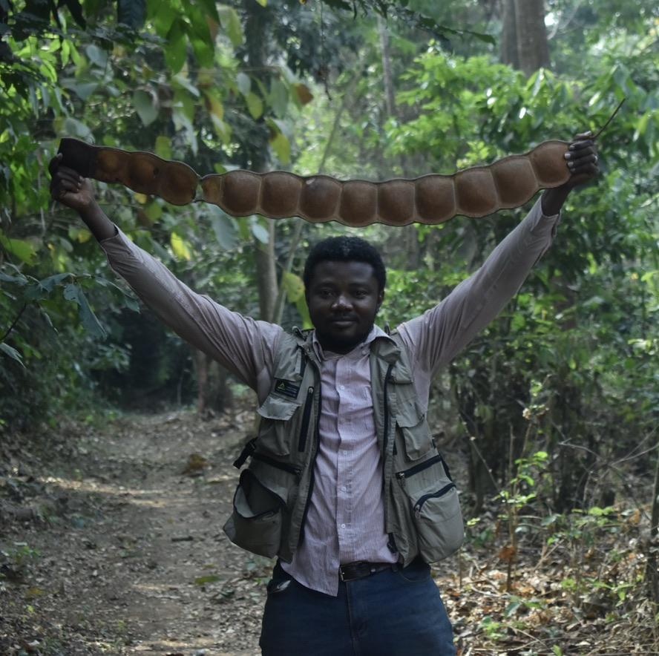
Thank you
Contact
Until 27th October 2023:
Faculty of Natural Sciences, Institute of Biology, FG Eco-Evolutionary Modelling (190m)
Email: bismark.ofosu-bamfo@uenr.edu.gh
X: @bofosubamfo1
Website: ofbamlab.wordpress.com

