Slide 2
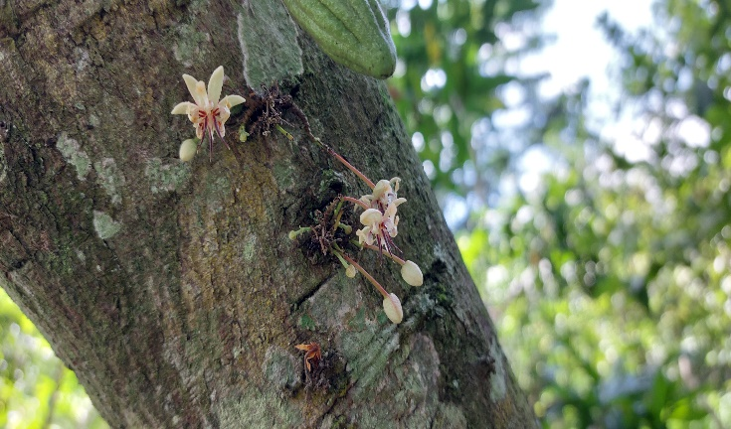
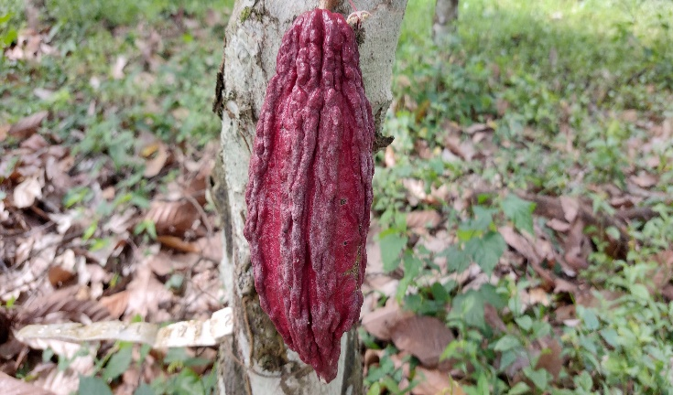
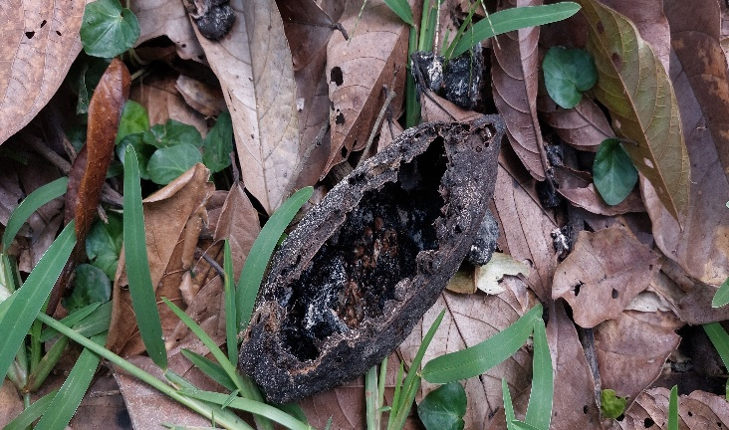
BioGARD Conference
The economic dependency of Ghana‘s cocoa sector on pollination services
Falk Krumbe, Camillus Wongnaa, Arndt Feuerbacher

Slide 3
Key points
Growing evidence of a global decline of pollinators (Cardoso et al. 2020)
Economic studies highlight the importance of pollinators (Gallai et al. 2009, Lippert et al. 2021)
Effects on the whole economy have been ignored
Focus: Cocoa pollinators in Ghana

Slide 4
Ghana‘s cocoa sector
Ghana is the second largest producer of cocoa (FAOSTAT 2019)
Contributes about 3% to GDP (Ghana Statistical Service 2015)
Provides income to more than 800.000 smallholder farmers (Hashmiu et al. 2022)

Slide 5
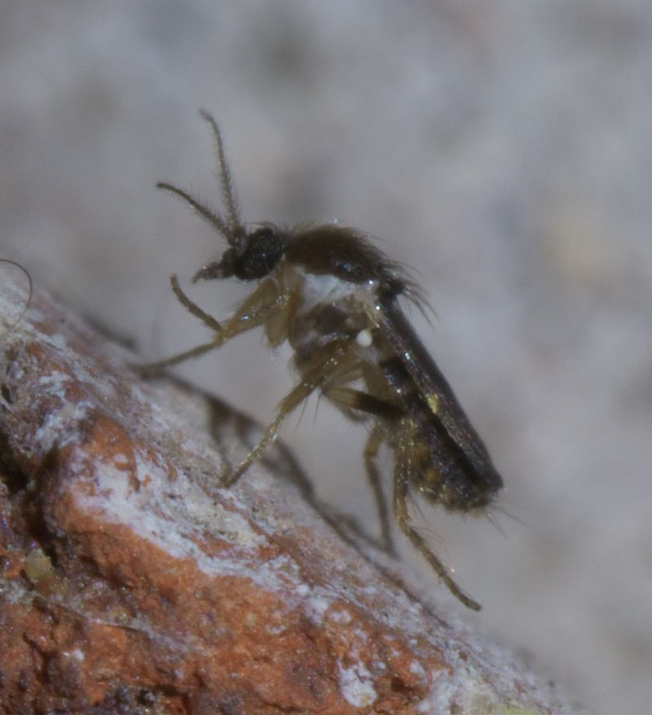
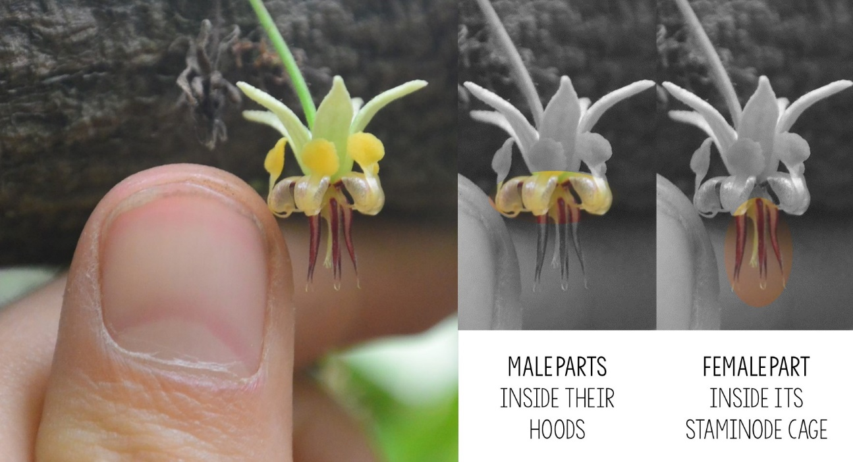
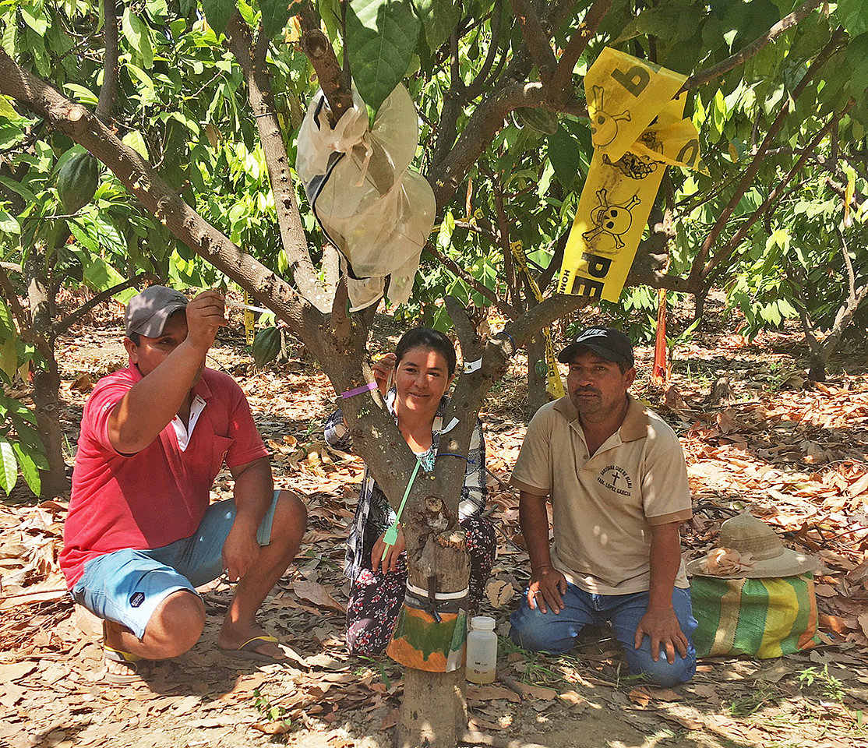
Pollinator identity
Cocoa depends on wild pollinators
Forcipomyia midges
Source: Justine Vansynghel / Universität Würzburg
CacaoPollination.com - Vrije Universiteit Brussel
5

Slide 6
Stylised Scenarios
Change in pollinator population (pollinated flowers)
Change in cocoa productivity
Polli 1
-11%
-10%
Groeneveld et al. (2010)
y=−0.83+0.34×log(x)
-30%
Polli 2
-37%
-50%
Polli 3
-72%

Slide 7
Model framework
Data
Social Accounting Matrix (2015)
(Ferreira et al. 2021)
Change in cocoa productivity
Supplementary Data
Stage 2
(McDonald and Thierfelder 2015)
Polli 1
-11%
Labour Force Report 2015 (GSS 2016)
Enhance National Landuse/Landcover (GFC 2020)
Polli 2
-37%
Polli 3
-72%
Cocoa production data
Ghana specific elasticities

Slide 8
Model features
Househould accounts: Regions, Expenditure, Settlement
Agricultural activities: Regions
Seasonal labor split (Pre & post harvest)
Small country assumption lifted for cocoa

Slide 9
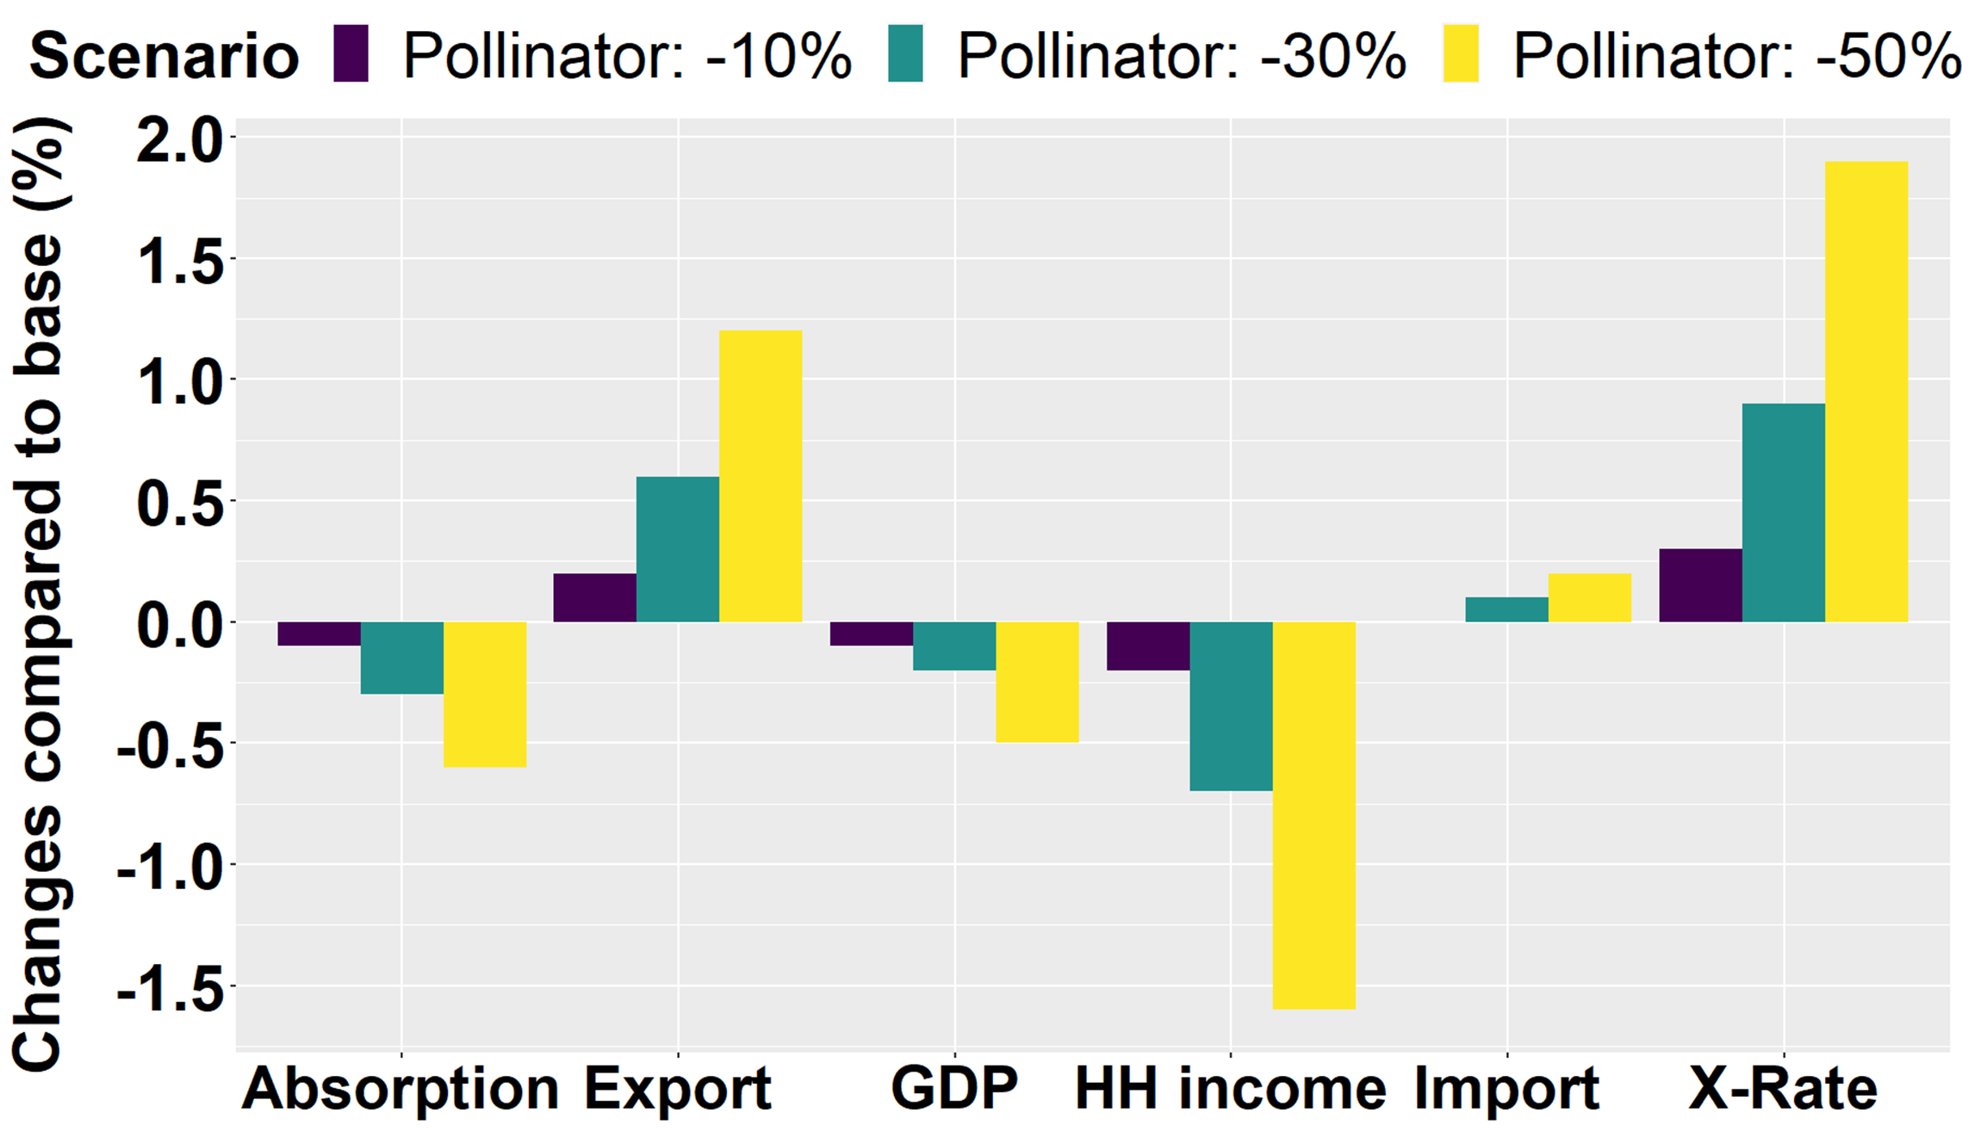
Results - Macro level changes

Slide 10
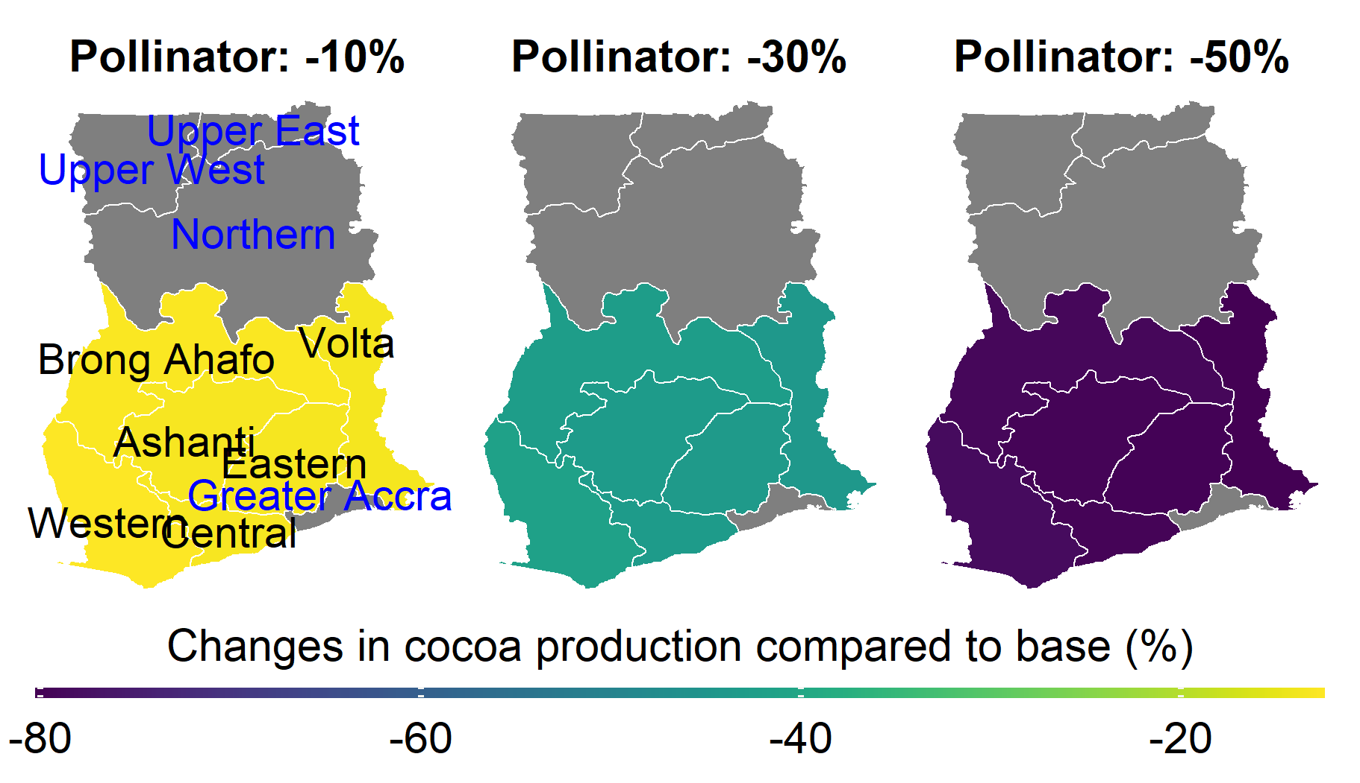
Results – Cocoa production
10

Slide 11
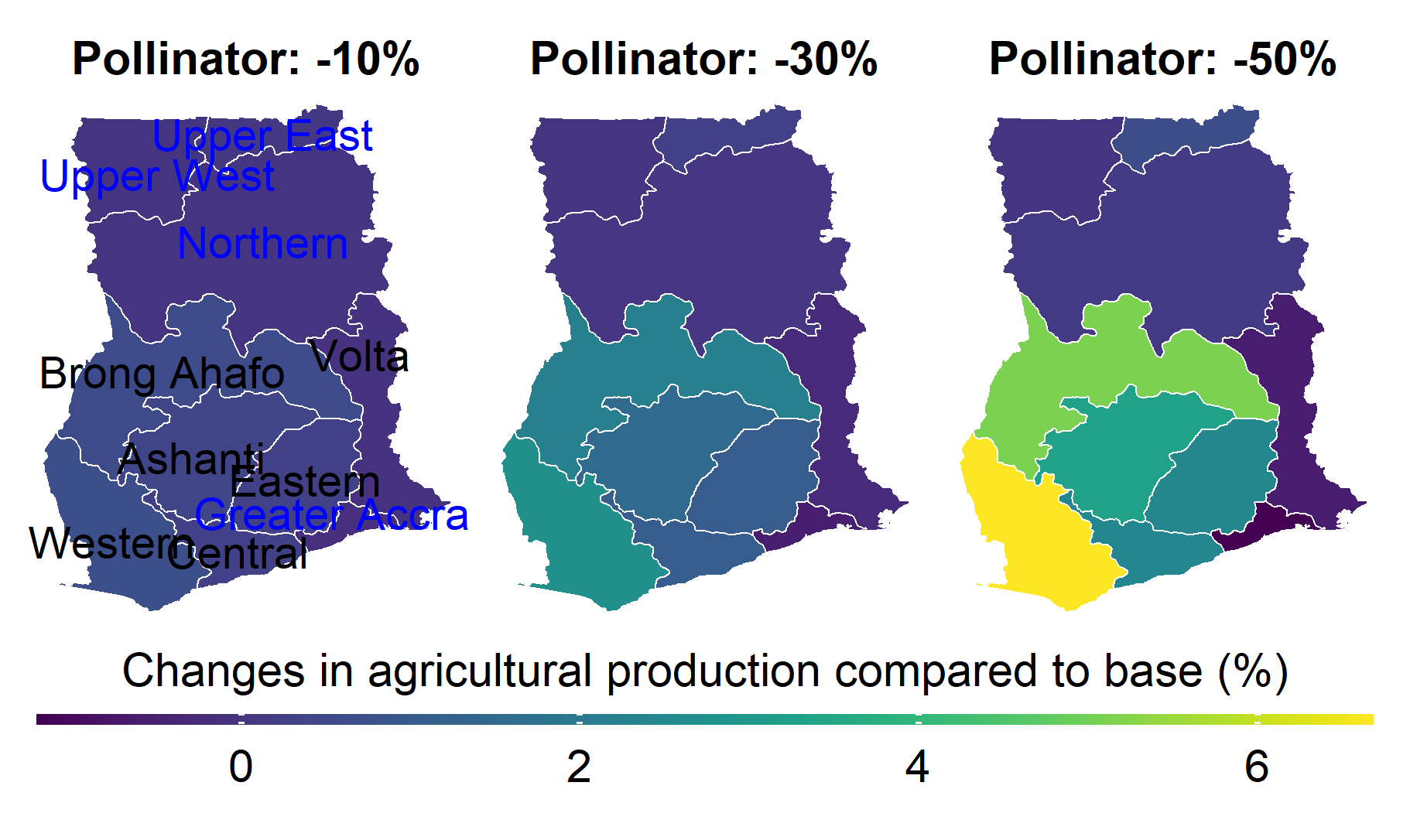
Results – Agric. production
11

Slide 12
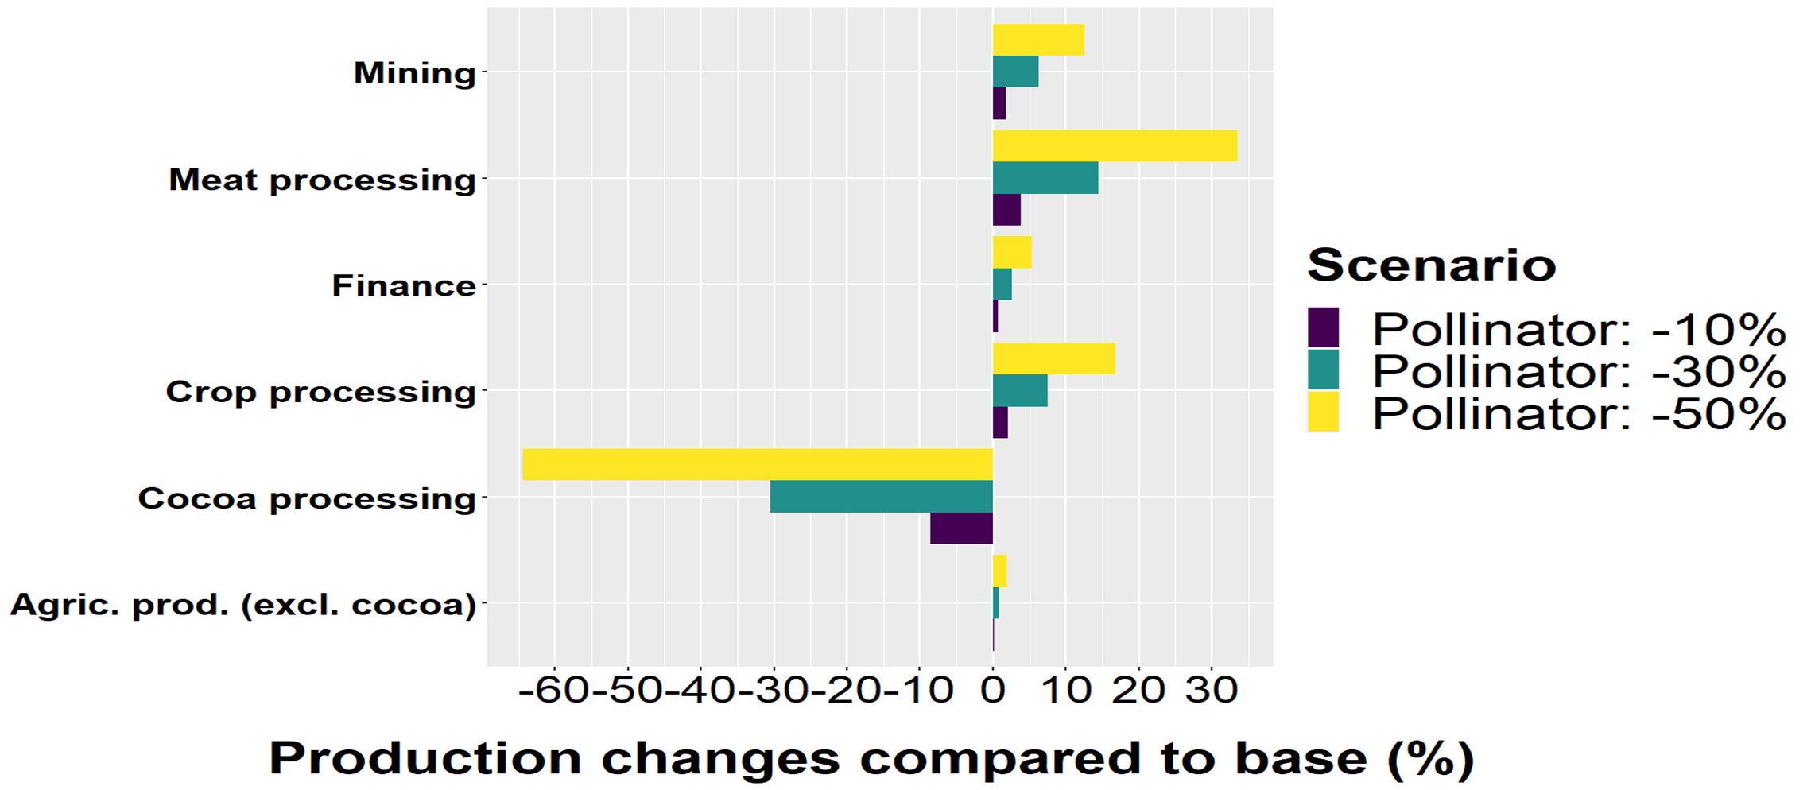
Results - Major industry changes

Slide 13
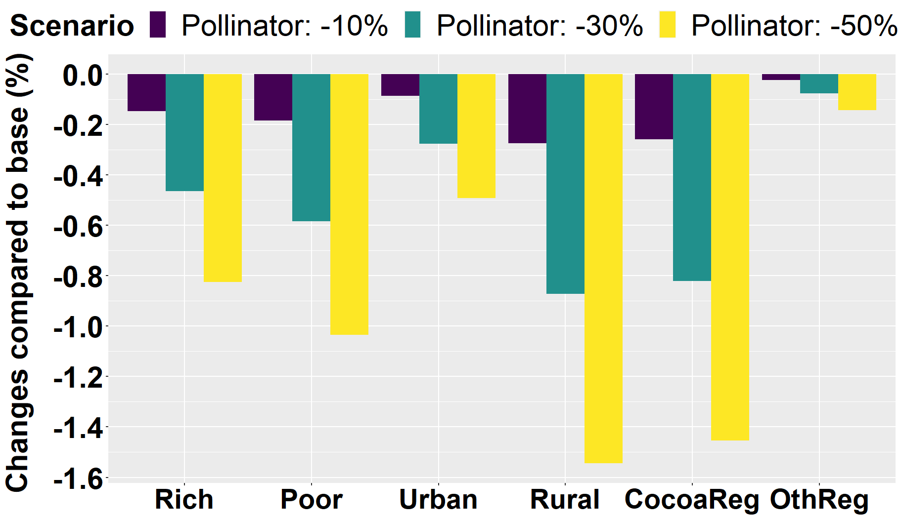
Results - Income changes

Slide 14
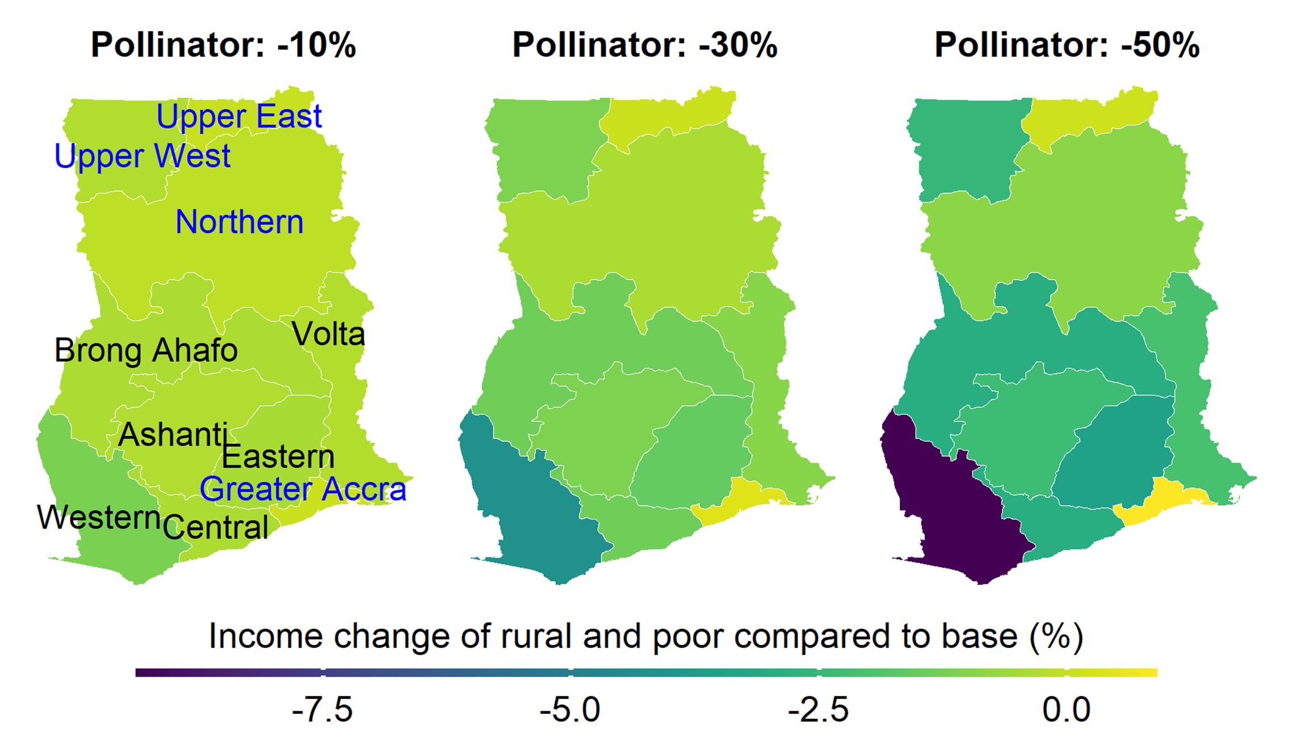
Results - Income of rural &poor
14

Slide 15
Discussion
Macroeconomic effects minor
Rural and poor depend the most on adequate pollination services
Adequate pollination services (could) prevent expansion of the mining sector

Slide 16
Conclusion
Changing ecosystem services affect the whole economy
Winners and losers

Slide 17
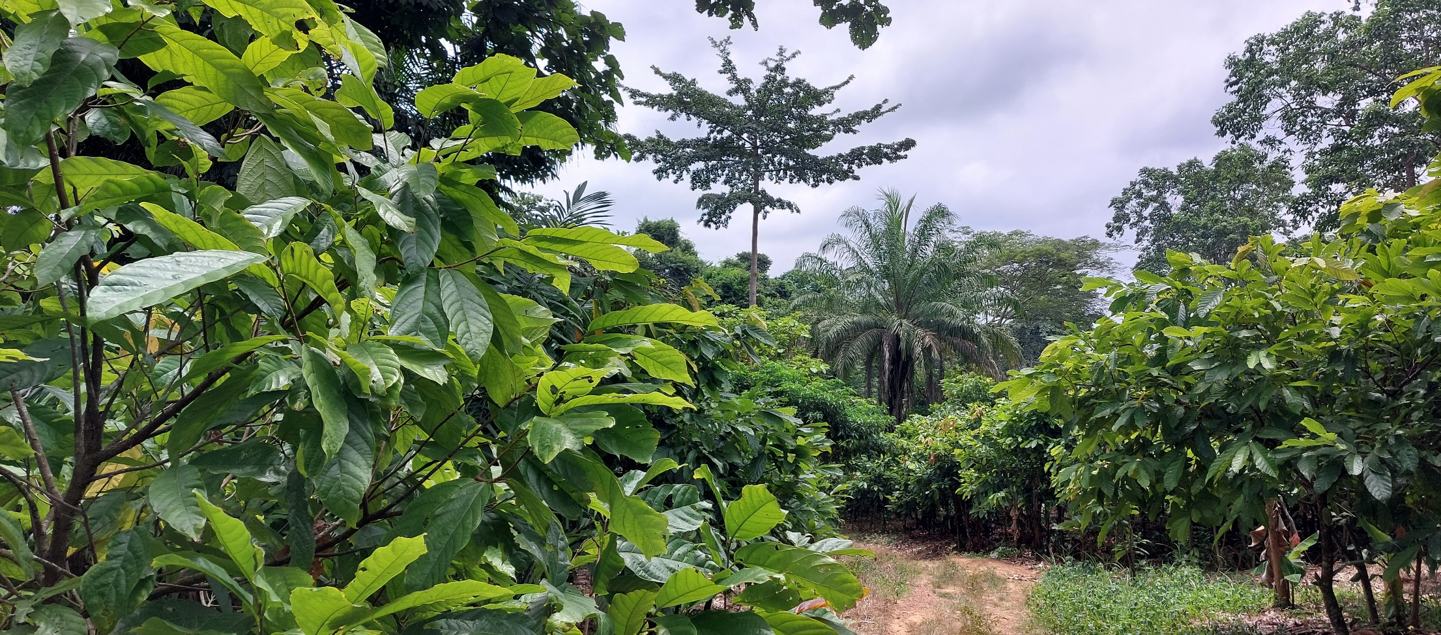
Thank you!
Questions?
Questions?

Slide 18
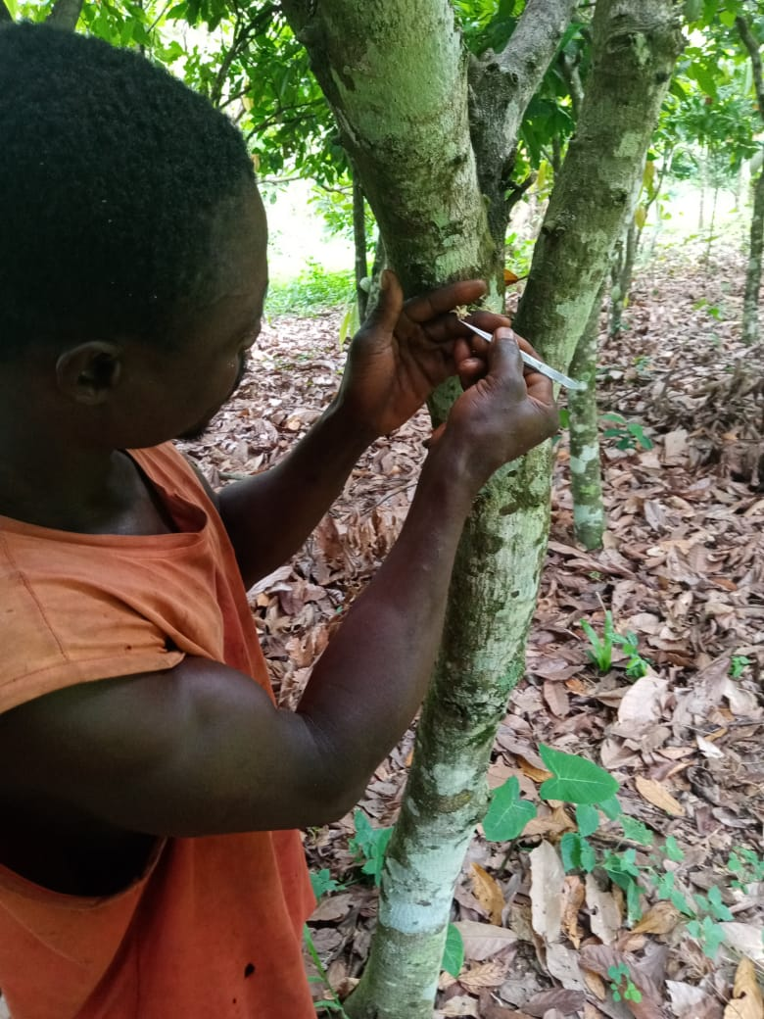
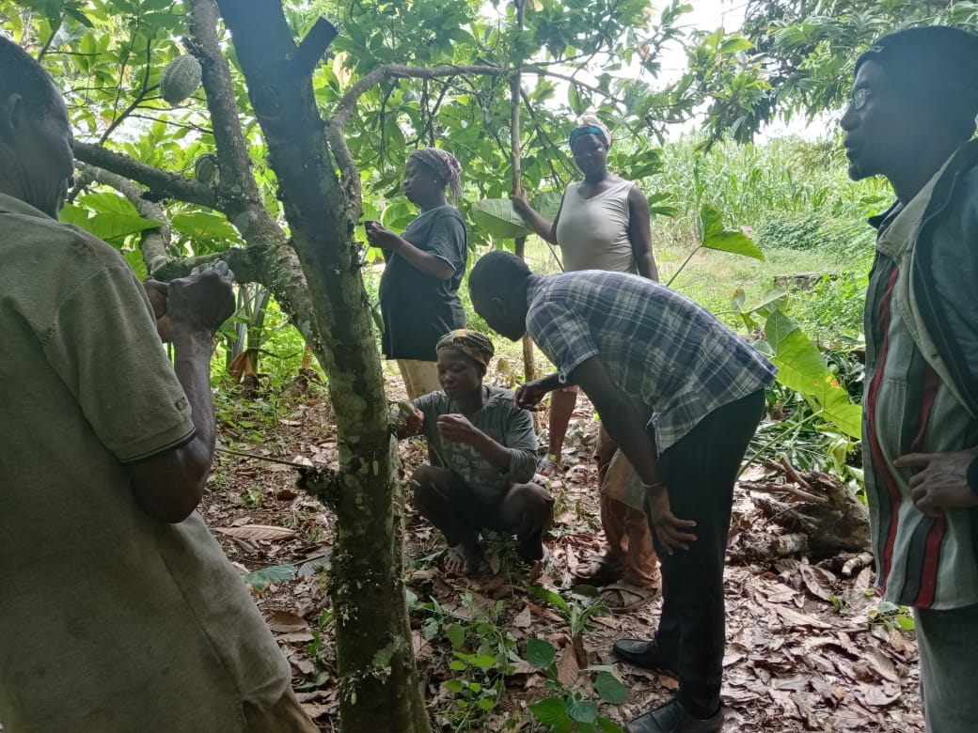
Discussion 2
Cocoa pollination is currently highly topical in Ghana (Wongnaa et al. 2021)
Knowledge of pollinators is limited (Umeh et al. 2022)
Kindly provided by Simon Asomontsi

Slide 19
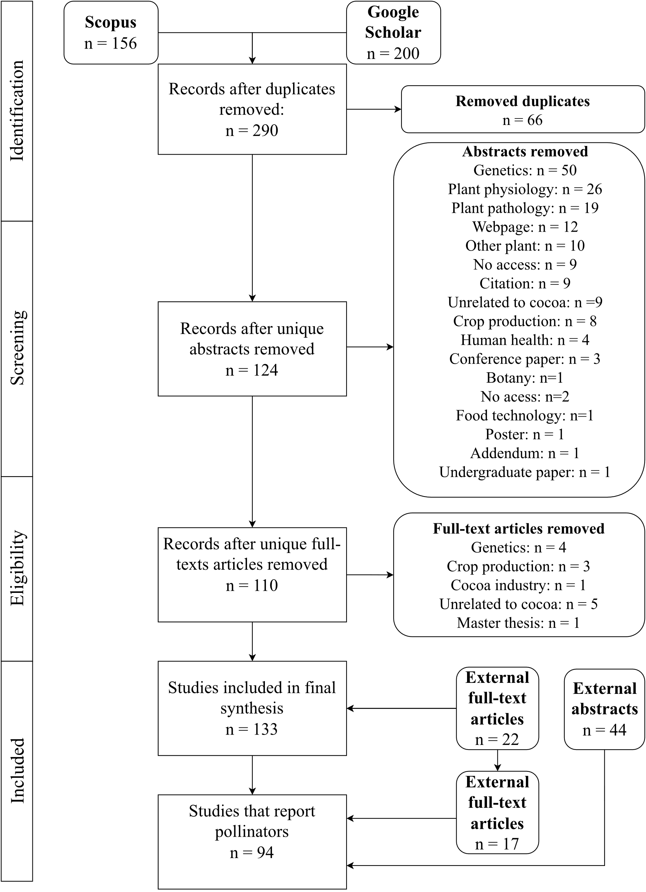
Study framework
Systematic literature review
Scenario design
CGE model
Discussion
Ghana SAM
Stage 2
Macro changes
Agricultural changes
Income changes
Policy implications
?

Slide 20
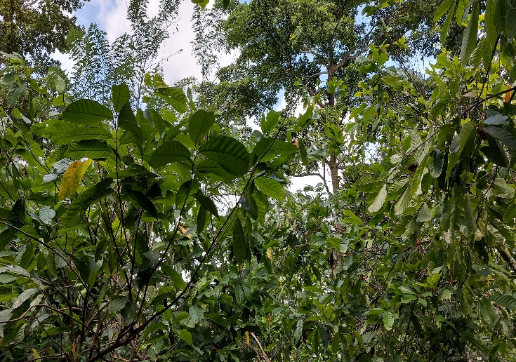
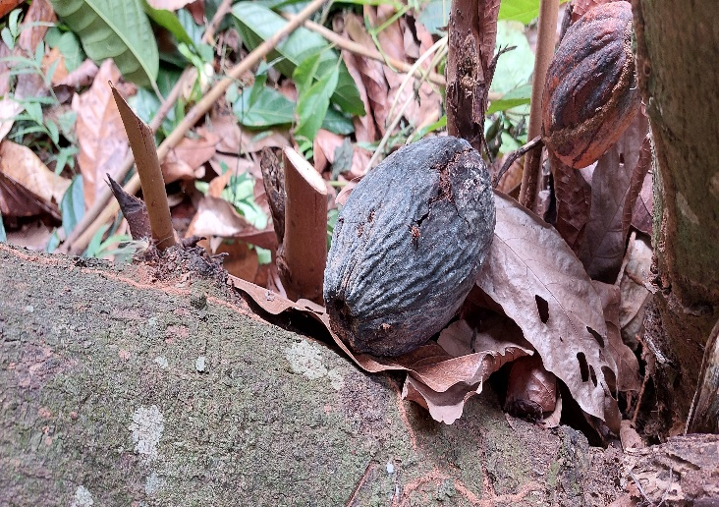
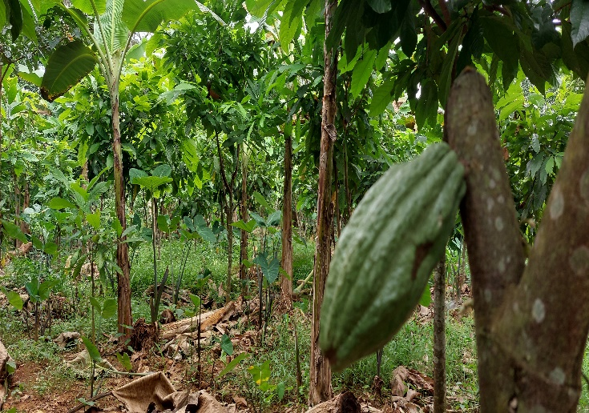
Pollinator dynamics
Rainfall pattern (Arnold et al. 2018)
Pesticide use (Kwapong & Frimpong 2013)
Provision of habitats (Frimpong et al. 2011)
What are the main drivers of cocoa pollinator populations?
20

Slide 21
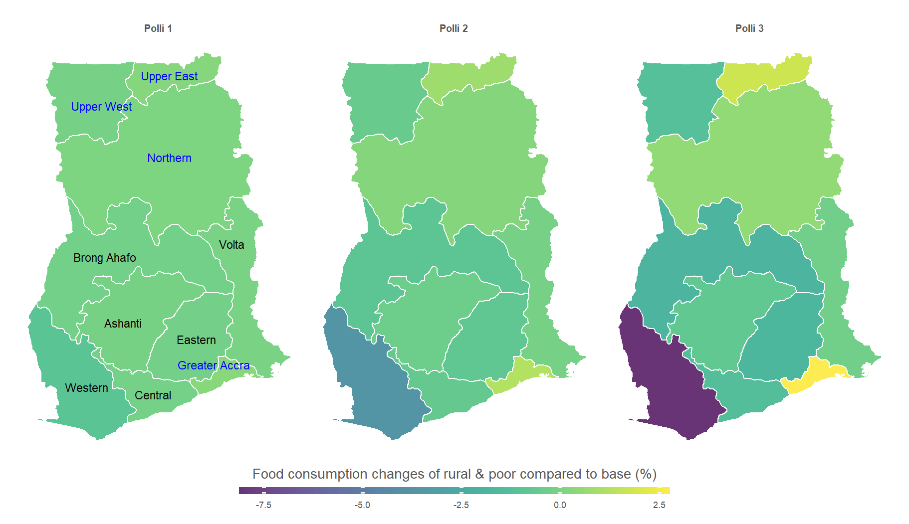
Results – Food consumption
21

Slide 22
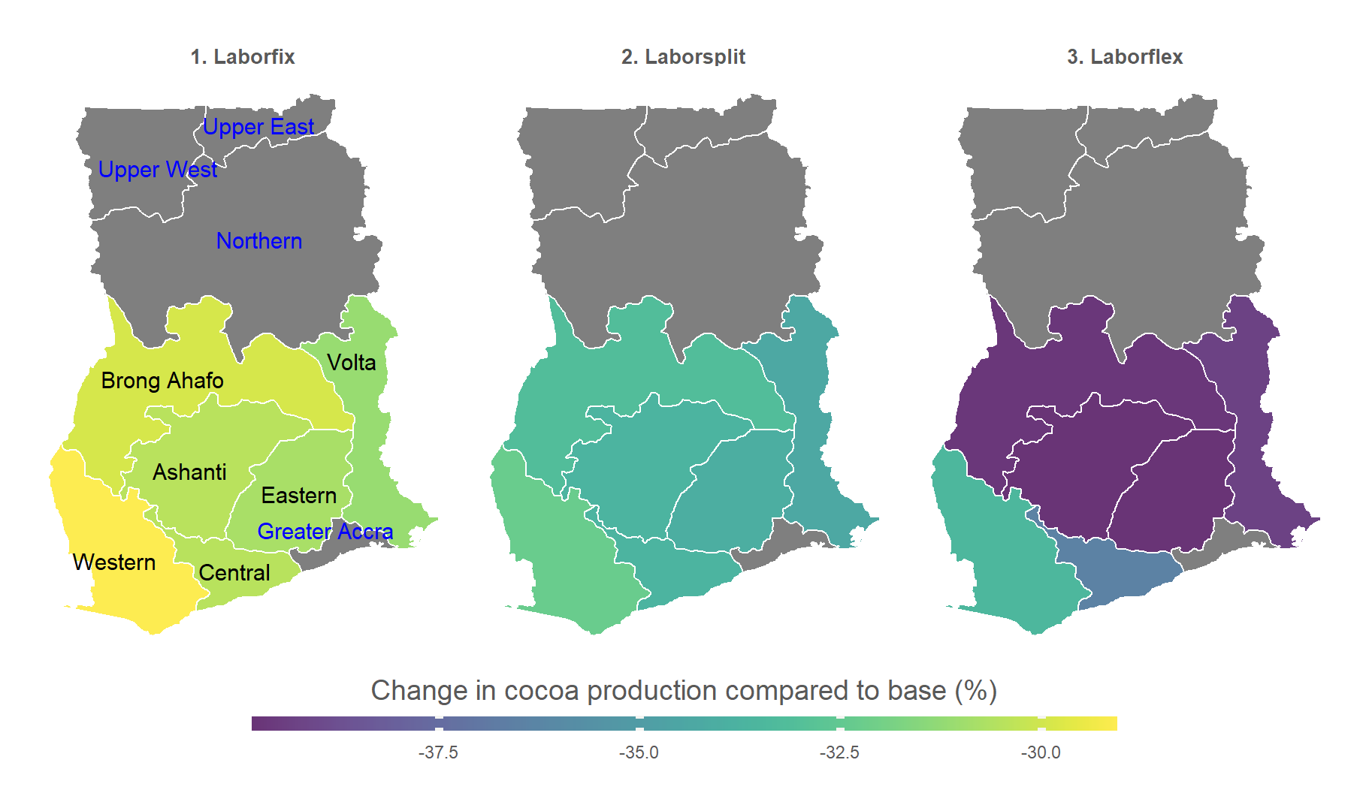
Model - Seasonal labor split

Slide 23
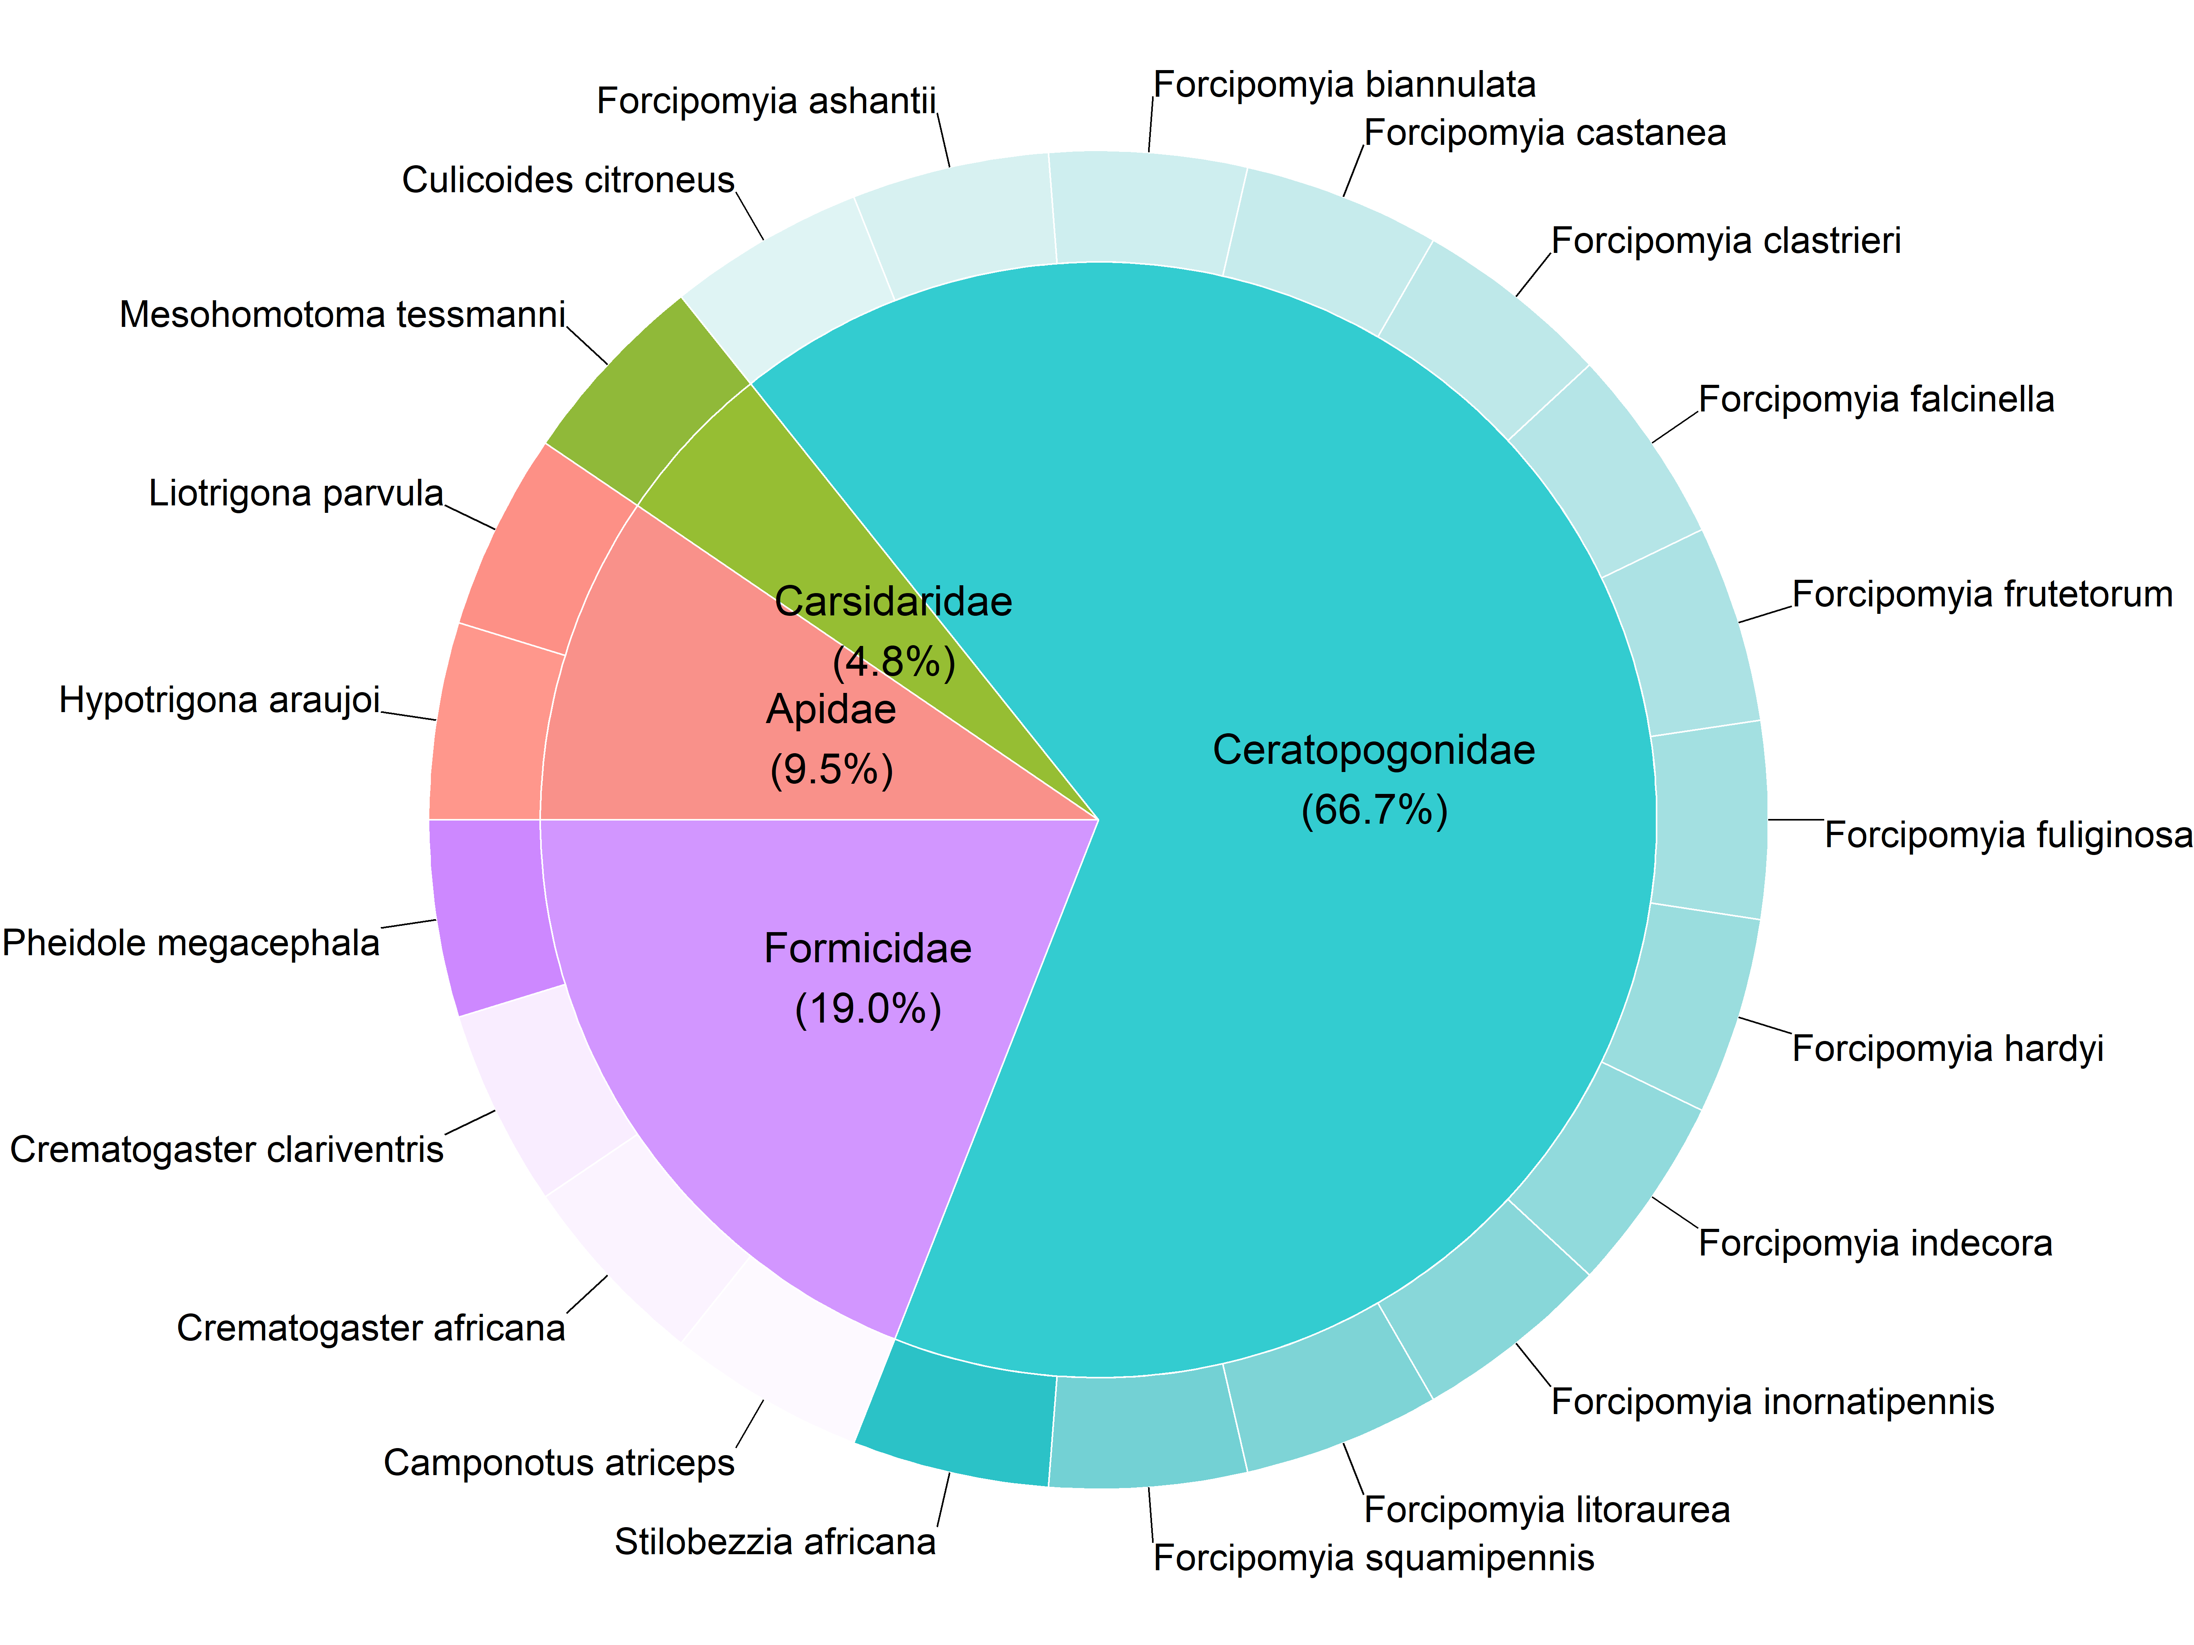
Pollinator identity II
Who are the main cocoa pollinators (flower visitors) in Ghana?

Slide 24
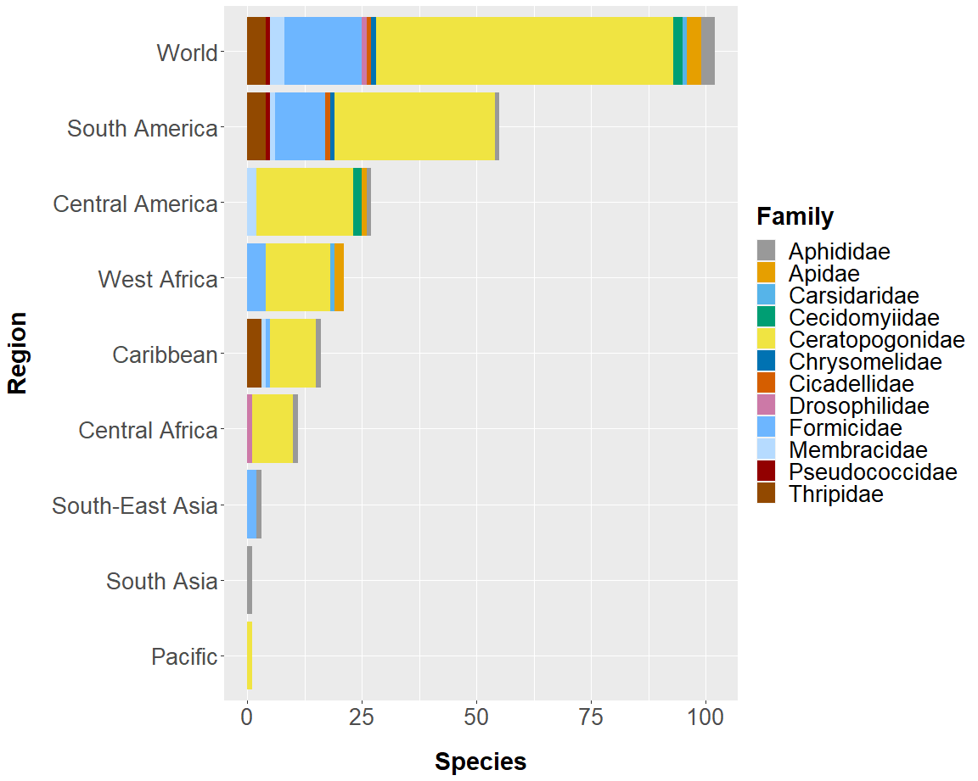
Pollinator identity
Who are the main cocoa pollinators?

Slide 25
Ghana SAM Accounts
Commodities | Agricultural (19), Natural Resources (4), Food (8), Industrial (1), Utility (1), Construction (1), Service (9)
Activities | Household as producer of agricultural commodities (10)¹, Household as producer of cocoa (6)², Natural Resources (3), Food (8), Industrial (1), Utility (1), Construction (1), Service (9)
Factors | Labor | Non-Agricultural, Agricultural |  | Agriculture: Preharvest (12)¹, Postharvest(20)¹
 | Land | Agricultural (10)¹, Cocoa (6)²
 | Capital | Crops (1), Livestock (1), Mining (1), Other (1)
Margins | Trade and transport margin (1), Export margin (1)
Institutions | Households | Rural, Urban | 1st expenditure quintile (20)¹, 2nd – 5th expenditure quintile (20)¹
 | Enterprises (1), Government (1), Rest of the world (1)
Taxes | Import (1), Export (1), Sales (1), Direct (1)
Capital | Changes in stocks (1), Savings-Investments (1)
Table 2 – Adapted Ghana SAM accounts. Source: Based on European Commission et al. (2021).
Note: Numbers in parentheses describe the quantity of accounts (e.g. there are 19 agricultural commodity accounts).
¹ Disaggregated for the 10 regions of Ghana. ² Disaggregated for the 6 cocoa growing regions of Ghana.

Slide 26
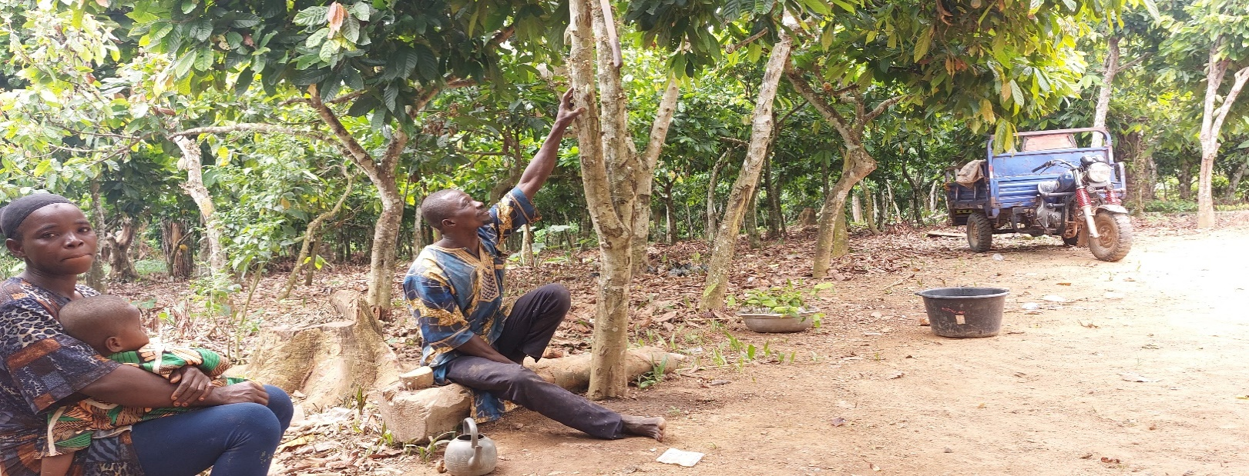
Ghana‘s cocoa sector
Ghana is the second largest producer of cocoa (FAOSTAT 2019)
Contributes about 3% to GDP (Ghana Statistical Service 2015)
Provides income to more than 800.000 smallholder farmers (Hashmiu et al. 2022)

Slide 27
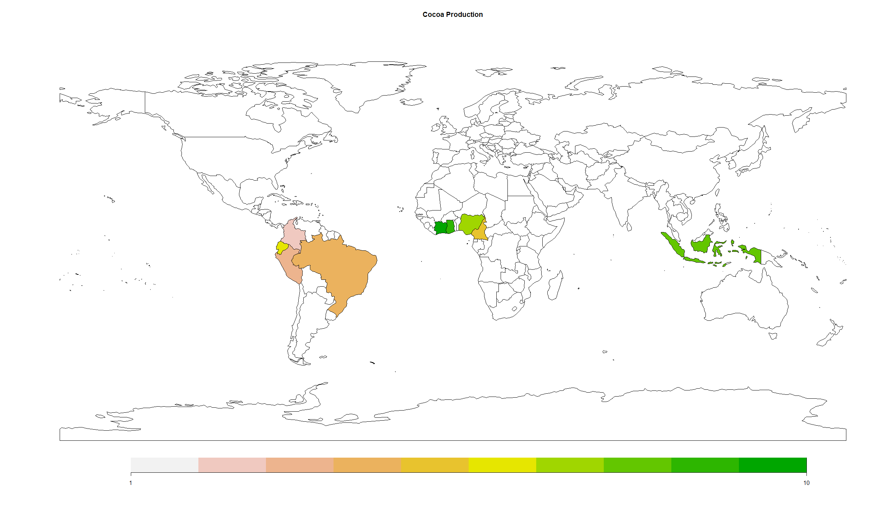
Global cocoa economy (2019)
FAOSTAT (2019)
76.113
102.154
141.775
259.451
280.000
283.680
348.448
774.195
811.700
2.235.043
[t]

Slide 28
Publication bibliography I
Arnold, S.E.J.; Bridgemohan, P.; Perry, G. B.; Spinelli, G. R.; Pierre, B.; Murray, F. et al. (2018): The significance of climate in the pollinator dynamics of a tropical agroforestry system. In Agriculture, Ecosystems & Environment 254, pp. 1–9. DOI: 10.1016/j.agee.2017.11.013.
Boysen, Ole; Ferrari, Emanuele; Nechifor, Victor; Tillie, Pascal (2023): Earn a living? What the Côte d’Ivoire–Ghana cocoa living income differential might deliver on its promise. In Food Policy 114, p. 102389. DOI: 10.1016/j.foodpol.2022.102389.
Cardoso, Pedro; Barton, Philip S.; Birkhofer, Klaus; Chichorro, Filipe; Deacon, Charl; Fartmann, Thomas et al. (2020): Scientists' warning to humanity on insect extinctions. In Biological Conservation 242, p. 108426. DOI: 10.1016/j.biocon.2020.108426.
European Commission; Joint Research Centre; Ferreira, V.; Almazán-Gómez, M.; Nechifor, V.; Ferrari, E. (2021): Social accounting matrix for Ghana 2015: Publications Office.
FAOSTAT (2019). Food Agriculture and Organization (FAOSTAT). Retrieved from http://www.fao.org/faostat/en/#data/QC
Frimpong, E. A.; Gemmill-Herren, B.; Gordon, I.; Kwapong, P. K. (2011): Dynamics of insect pollinators as influenced by cocoa production systems in Ghana. In J Poll Ecol, pp. 74–80. DOI: 10.26786/1920-7603(2011)12.
Ghana Statistical Service (2015): Annual Gross Domestic Product. Available online at https://www.statsghana.gov.gh/gssmain/fileUpload/National%20Accounts/2015_Annual_GDP_September_2015_Edition.pdf, checked on 10/16/2022.
Ghana Forestry Commission (2020): Enhanced Land Use and Land Cover Data 2019. With assistance of Kwame Nkrumah University of Science and Technology, Ecometrica, University of Leicester.
Ghana Statistical Service (2016): Labour Force Survey 2015.

Slide 29
Publication bibliography II
Groeneveld, Janna H.; Tscharntke, Teja; Moser, Gerald; Clough, Yann (2010): Experimental evidence for stronger cacao yield limitation by pollination than by plant resources. In Perspectives in Plant Ecology, Evolution and Systematics 12 (3), pp. 183–191. DOI: 10.1016/j.ppees.2010.02.005.
Hashmiu, Ishmael; Agbenyega, Olivia; Dawoe, Evans (2022): Cash crops and food security: evidence from smallholder cocoa and cashew farmers in Ghana. In Agric & Food Secur 11 (1). DOI: 10.1186/s40066-022-00355-8.
Klein, Alexandra-Maria; Vaissière, Bernard E.; Cane, James H.; Steffan-Dewenter, Ingolf; Cunningham, Saul A.; Kremen, Claire; Tscharntke, Teja (2007): Importance of pollinators in changing landscapes for world crops. In Proceedings. Biological sciences 274 (1608), pp. 303–313. DOI: 10.1098/rspb.2006.3721.
Kwapong, P. K.; Frimpong, K. (2013): Pollinator management and insecticide usage within cocoa agroecosystem in Ghana. In Research and Reviews in Biosciences (7), pp. 491–496.
McDonald, S.; Thierfelder, K. A. (2015): A Static Applied General Equilibrium Model: Technical Documentation: STAGE Version 2: January 2015. Model Documentation 2015. A. Available online at http://cgemod.org.uk/STAGE%20CGE%20Model%20v2.pdf, checked on 10/17/2022.
Potts, Simon G.; Biesmeijer, Jacobus C.; Kremen, Claire; Neumann, Peter; Schweiger, Oliver; Kunin, William E. (2010): Global pollinator declines: trends, impacts and drivers. In Trends in ecology & evolution 25 (6), pp. 345–353. DOI: 10.1016/j.tree.2010.01.007.
Umeh, Blessing C.; Avicor, Silas W.; Dankyi, Enock; Kyerematen, Rosina (2022): Farmers’ knowledge and practices on pollination and insecticide use in cocoa farming in Ghana. In International Journal of Agricultural Sustainability, pp. 1–13. DOI: 10.1080/14735903.2022.2106656.

Slide 30
Publication bibliography III
Wongnaa, Camillus Abawiera; Apike, Isaac Akurugu; Babu, Suresh; Awunyo-Vitor, Dadson; Kyei, Afrane Baffour (2021): The impact of adoption of artificial pollination technology in cocoa production: Evidence from Ghana. In Journal of Agriculture and Food Research 6, p. 100208. DOI: 10.1016/j.jafr.2021.100208.

Slide 31
Pollination yield curve
Yield curve inspired by Groeneveld et al. 2010

Slide 32
Results - Macro level changes
 | Changes compared to base (%)
GDP Components (Real Macro Totals) | Polli 1 | Polli 2 | Polli 3
GDP | -0.1 | -0.3 | -0.3
Absorption | -0.1 | -0.4 | -0.9
Average household-consumption | -0.1 | -0.3 | -0.7
Government consumption | -0.1 | -0.5 | -0.9
Investment | -0.2 | -0.5 | -0.9
Export | 0.2 | 0.8 | 2.2
Import | 0.0 | 0.2 | 0.4
Other macro-level indicators
Real exchange rate | 0.2 | 0.7 | 1.2
Purchaser price index | 0.1 | 0.3 | 0.7
Average household income | -0.1 | -0.2 | -0.4
Factor income
Labor | 0.1 | 0.4 | 0.6
Agricultural labor | -2.6 | -8.3 | -15.0
Agricultural land | -0.3 | -1.0 | -1.8
Cocoa land | -7.3 | -22.9 | -40.9
Capital - Agriculture | -0.7 | -2.2 | -4.0
Capital - mining | 0.7 | 2.0 | 3.5
Capital - other | 0.1 | 0.4 | 0.6

Slide 33
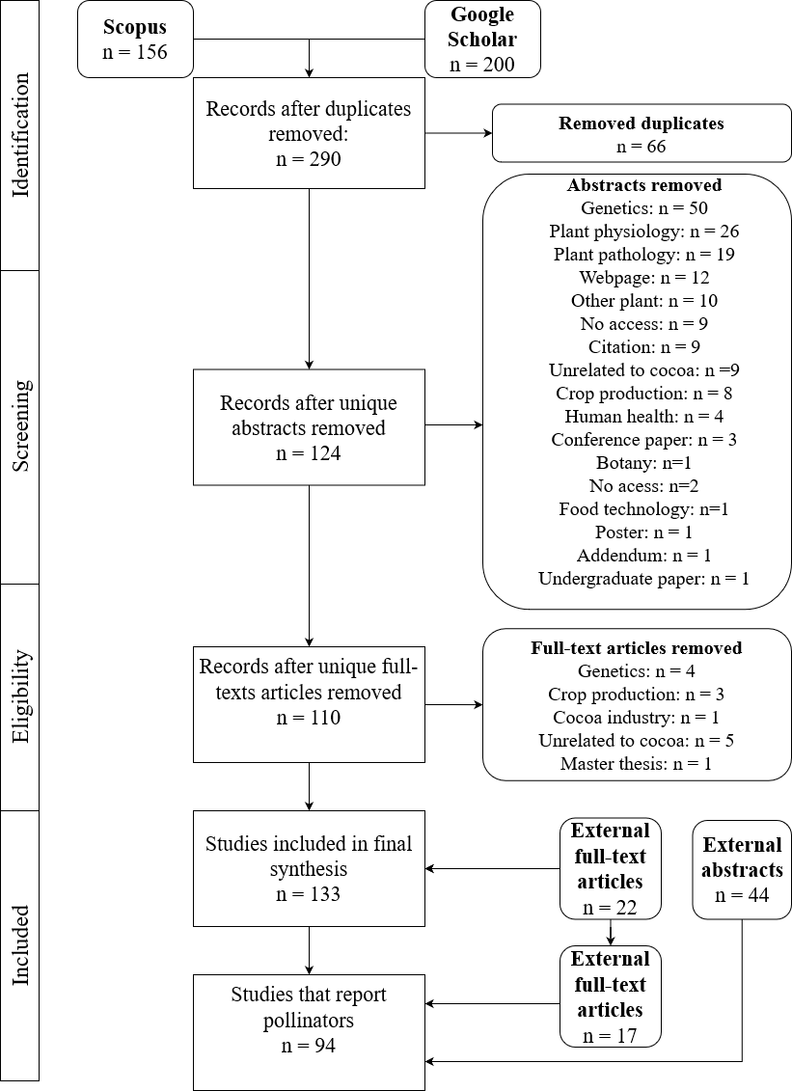
PRISMA – Enlarged picture

Slide 34
Interviewees
Name | Profession | Interview type
Thomas Aquinas Ayitey | Extension Agent of COCOBOD | Single interview
Dr. Richard Adu-Acheampong | Entomologist at the Cocoa Research Instiute | Single interview
Dr. Joseph Bandanaa | CSIR -PGRRI -Sustainable cocoa production and organic cocoa production | Focus Group Discussion
Dr. Bismark Asitoako | CSIR -PGRRI -Cocoa Agroforestry | Focus Group Discussion
Mr. Eric Opoku-Mensah | CSIR -PGRRI -Cocoa agronomy and physiology | Focus Group Discussion
Dr. Camillus Abawiera Wongnaa | Agricultural Economist at KNUST - researched the economics of manual pollination | Single interview
Emmanuel Dapaah Ankomah | BSc Agriculture (Economics), working at KNUST | Single interview
Dr. Kofi Frimpong-Anin | Cocoa pollination scientist | Single interview
Dr. Michael Kodwo Adjaloo | Cocoa pollination scientist | Single interview
Simon Asomontsi | District Extension Coordinator - COCOBOD | Single interview
Andrew Roland Obosu | Operations manager - Cocoa Abrabopa Association -Kumasi | Single interview
Agyei Emmanuel Amponsah | Trained manual pollinator of COCOBOD | Single Interview
Mr. William K. Dumenu | Research Scientist at the Forestry Research Institute of Ghana | Single Interview
External experts (outside of Ghana)
Dr. Manuel Toledo-Hernández | Ecologist - Cocoa pollination | Single interview
Dr. Wouter Vanhove | Agronomist - Research Experience on cocoa pollination in Cote D'Ivoire | Email correspondence

Slide 35
Interviewees - Farmers
Farmers
Identification | Age | Gender | Farm size (acre) | Area pollinated (acre) | Interview type | Knowledge of natural pollination
Bunsu Kwan | missing | male | 30.6 | 1 | Single interview | No
Bonfa 1 | 75 | male | 14 | 0 | Focus Group | No
Bonfa 2 | 53 | male | 40 | 0 | Focus Group | No
Bonfa 3 | 52 | male | 6 | 0 | Focus Group | No
Bonfa 4 | 28 | male | 12 | 0 | Focus Group | No
Bonfa 5 | 30 | male | 11 | 0 | Focus Group | No
Bonfa 6 | 32 | male | 8 | 1 | Single interview | Yes
Huni Valley 1 | 70 | Male | 15 | 3 | Single interview | Yes
Huni Valley 2 | 54 | Male | 18 | 5 | Single interview | Yes
Huni Valley 3 | 60 | Male | 9 | 4 | Single interview | Yes
Huni Valley 4 | 45 | Female | 10 | 4 | Single interview | Yes
Huni Valley 5 | 47 | Male | 20 | 9 | Single interview | Yes
Huni Valley 6 | 43 | Female | 6 | 2 | Single interview | Yes
Huni Valley 7 | 41 | Male | 16 | 6 | Single interview | Yes
Huni Valley 8 | 40 | Male | 55 | 15 | Single interview | Yes
Huni Valley 9 | 35 | Female | 4 | 1 | Single interview | No
Huni Valley 10 | 52 | Female | 12 | 2 | Single interview | No
Average | 47.3 |  | 16.9 | 3.1

Slide 36
Goods & services
Product Markets
Expenditure
Goods & services
Goods & services
Households
(e.g. Western region)
Government
Firms
(e.g. Cocoa Activity)
Taxes
Taxes
Profits/Factor income
Factor markets
(Land, Labor, Capital)
Factor inputs

Slide 37
Model assumptions
Markets are perfectly competitive
Consumers maximize utility (Stone Geary Utility Function)
Producers maximize profits (Leontief or CES technologies)
Prices adjust so that markets clear
Law of one price
Armington insight
Linear Expenditure System is assumed.
Land is immobile
No mobility between agricultural and non-agricultural labor
Small country assumption is relaxed for cocoa (commodity that does not face perfectly elastic demand on the world market)
Shock is implemented at the CES aggregation function for level 2 of production nest// Quantity of aggregate value added

Slide 38
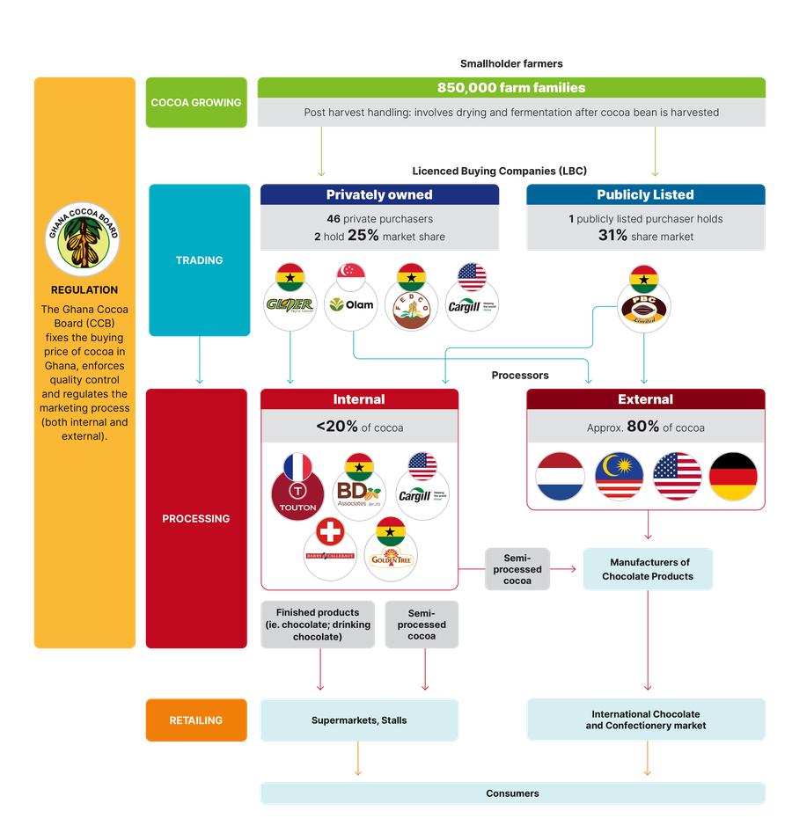
©2022 Asoko Insight

