Slide 1
Minor livestock species for food production in Africa, zoonotic diseases, and One Health
Maria Oguche (Co-authors:Thomas Potthast, Marcus Giese, Juliet Kariuki, Kerstin Schopp and Mizeck Chagunda)

Slide 2
Background
Role of wildlife in the origin and spread of zoonotic diseases
(Jones et al., 2013; Opara, 2012)
Ban on bush meat consumption
(Ibitoye et al., 2019; Molina-flores et al., 2020)
Increased minor livestock production at household level (Ibitoye et al., 2019; Amissah-Reynolds, 2020)
Zoonoses implications of minor livestock intensification??
(Molina-flores et al., 2020,)
Use of One Health approach for sustainable livestock intensification (Overgaauw et al., 2020; Peterson & Barnes, 2020)
Notes:
This chat will be put verbally in the context of mega trends like the livestock intensification.
Minor livestock as a coping strategy
Implications of intensification especially in Africa where:
Little attention and investment in disease prevention and vertinary medicine

Slide 3
Study Objectives
To analyze:
the relationship between zoonotic diseases and the consumption of minor livestock species;
the directions of infection and which species have been linked to the spread of zoonosis;
the recognition of the One Health approach regarding livestock intensification.

Slide 4
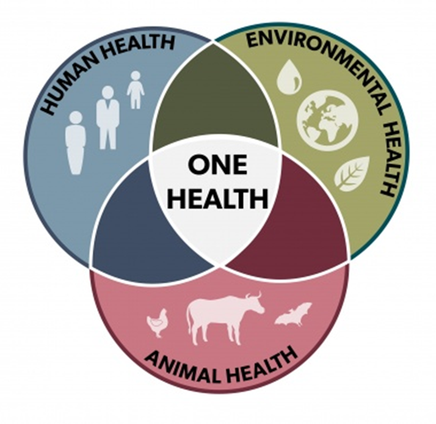
One Health Approach
Systems that support sustainable, equitable health and well-being across different systems
(https://www.ilri.org/one-health, 05.07.2023)
Notes:
Efficient in reducing human and animal health risks at the human-animal-plant-environment interface: zoonoses, AMR, food safety, disease emergence
Programs and approaches like this, improve the quality and quantity of animal sourced foods

Slide 5
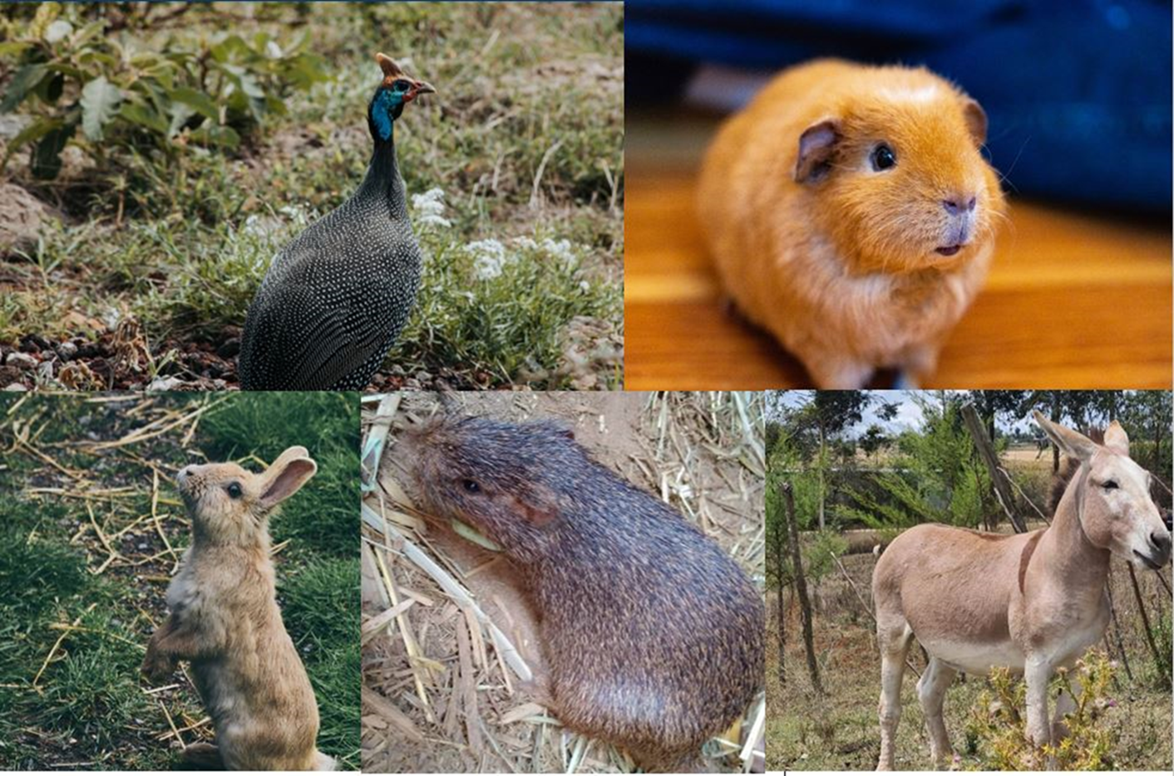
Overview of Selected Species
Guinea fowl
Photo credit: Unsplash
Guinea pig
Photo credit: Unsplash
Rabbit
Photo credit: Unsplash
Donkey
Photo credit: Juliet Kariuki
Grasscutter
Photo credit: Suleman Issifu
Overview of Selected Species
Notes:
Their selection is based on the representation of different animal sizes; geographic scope in Africa; diversified animal groups, e.g., poultry, rodents; level of domestication and availability of literature.
All are mammals and herbivores except guinea fowl which is in the animal class of aves and it is an Omnivore
In terms of diseases, these 5 are linked to the spread of zoonotic diseases.

Slide 6
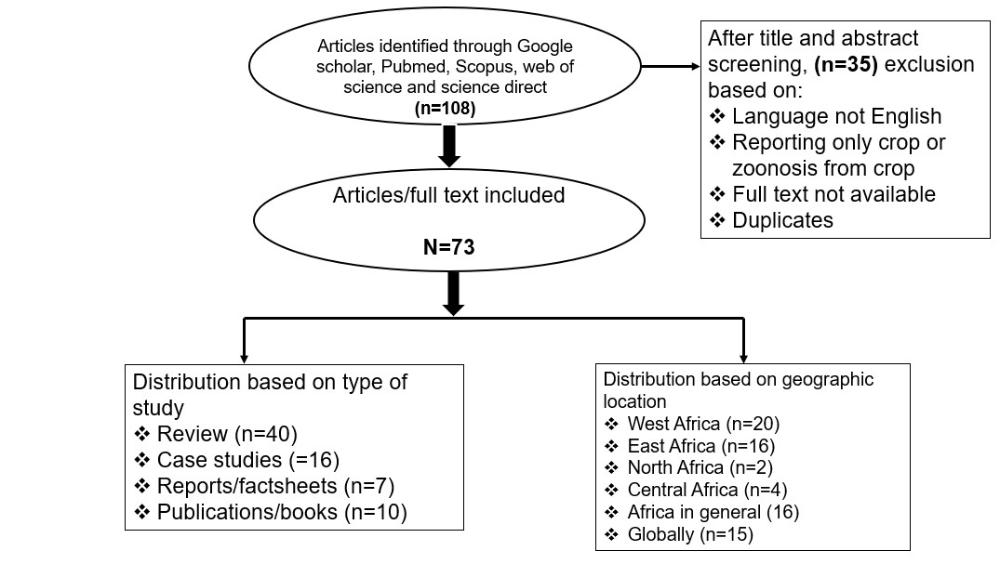
Methodology
Methodology: Literature distribution
Notes:
Preferred Reporting Items for Systematic Review and Meta-Analysis” (PRISMA) and Boolean search strings
Identification of search terms
Literature search
Inclusion criteria

Slide 7
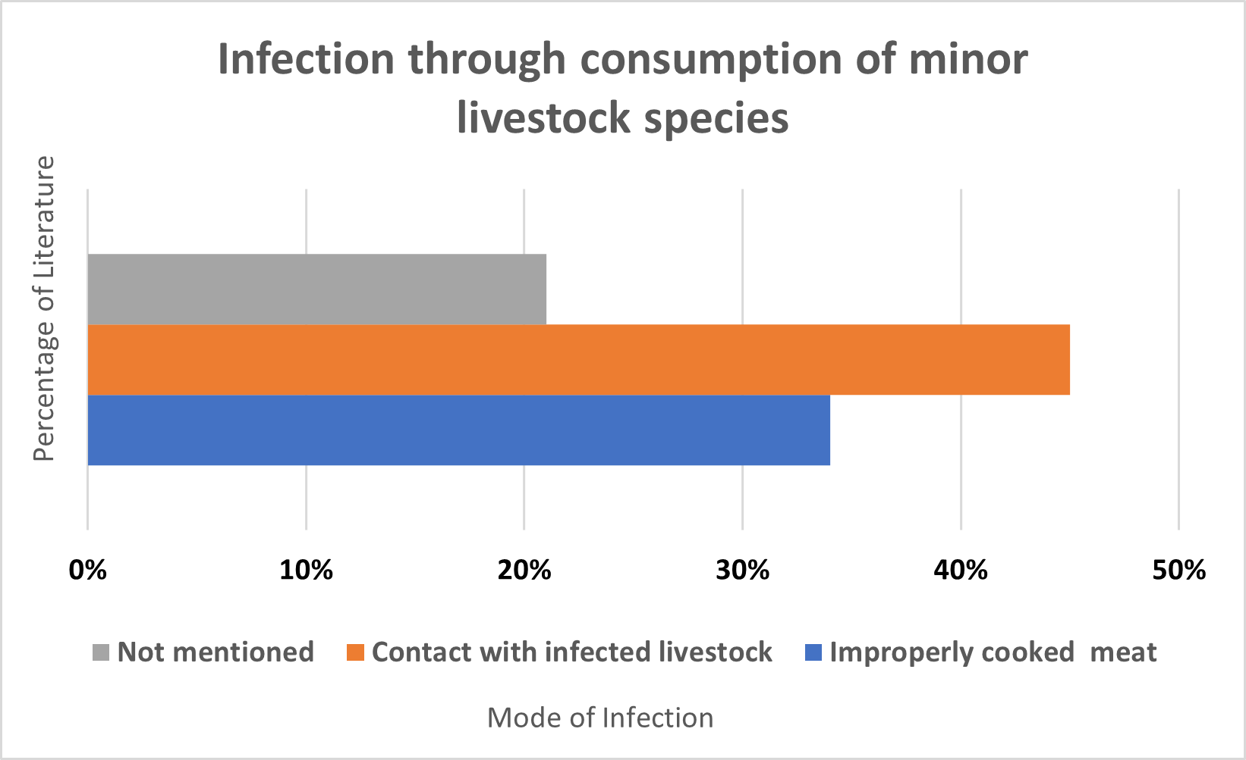
Results
Objective 1: Relationship between zoonotic diseases and the consumption of minor livestock species
21%
45%
34%
Results
Notes:
Direct or Indirect - Infection can occur from consuming undercooked/raw or contaminated meat or milk
as some of the disease microbes can still survive under heat conditions such as the hanging of meat over open fires and .some pathogens survive pasteurization treatments.
Also, the consumption of raw and unpasteurized milk from infected, neglected milk-producing livestock such as donkeys has been reported to enable the transmission of NZDs such as brucellosis, Toxoplasma gondii, fascioliasis.

Slide 8
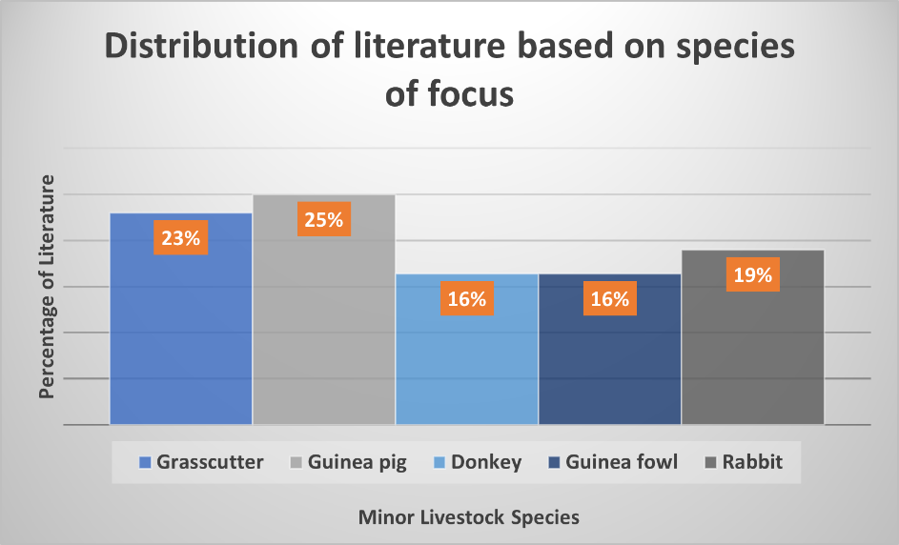
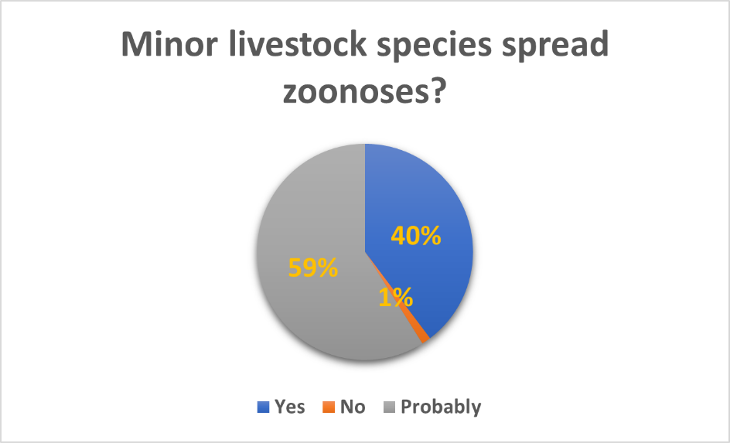
Objective 2a: Direction of infection
Objective 2b: Linkage of species to the spread of zoonosis
Results
Notes:
All the livestock species focused on in this study have been linked to existing or emerging zoonotic diseases. Guinea pigs had the highest number of articles (25%) linking them to zoonotic diseases
This assertion is particularly for NLS considered wild species, such as grasscutters and guinea fowl
However, to better understand their disease spillover, studies have identified that it is important to know if the species with the disease is a natural or incidental host of the pathogen.

Slide 9
Neglected Tropical Zoonotic Diseases

Slide 10
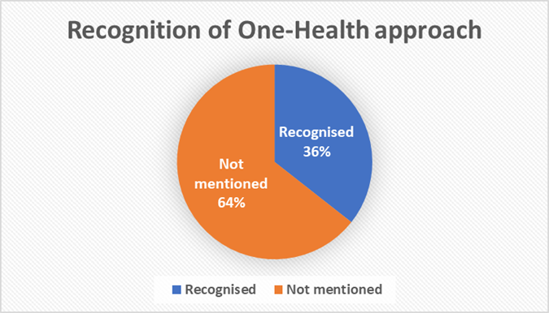
Objective 3: Recognition of the One Health approach for sustainable livestock intensification
Results
Notes:
64 % did not mention or recommend using the One Health approach to reduce the incidence of zoonoses. In comparison, 36% have recognized and highly recommended using the One Health holistic approach in designing and promoting livestock production, actions and strategies to keep people healthy while achieving efficient production.

Slide 11
Conclusions
Considering the immense nutritional potential of minor livestock species, if:
farmers’ knowledge on minor livestock species,
zoonosis,
animal welfare,
food ethics, and
environment
is not taken into consideration,
consumption,
production, and
Intensification
is less likely to have a sustainable impact in the face of increasing vulnerability to zoonoses.
Notes:
These categories of livestock are often not infected by the diseases that are classified by the WHO as NZD but are often hosts to other zoonotic diseases e,g Escherichia coli , toxoplasmosis, fascioliasis and gastrointestinal Helminthes that are not on the WHO list of NZD
More policy inclusion will translate to more data available on these livestock and their diseases in databases
Other species previously ignored by mainstream science such as Brush-tailed porcupines, Fruit bat-bushmeat have witnessed increased hunting/production and increasing production trends of such species has brought about zoonotic outbreaks such as the case of the 2013-2016 west African Ebola outbreak attributed to the Fruit bat (which was a reservoir specie of the Ebola virus)
To achieve effective management and control of existing, emerging and re-emerging zoonotic diseases, the One Health approach is recognized as well as recommended as the most prominent and efficient approach for a better survey, diagnosis and control

Slide 12
Further gaps identified
These categories of livestock are often not infected by the diseases that are classified by the WHO as NZD but are often hosts to other zoonotic diseases
Policy exclusion of minor livestock species could be possible reasons for lack of data on these livestock and their diseases in databases
Neglect of other species such as Brush-tailed porcupines, Fruit bat-bushmeat by mainstream science which are witnessing increased hunting/production
Notes:
e,g Escherichia coli , toxoplasmosis, fascioliasis and gastrointestinal Helminthes that are not on the WHO list of NZD
More policy inclusion will translate to more data available on these livestock and their diseases in databases
such species has brought about zoonotic outbreaks such as the case of the 2013-2016 west African Ebola outbreak attributed to the Fruit bat (which was a reservoir specie of the Ebola virus)
To achieve effective management and control of existing, emerging and re-emerging zoonotic diseases, the One Health approach is recognized as well as recommended as the most prominent and efficient approach for a better survey, diagnosis and control

Slide 13
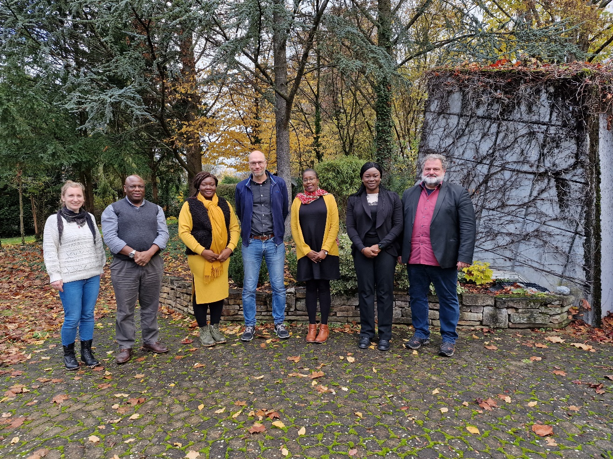
Thank you for your attention

Slide 14
References
Assan, N. (2013). Original article Promoting micro livestock farming to enhance animal product supply in sub saharan Africa. Scientific Journal of Biological Sciences (2013), 2(12), 232–243. https://doi.org/10.14196/sjbs.v2i12.1063
Chrispinus Mutsami, John Mburu, M. W. and S. O. (2019). The rabbit value chain in Kenya: A framework for food policy and research. Livestock Research for Rural Development 31 (5). Retrieved November 25, 2021 from https://lrrd.cipav.org.co/lrrd31/5/ckhal31071.html
Ibitoye, O., Kolejo, O., & Akinyemi, G. (2019). Burgeoning and Domestication of Grasscutter (Thryonomys swinderianus) in a Post-Ebola Era: A Reassessment of its Prospects and Challenges in Nigeria. World Scientific News, 130(May), 216–237. www.worldscientificnews.com
Jones, B. A., Grace, D., Kock, R., Alonso, S., Rushton, J., Said, M. Y., McKeever, D., Mutua, F., Young, J., McDermott, J., & Pfeiffer, D. U. (2013). Zoonosis emergence linked to agricultural intensification and environmental change. Proceedings of the National Academy of Sciences of the United States of America, 110(21), 8399–8404. https://doi.org/10.1073/PNAS.1208059110/-/DCSUPPLEMENTALAluko, A. F., & Salako, A. E. (2015). Grasscutter: a Review of the Habitat, Feeds and Feeding, Behaviour and Economic Importance. American Journal of Research Communication, 3(9), 96–107.
Mehrabi, Z., Gill, M., van Wijk, M., Herrero, M., & Ramankutty, N. (2020). Livestock policy for sustainable development. Nature Food, 1(3), 160–165. https://doi.org/10.1038/s43016-020-0042-9
Molina-flores, B., Manzano-baena, P., Coulibaly, M. D., & Bedane, B. (2020). The role of livestock in food security, poverty reduction and wealth creation in West Africa. In Food and Agriculture Organisation of the United Nations. https://doi.org/10.4060/ca8385en
Opara, M. (2012). Zoonotic Role of the Grasscutter. Zoonosis. https://doi.org/10.5772/37893
Swanepoel, F., Stroebel, A., & Moyo, S. (2010). The Role of Livestock in Developing Communities: Enhancing Multifunctionality. www.africansunmedia.co.za

