Slide 1
Agricultural sustainability with a focus on greenhouse gas emissions of cash crop vs. mixed crop-livestock rotation systems
Lisa Matthews ¹
Supervisor: Pieter. Swanepoel¹,
Co-supervisor: Johann Strauss¹²
Collaborators: Thorsten Reinsch³, Henk Smit³, Christof Kluß³, Arne Poyda³, Friedhelm Taube³
¹Stellenbosch University, Department of Agronomy
²Western Cape Department of Agriculture
³Christian-Albrechts University of Kiel, Germany
April 2023

Slide 2
Introduction
Responsible for a quarter of anthropogenic Greenhouse gases (GHGs)
To keep global warming well below 2°C, need both emission reductions and carbon dioxide removals
Critical to develop sustainable low-carbon agricultural systems, without negatively affecting food production
Data gaps for South Africa - difficult to evaluate or compare Global Warming Potentials (GWPs)
This study investigates using crop rotation as an ecological intensification strategy
Notes:
Agriculture is the predominant user of land globally and we have reshaped the natural landscape
A driver of major environmental crises: climate change; biodiversity loss; disrupted nitrogen (N) and phosphorus (P) nutrient flows; and land use change
23% of human caused GHG gases are attributed to the agricultural sector
To prevent global warming from reaching critical threshold’s, emission reduction’s are required from all industries, however agriculture is unique in that its value chain involve natural ecosystem processes and land management, allowing for the potential to remove carbon dioxide, particularly through soil carbon sequestration

Slide 3
Why crop rotation?
Accessible technology
Rotation can be implemented across range of contexts
Circular economy through resource reuse
Co-benefits such as improved resilience, system flexibility, decreasing climate and market risk
Modifies both the agroecosystem and the management
Legumes
Livestock incorporation
High diversity
Notes:
Economy of scale vs. economy of scope
Higher system diversity, ecosystem services
Circular economy – resource reuse

Slide 4
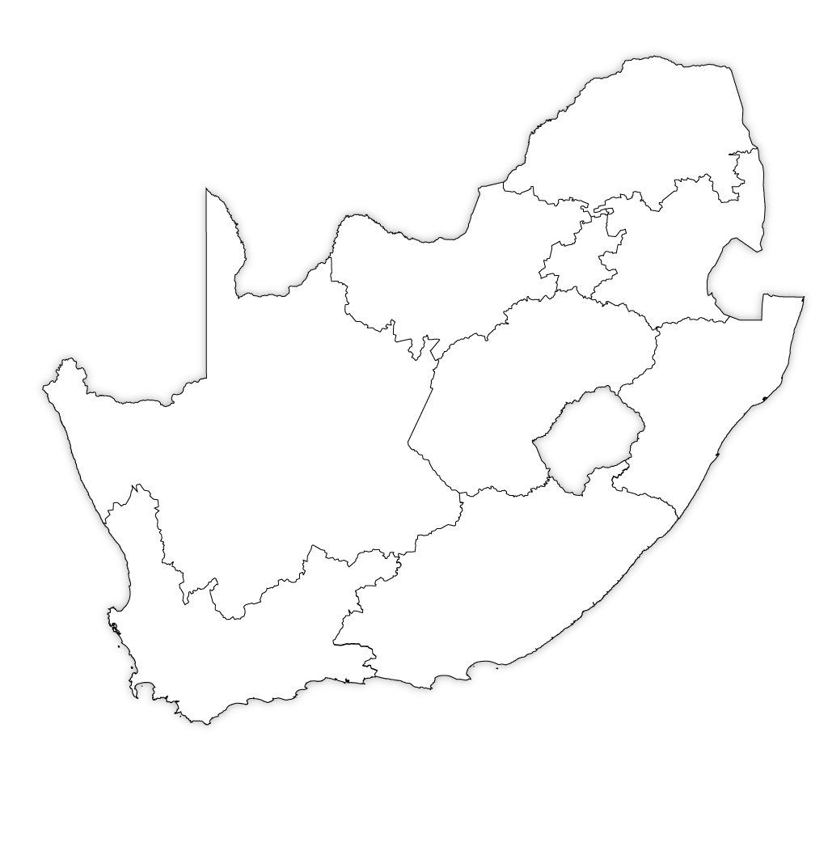
Focus region: dryland cropping systems in the Western Cape, South Africa
Research questions
What is the ability of the dryland grain systems to sequester carbon in soils and does crop rotation influence this ability?
Soil GHG emissions: How much nitrous oxide and methane are emitted from soils? What are the seasonal dynamics? Does rotation sequence and nitrogen sourcing impact this?
What is the global warming impact of our systems? Can this be intentionally mitigated through crop rotation design mitigate?
Experimental site: Langgewens Research Farm, Moorreesburg
Notes:
In the Western Cape province of South Africa, crop rotation is already widely utilised, due to its production benefits, and the failure of wheat monoculture in this region (de Villiers 2021). Rotations strategies can vary from rotating between different cash crops, to highly diverse systems that incorporate legumes, cover crops or pastures with livestock. Typical products from this region are wheat (Triticum aestivum), canola (Brassica napus), oat (Avena sativa), barley (Hordeum vulgare), lupin (Lupinus spp.) and sheep (Ovis aries) wool and meat.
There are large knowledge gaps in South Africa on the direct emissions of cropland, and even more so on the ability of crop rotation design to mitigate emissions or improve soil C sequestration (Garrett et al. 2017).

Slide 5
Experimental Site: rotations
Experimental rotation systems
 | Year 1 | Year 2 | Year 3 | Year 4
WWWC | wheat | wheat | wheat | canola
WCWL* | wheat | canola | wheat | cover crop
WMCM | wheat | medic pasture + livestock | canola | medic pasture + livestock
Fully reliant on synthetic N fertiliser (wheat 87 kg N ha⁻¹;
canola 80 kg N ha⁻¹)
Mostly reliant on N fixation
(wheat 26 kg N ha⁻¹;
canola 48 kg N ha⁻¹)
Diverse crop rotations with livestock or legumes seen in literature to decrease inputs and improve yields
But livestock introduce additional emissions (enteric fermentation and manure management)
WCWL
Wheat following cover crop: 72 N ha⁻¹ Wheat following canola: 87 kg N ha⁻¹
Canola: 80 kg N ha⁻¹
Cover crop phase 5 N ha⁻¹

Slide 6
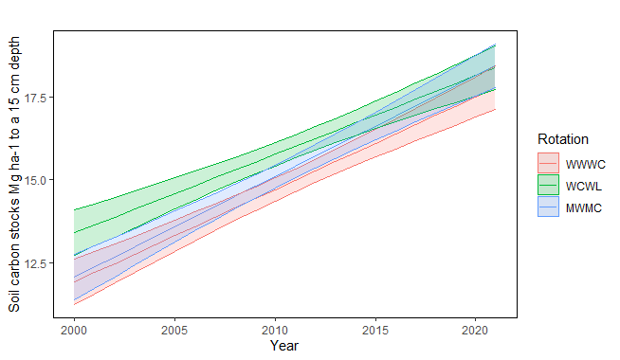
Carbon sequestration
2000 – 2021 annual soil sampling over summer fallow and soil organic carbon % obtained via Walkley-Black lab method
Soil organic carbon % converted to carbon stocks and linear regression modelled
All systems showed a net annual increase in carbon stocks
No significant differences between rotations
Carbon stock changes over 21 years in different crop rotation systems
 |  | System
 | WWWC | WCWL | WMCM
C sequestered (Mg C ha⁻¹ year⁻¹) | 0.279 | 0.237 | 0.304
CO₂ sequestered (Mg CO₂ ha⁻¹ year⁻¹) | 1.033 | 0.878 | 1.126
Linear regression modelled in R using ‘emmeans’ package
Notes:
Rotation year and plot all significant effects on linear model.
. No rotation differences occurred regarding the rate of C sequestration, but the accumulation may be driven by different mechanisms in different systems, as the soil was able to support WMCM and WCWL with nitrogen than WWWC

Slide 7
Historical changes in soil organic carbon
1.7 – 1.8 %
2021 SOC% less than pre-cultivated estimates
1.4%
0.9 – 1.0 %
Soil organic C %
Natural vegetation
Conversion to cropland, rapid SOC loss + continued soil degradation
CA crop rotation trial
Timeline
1926
1997
2021
2038?
Estimates of pre-cultivated SOC% from natural renosterveld remnants

Slide 8
Direct land use impacts (LUC)
Lost of SOC between pre-cultivated natural site and 2021
100 year period
1.7 – 1.8 %
1.4%
20 year period
Annual SOC increase of last 20 years
0.9 – 1.0 %
Soil organic C %
Natural vegetation
Conversion to cropland, rapid SOC loss + continued soil degradation
CA crop rotation trial
Two different direct land use impacts depending on time period used
Timeline
1926
1997
2021
2038?
Notes:
No LUC 20 = increase if 0.4 0.5 % SOC. 100 year period represents a loss of 0.3 – 0.4. also because wcwl had the highest 20 year – affected by slope of increase, but lowest 100 yr – difference between the linear model of current year vs. pre-cultivated
100 year is the similar principle as ‘carbon opportunity costs’ sometimes used in carbon footprinting whereby you compare it to a potential carbon level if the land were to be fully restored (however COC values include biomass of permanent vegetation, unlike 100 year period CS).

Slide 9
Soil nitrous oxide and methane emissions
Closed chamber method
Weekly – biweekly flux sampling (39 sampling days)
Big N₂O emission spike detected following a rainfall event over the summer fallow period (but not in WWWC)
Heat + moisture + surplus N prerequires for emissions.
WWWC lower organic N stored in soil
CH₄ emissions negligible 0.11 – -0.33 kg CH₄-C ha⁻¹ year⁻¹)
Analysis in R using ‘nlme’ and ‘multcomp’ packages

Slide 10
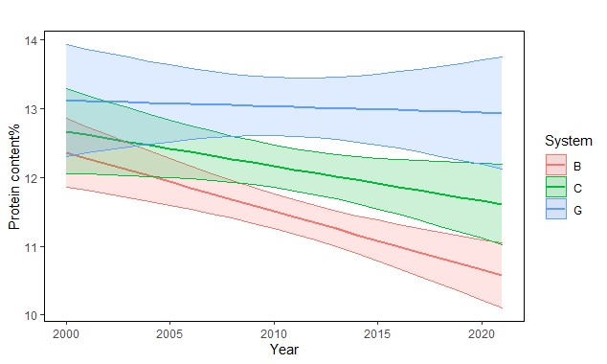
Outputs
Systems produce different levels of outputs
Dropping of wheat protein content
Canola and wheat performance in 2021
a
b
- 0.009 (0.0337)
c
WWWC
WCWL
WMCM
- 0.051 (0.0250)
- 0.085 (0.0201)
2016 – 2021: > 90% of wheat harvested from WLWC and WMCM were considered bread grade, but only 75% of wheat from WWWC
Linear regression modelled in R using ‘emmeans’ package
Notes:
Higher production = higher biomass = more inputs to soil
The wheat protein content is a parameter used in grading, the criteria for protein content are as follows: super grade > 12.5%; bread grade 1 > 11.5%; bread grade 2 > 11.5%; bread grade 3 > 10.5%; and class other (animal feed grade) > 9.5% (Republic of South Africa 1990). In 2000, protein content was between 12 and 13% for all rotations, but by 2021 protein content had reduced by 1.8% in WWWC, 1.1% in WCWL but only by 0.2% in WMCM.
Yield has remained constant – N is limitinh

Slide 11
Overview
Rotation systems mapped out: inputs, outputs and processes
Data collected though:
Direct sampling
Historical trial data & farm records
Literature
Soil N₂O & CH₄ emissions
Soil carbon stocks & input records
Emission sources inventoried
Emission factors, indirect land use emissions
Life Cycle Assessment approach of GWP (carbon footprint)
Emissions per hectare vs. emissions per product
Production system boundaries
Create multiple LCA models and test relative performance of rotations
Notes:
We really want look at the system in as many ways as possible and flesh out differences which could be caused

Slide 12
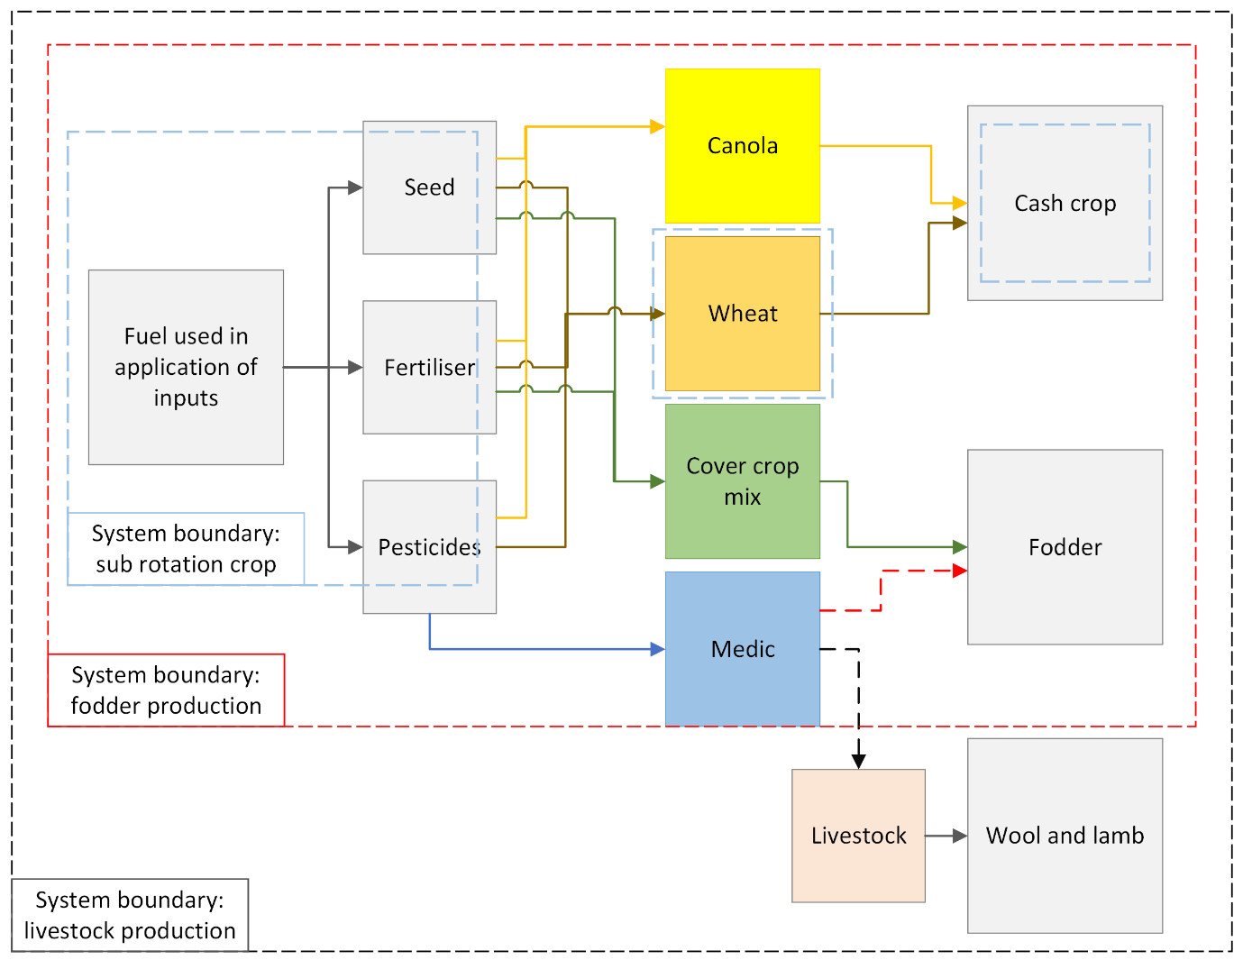
System boundaries
Each boundary implies an assumption about the system:
Fodder production: in WMCM medic pasture livestock production is seen as a separate enterprise, and the output in the medic pasture phases is the production of fodder
Livestock production: in WMCM medic pasture livestock products are considered the output, but medic biomass production is not considered.
Sub-rotation boundary: production of one commodity type within a rotation, only taking into account inputs applied during that crop’s production phase.
To deal with different commodities in one functional unit we made use of a Grain equivalent (GE) metric
Wheat: 100 kg = 1.04 GE
Canola: 100 kg = 1.3 GE
Lucerne hay (M. sativa) 100 kg dry matter = 0.58 GE
Sheep: 20 kg lamb = 2.87 GE
(German Federal Ministry of Food and Agriculture, 2012)
Wool has no grain equivalent: economic allocation of direct livestock emissions based on the gross income generated by the products (lamb meat 72.6% and ewe wool 27.4%).
Notes:
as its (output is dry biomass of medic hay)
Fodder production: assumes the goal is produce animal fodder as an output. Similar to how the cover crop phases are treated (using feeding value of lucerne hay) as this product could either replace other animal feed, and livestock production systems are best compared to other livestock systems. Argument that an integrated crop-livestock system should be compared not to a crop system, but to both an isolated crop and an isolated livestock system. Scenario in which a livestock producer links to a crop farmer.
Livestock production: this system assumes that livestock is part of the system, and its presence central to the process of N fixation. – could medic pasture be planted without a grazer – yes but livestock ensures the profitability of that process. Adding livestock to grain systems is an expansion of the system, and if it increases absolute emissions on a farm it should be included.
Sub-rotation boundary: this looks only at one crop type within the rotation (common crops are wheat and canola in all systems. Only considers inputs and outputs directly related to producing that commodity in that year. Different phases are not grouped together – for the example provided in the figure – it is the footprint of wheat production within a specific system – to compare to the production of the same commodity within another system.

Slide 13
Sources of emissions
Sources that differ most:
Fertiliser
Annual carbon sequestration
Fuel usage
Soil N₂O
(emission reduction of replacing N fertiliser 4x the N₂O emission increase)
500 kg CO₂-eq
Livestock emit more GHGs than all other inputs in WMCM
Indirect land use impact = 1430 kg CO₂ ha⁻¹ bigger than any affectable source of emissions
750 kg CO₂-eq
1000 kg CO₂-eq
Notes:
The GWP100-AR6 metric was used to weight CH₄ and N₂O into carbon dioxide equivalents (CO₂-eq), where CH₄ (non-fossil) = 27.0 ± 11 and N₂O = 273 ± 130 CO₂-eq.
Although the long-term build-up of N in the soil organic fraction through fixation increased direct N2O emissions in the fallow season (60-, 133- and 180 kg CO2-eq ha-1 for WWWC, WCWL, and WMCM, respectively) the replacement of synthetic fertiliser had an emission reduction more than 4 times larger the N2O emission increase (669-, 422-, and 178 kg CO2-eq ha-1 for WWWC, WCWL, and WMCM, respectively).

Slide 14
Global warming potential of different agricultural commodities
The global warming potential of same commodities were significantly different based on the rotation system
Wheat in WMCM had the lowest global warming potential
Lamb had highest global warming potential (but have no reference to ‘business as usual’)
a
b
c
cd
e
def
ef
ef
f
Do the benefits of incorporating livestock outweigh the emission increase?
n=6 n=4 n=2
n=2 n=2 n=2
n=2 n=4
n=4
GE used for commodities:
Wheat: 100 kg = 1.04 GE
Canola: 100 kg = 1.3 GE
Fodder: 100 kg dry matter = 0.58 GE
Lamb: 20 kg lamb = 2.87 GE

Slide 15
Relative global warming potentials
GHG emissions per product
GHG emissions per hectare
System boundary: fodder production
System boundary: livestock production
System boundary: sub-rotation crop
System boundary: fodder production
System boundary: livestock production
System boundary: sub-rotation crop
Notes:
Effect of using different system boundaries

Slide 16
Summary
In comparison to WWWC
WCWL:
35% reduction in emissions per GE (product)
15% reduction in emissions per hectare (area)
WMCM:
11% reduction in emissions per GE (product)
7% reduction in emissions per hectare (area).
a
e
b
f
f
c
g
d
But if medic pastures considered as fodder production rather than livestock production:
55% reduction in emissions per GE (product)
35% reduction in emissions per hectare (area)
Notes:
In system WCWL, the GEs of only wheat and canola (31 GE ha-1) were the same as the total GEs produced in WWWC (29 GE ha-1), even though only 75% of the production area was used.

Slide 17
Conclusions and recommendations
Phases that incorporated a legume phase had a lower GWP, but if livestock were added most of reduction lost.
N-fixation to replace fertiliser highest emission reduction potential + improved protein content
Cover crops: grain production is not sacrificed
Soil carbon sequestration has a big impact on GWP, all systems removed more CO₂ annually than what was emitted through inputs and direct emissions
Increasing outputs and efficiency is important along with mitigation (figure →).
Notes:
Increasing input efficiency and outputs is an important GHG mitigation strategy, but it should be kept in mind that the LCA approach favours intensification by setting output as a divisor of total global warming impact. Arguably, increasing yields can protect natural areas from agricultural expansion, but it should be kept in mind that intensification could bring have additional negative environmental impacts (Dudley and Alexander 2017). Intensification should be achieved sustainably by increasing ecosystem functioning and provisional services

Slide 18
Implications of findings
Livestock can convert forage and fodder products into food products (can be used to rotate cash crop phases with less intensive fodder phases)
Mitigation benefit was due to N fixation, livestock ensures pasture is profitable
Incorporating should be done carefully (high stocking rate, overgrazing, insufficient N fixation)
Perspective shift from managing a crop production system for annual output to managing a production system as a multi-year agroecosystem
Ecosystem services are considered co-products that support internal processes
Conceptualise the linkages between different phases in the rotation
Massive GHG mitigation potential: Livestock integration through linking existing producers

Slide 19
Thank you to the project funders
LisaLMatt@gmail.com

