Slide 1
Mobilizing Natural Enemies for Sustainable Plant Pests and Diseases Management
Mwangi J. M.
Department of Biological Sciences
Chuka University
www.chuka.ac.ke
kmwanginosky@gmail.com
Notes:
Introduce the project and the supervisors

Slide 2
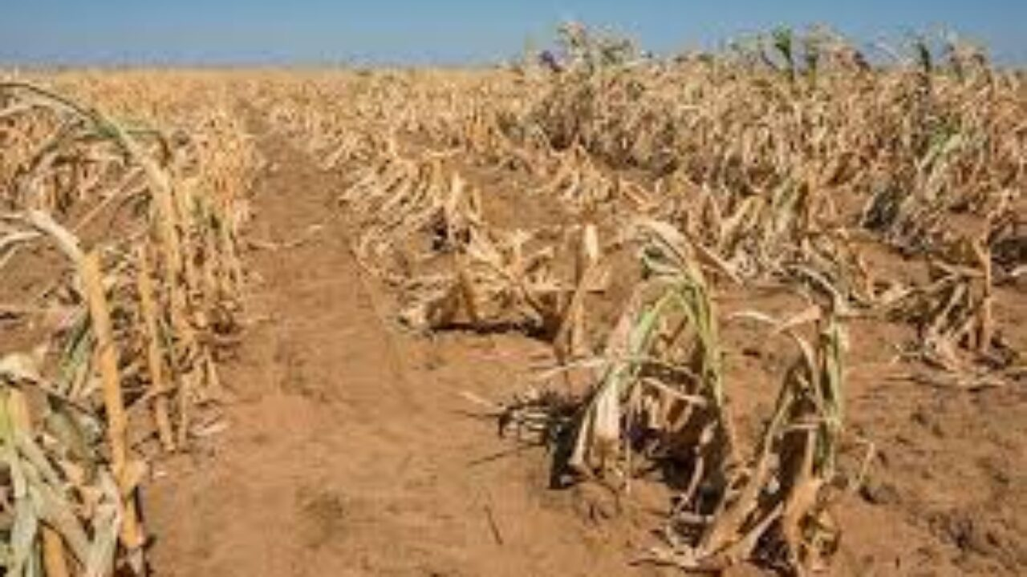
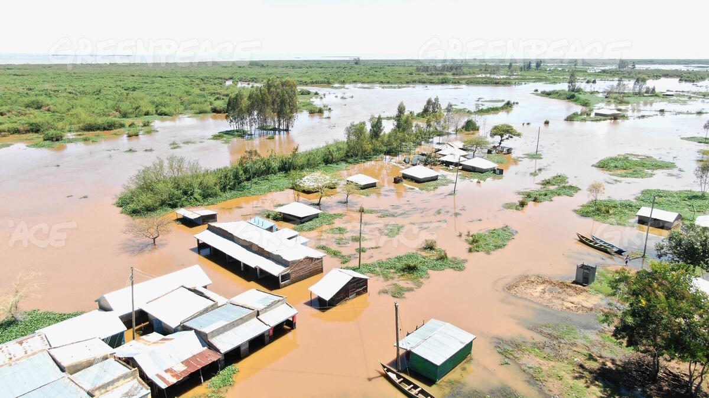
Overview: Food Production Systems
Status of food security –SDG No. 3
Small holder farmers contribute 70%
Impact of climate change
Destabilized agroecosystems
Crop loss to pests and diseases
Invasive/emerging pests and diseases
Pest management challenges
Perennial Drought
Raging Floods

Slide 3
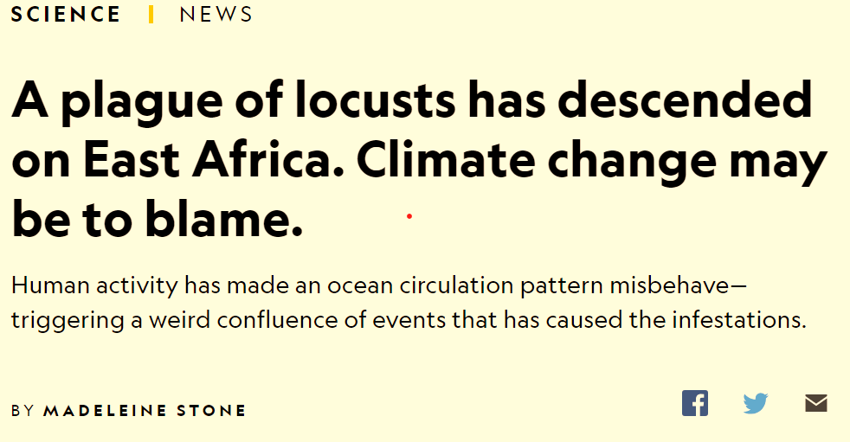
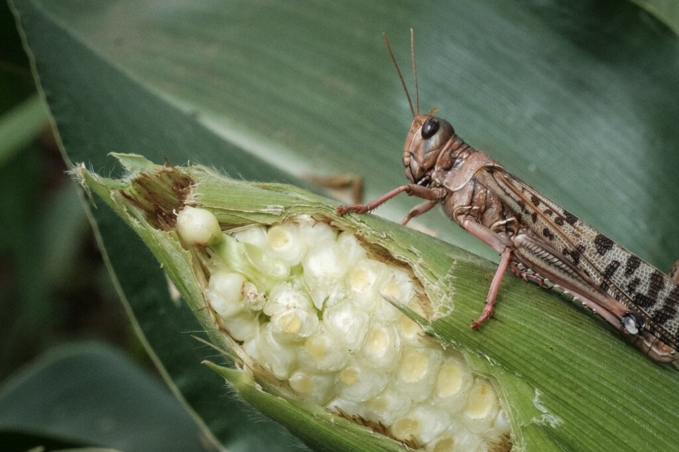
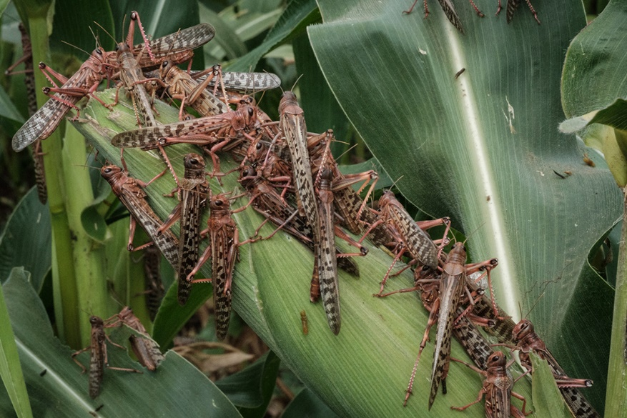
Invasive and Emerging Pests and Diseases
Put lives of 3.1 million people in arid and semi-arid areas of Kenya at risk
Locust outbreak in Kenya in 2021

Slide 4
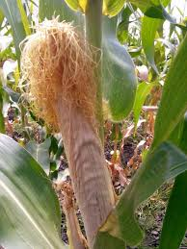
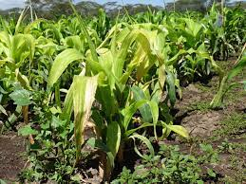
Invasive and Emerging Pests and Diseases
Maize Lethal Necrosis Disease (MLND)
Up to 23–100% loss in the affected counties in Kenya (Boddupalli et al., 2020)

Slide 5
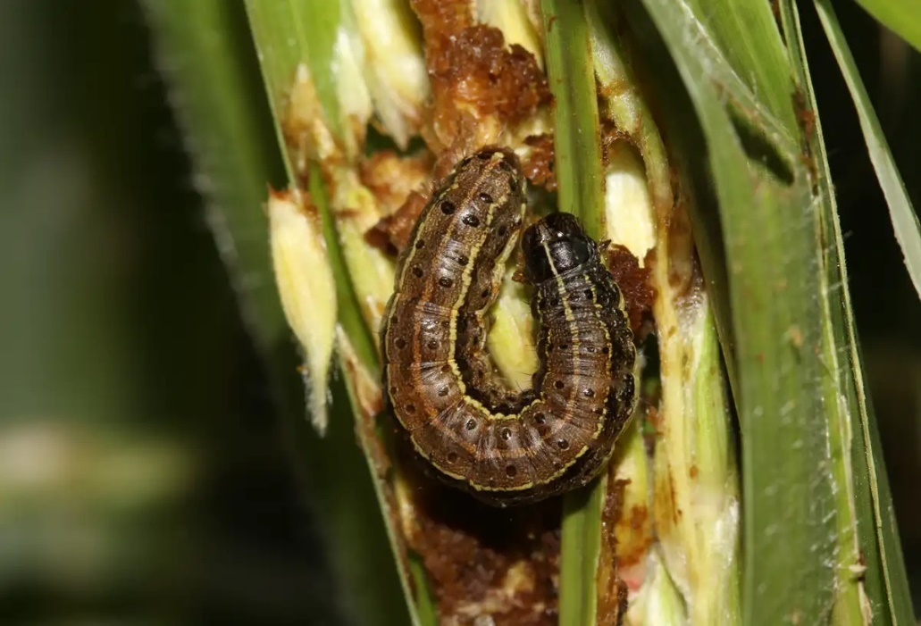
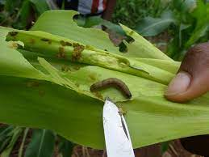
Invasive and Emerging Pests and Diseases
Fall armyworm (Spodoptera Frugiperda) in maize
A third of the annual maize production lost, estimated at about 1 million tonnes (Groote et al., 2020)

Slide 6
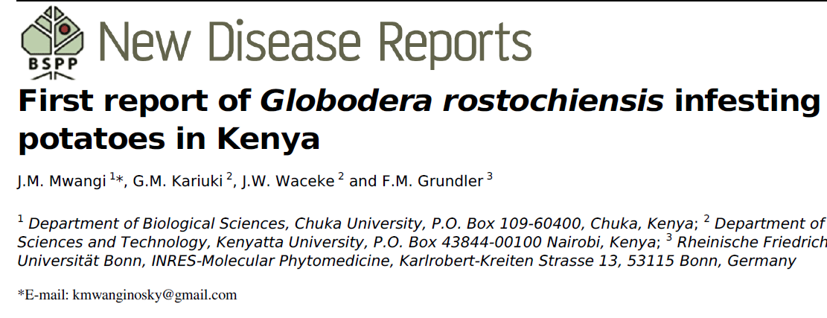
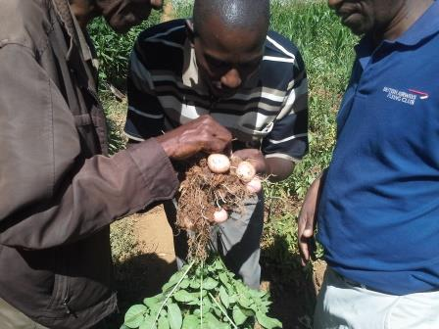
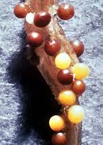
Invasive and Emerging Pests and Diseases
Golden Potato Cyst Nematode Globodera rostochiensis
PCN diagnosis in the field)
Cause 80% yield loss if left uncontrolled.

Slide 7
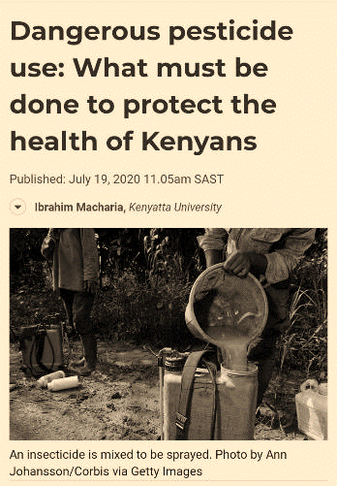
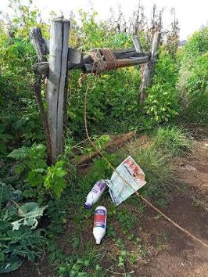
Challenges of Pest and Diseases Management
Overuse/misuse of pesticides
They accumulate in the soil
Persistent pesticide residues
Effect on human health
Effect of pesticides on environment
Contribute GHG Emissions
Loss of biodiversity
Contamination of water bodies
Farmers mishandle pesticides oblivious of the risks

Slide 8
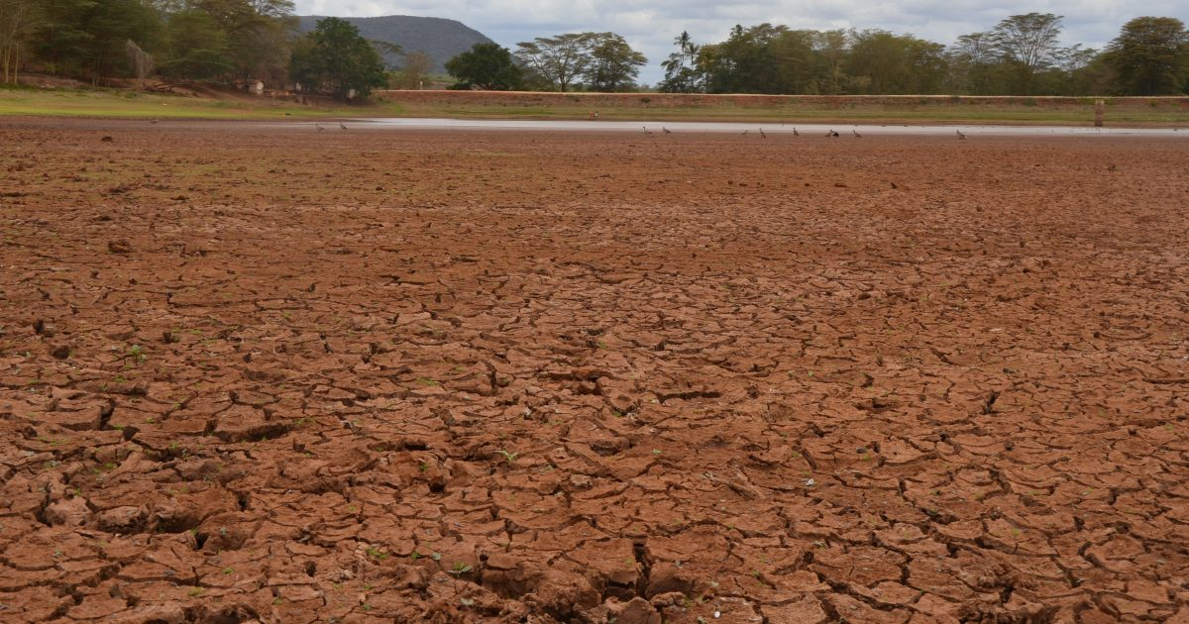
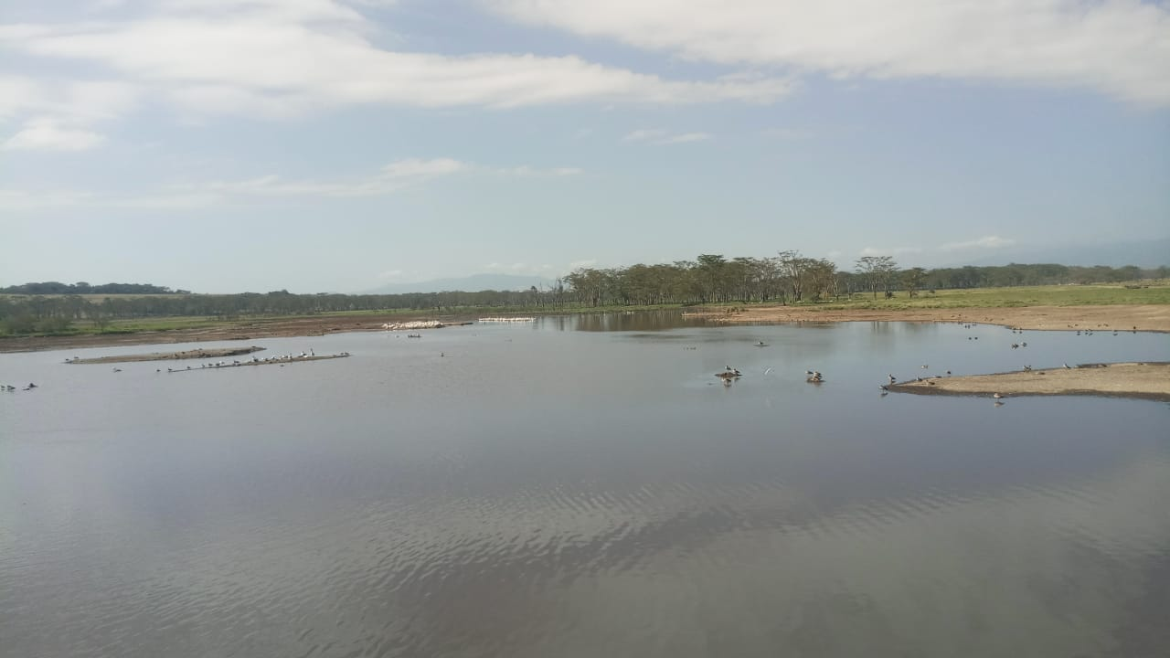
Project: Sustainable Agricultural Production Systems
Riverine/watershed ecosystem restoration and management
Sustainable agricultural approaches
Management of plant diseases and pests and their impact of the ecosystems
Pesticides and synthesis fertilizer
Dry water pan
Alternative options
Use of natural enemies in pests and disease management
Lake Nakuru ecosystem

Slide 9
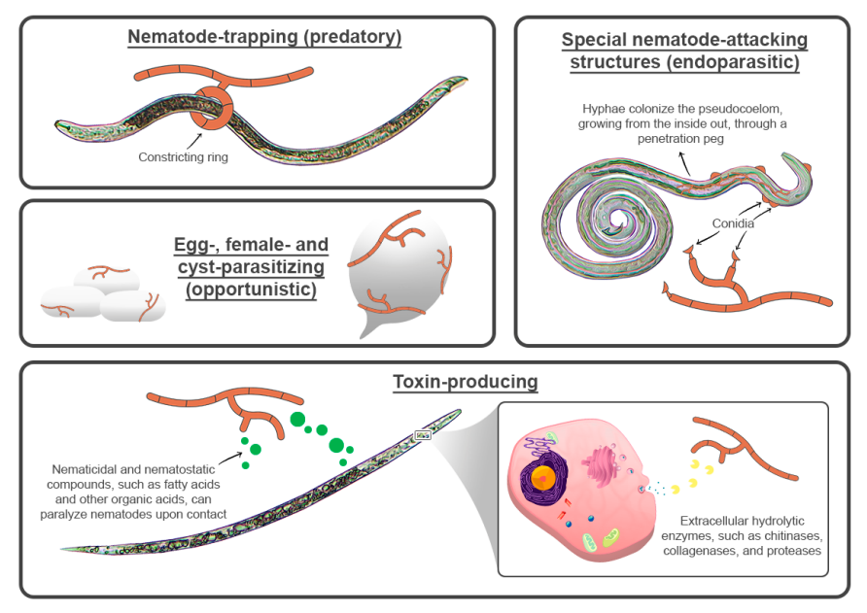
Use of Natural Enemies in Pest Management
Microbes as natural enemies
There are 85 registered biopesticides in Kenya (PCPB, 2022).
Farmers have high willingness to adopt biocontrol strategy and to lower use of pesticides
Farmers lack knowledge, experience and technical support on biocontrol concept (Constantine et al., 2023)
Action of nematophagous fungi (Pires et al., 2022)
Little has been done with microbial communities antagonistic to pests in Kenya

Slide 10
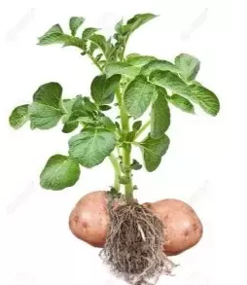
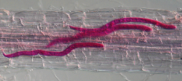
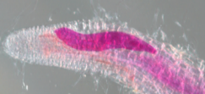
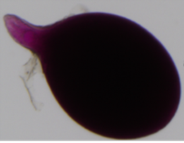
Potato cyst nematode (PCN)
Potato is a staple crop in Kenya
Production constrained by pests and disease
PCN in an emerging pests
Lowers production by 80%
No sustainable management
Juvenile in the roots
Stage 3 juvenile
Fast spread in Kenya
Reported in Uganda and Rwanda
Tanzania and Burundi ??
Mature female nematode

Slide 11
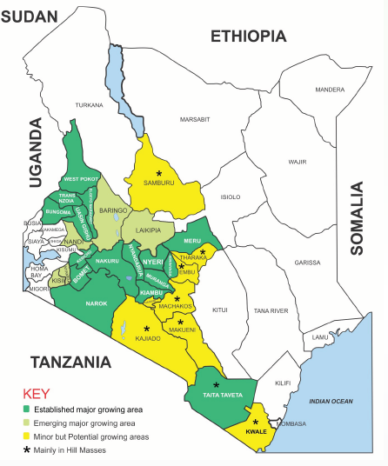
Potato cyst nematode (PCN)
Samples collected from six potato producing counties
Samples processed and cysts extracted
Nematode density determined

Slide 12
Potato cyst nematode (PCN)
Number of eggs per cyst
The number of nematodes eggs per cyst was estimated
Some cysts had significantly lower number of eggs
Viability of the eggs determined
Hatched juveniles differed by county
Viability of PCN eggs in PRD
Lower viability attributed to fungal infestation

Slide 13
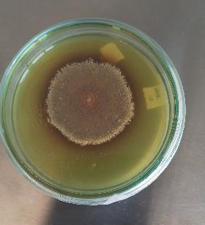
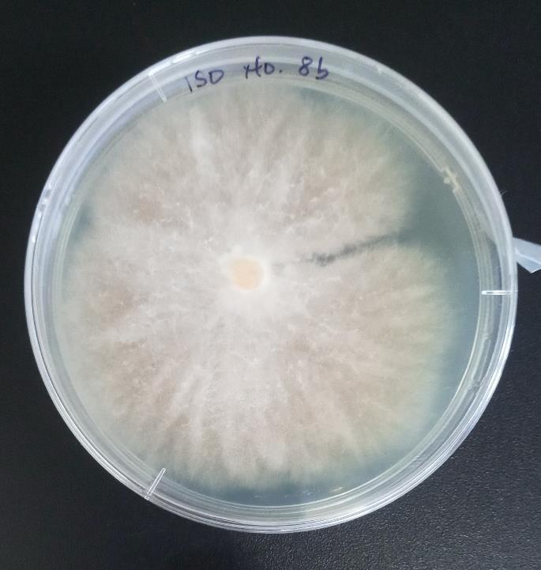
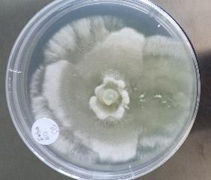
Use of Natural Enemies in Pest Management
Cysts were soaked in water for 24 hrs
Those showing signs of fungal infestation were selected
They were surface sterilized in 70% alcohol and rinsed in distilled water
They were plated in PDA
Eighteen Fungal Isolates obtained
Screening for more isolates ongoing

Slide 14
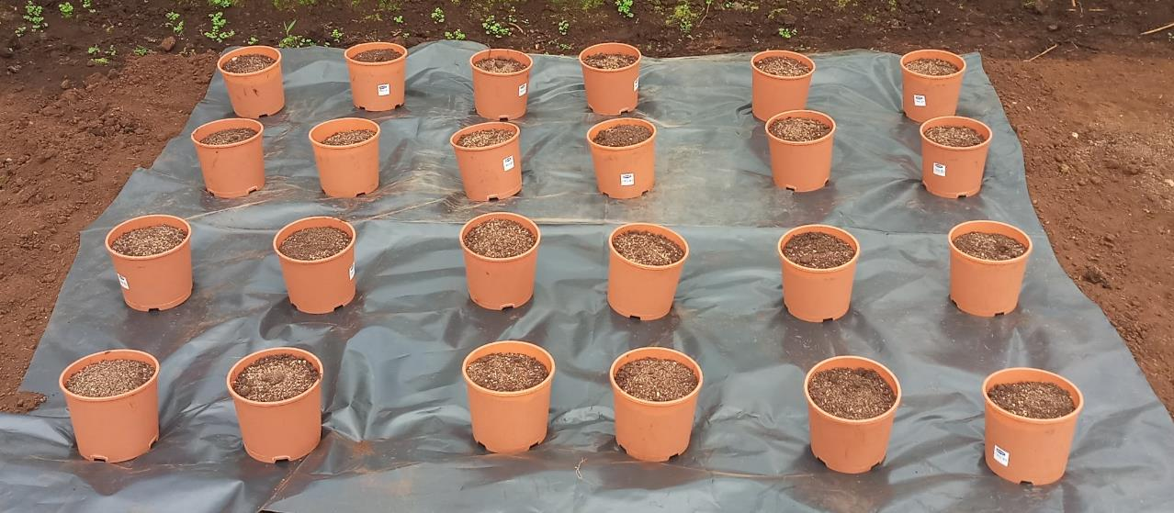
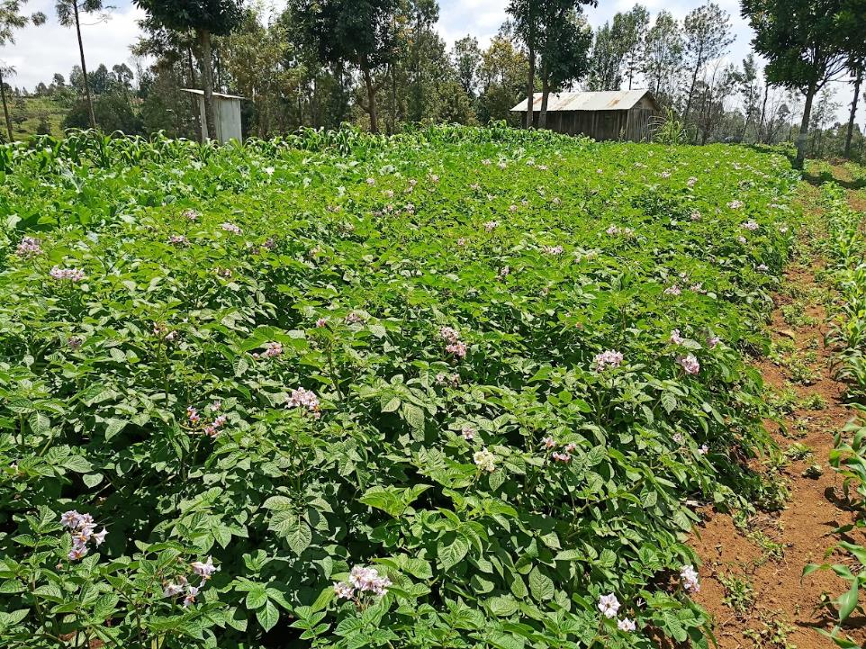
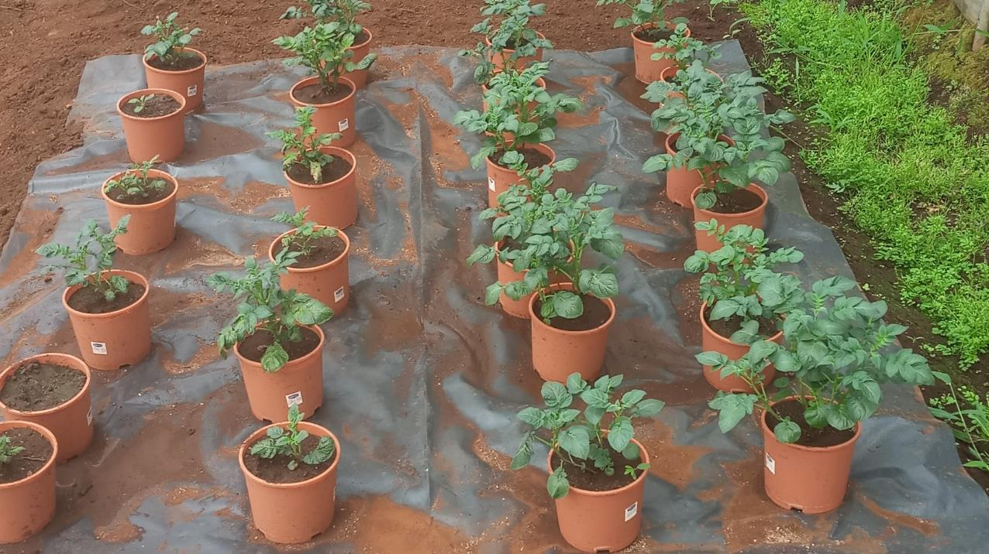
On going Work
Morphological and molecular identification
Invitro efficacy tests ongoing
Greenhouse efficacy test

Slide 15
Acknowledgement
Research Term
Prof Eunice Githae
Dr. Eric Kuria
Ms. Ruth Nyakinyua- Msc Student
Research Funded by Chuka University Internal Research Fund (IRF)

