Slide 1
Microbial Remediation Of Overexploited Soils In Malawi
Sarah Fröbel¹, Manuel Pufal¹, Keston O. W. Njira², Katharina Detert¹, Mathias A. Witte Paz³, Kay Nieselt^{3,} Herbert Schmidt¹
¹UHOH, Institute of Food Science and Biotechnology, Department of Food Microbiology and Hygiene
²Luanar, Crop and Soil Sciences Department, Lilongwe University of Agriculture and Natural Resources, Lilongwe, Malawi
³EKUT, Interfaculty Institute for Biomedical and Medical Informatics, Department of Integrative Transcriptomics
Bio-Geosphere Africa Conference 2023

Slide 2
Background
Soil degradation is a major threat to agricultural development in Malawi (Asfaw et al.. 2018)
Prominent indicators of soil health decline on Malawi soils include low organic matter and nutrients that are below threshold levels (Snapp, 1998; Njoloma et al., 2016)
Low soil fertility and decreased farm productivity/profitability are common challenges
It may reduce fertility of soils, pose health threats, decrease productivity of farmlands, and may lead to a general decline in profitability of crop production and food safety.

Slide 3
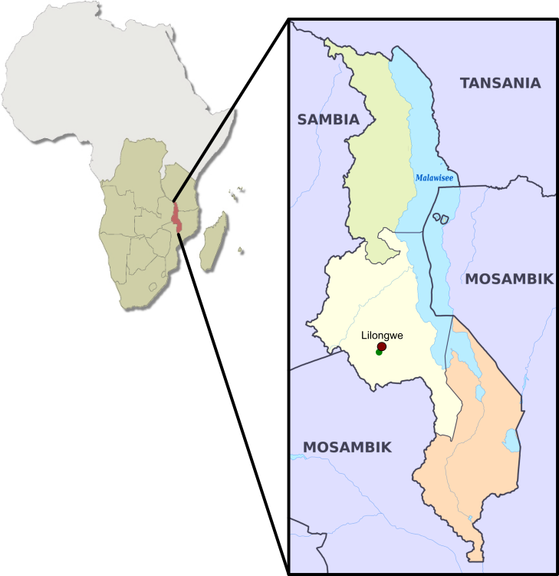
Agricultural Challenges in Malawi, Africa
Rapid population growth
Strong agricultural dependence
80 % Maize farming
Convention vs. conservation farming
Climate and problems:
In-season droughts
Heatwaves
Inconsistent rainfall
Floods during the rainy season
Delayed cropping season

Slide 4
Aims
Understanding the differences between the soils
influenced by soil proportion and soil parameters
pH, nitrogen availability, organic carbon content
Understanding the microbiota of different soils
Differences in soil microbiota composition
Identification of bacteria with antimicrobial effect
Characterization of antimicrobial substances
Metagenome analysis

Slide 5
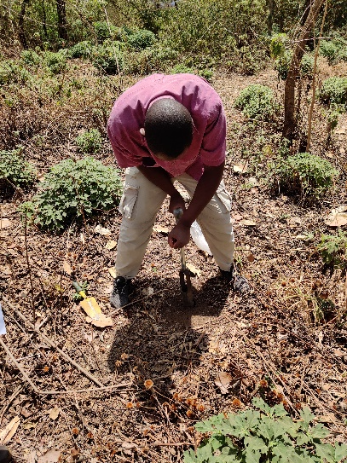
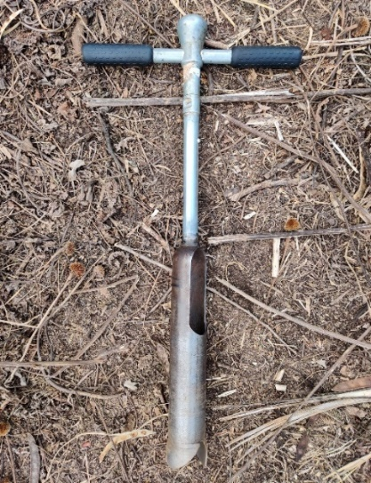
Soil Sampling
Green fallow
No farming > 5 years, no fertilizer application, shrubs and bushes
Maize monoculture
Annual farming > 30 years, conventional maize farming
Maize with intercropping
Annual farming > 30 years, 1 year break, conservation farming, intercropping and crop rotation

Slide 6
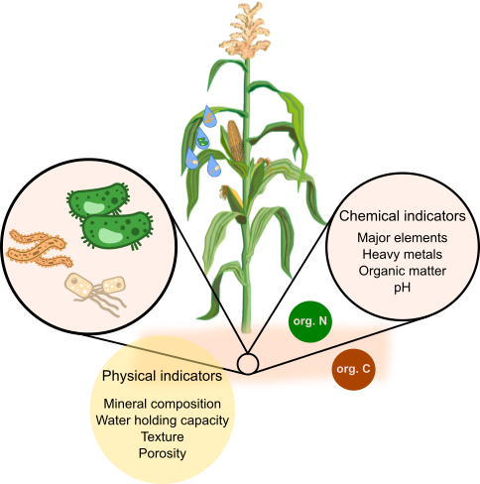
Soil Composition

Slide 7
Nutrient content
Sample | Potassium content K₂O [mg/100g soil] | Phosphorus content P₂O₅ [mg/100g soil] | pH value
green fallow | 19.7 | <2.5 | 5.1
corn monoculture | 11.2 | 8.1 | 4.3
corn monoculture with intercrop | 12.7 | <2.5 | 4.4
Reference value for K₂O in soil: 15 - 25 mg/100g soil
Reference value for P₂O₅ in soil: 10 - 20 mg/100g soil
Reference value for pH value in corn cultivation: 5-7

Slide 8
Nutrient content
Humus quality= ${Corg.}/{N total}$
green fallow: 12:1
corn monoculture: 10:1
corn monoculture with intercrop: 10:1
Reference value for Humus quality for
corn cultivation: 25:1

Slide 9
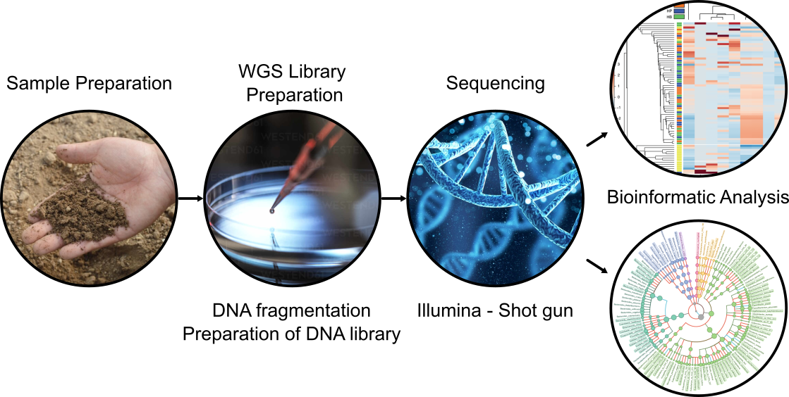
Metagenomic sequencing - Methods

Slide 10
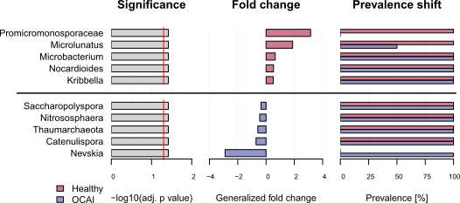
Metagenomic sequencing – GF vs. MC
GF – Green fallow, MC - Corn monoculture with intercrop

Slide 11
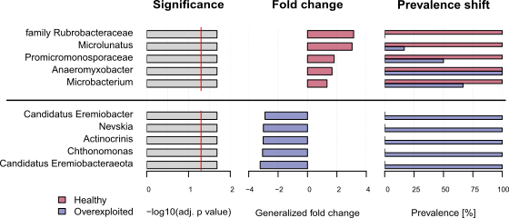
Metagenomic sequencing – GF vs. MM
GF – Green fallow, MM - Corn monoculture soils

Slide 12
Metagenomic sequencing – Phylogenetic tree
MM – Corn monoculture, MC Corn monoculture with intercrop, GF – Green fallow

Slide 13
Discussion
The nutrients in the fallow samples are closer to the reference values in the great majority of cases than the two conventionally operated cultivation vials.
Often found in green fallow are bacteria that form substances that contribute to improving soil quality.
Humic substances, genes for nitrogen fixation, growth-promoting substances, enzymes for cellulose utilization, antimicrobial substances
Representatives of these bacterial strains occur in lower amounts than in the converntionally farmed soils.
It may be possible to isolate useful bacteria from the green fallows and apply them to the soil as “biofertilizers”.

Slide 14
Summary
Understanding the differences between the soils
Major differences between the Soil green fallow and the others
None of the soils reaches the necessary standards
Understanding the microbiota of different soils
there are differences in the composition of the microbiota between soils
The composition of the microbiota in the fallow layer differs more strongly from that in the other two soils
For a better understanding, individual bacterial strains were isolated and tested for their antimicrobial activity.
Poster title: “Isolation and Characterization of Bacteria with Antimicrobial Activity from Malawian” Samples

Slide 15
Thanks to
Manuel Pufal - Project staff
Keston O. W. Njira – Project partner in Malawi
Mathias A. Witte Paz & Kay Nieselt - Bioinformatics
Herbert Schmidt – Project leader
Thank you for your attention

