Slide 1
Farmers’ preferences for adopting agroforestry in the Eastern Drylands of Rwanda
Nkurikiye, J.B., Vanermen, I., Van Ruymbeke, K., Uwizeyimana, V., Bizoza, R.A., Verbist, B. & Vranken, L.

Slide 2
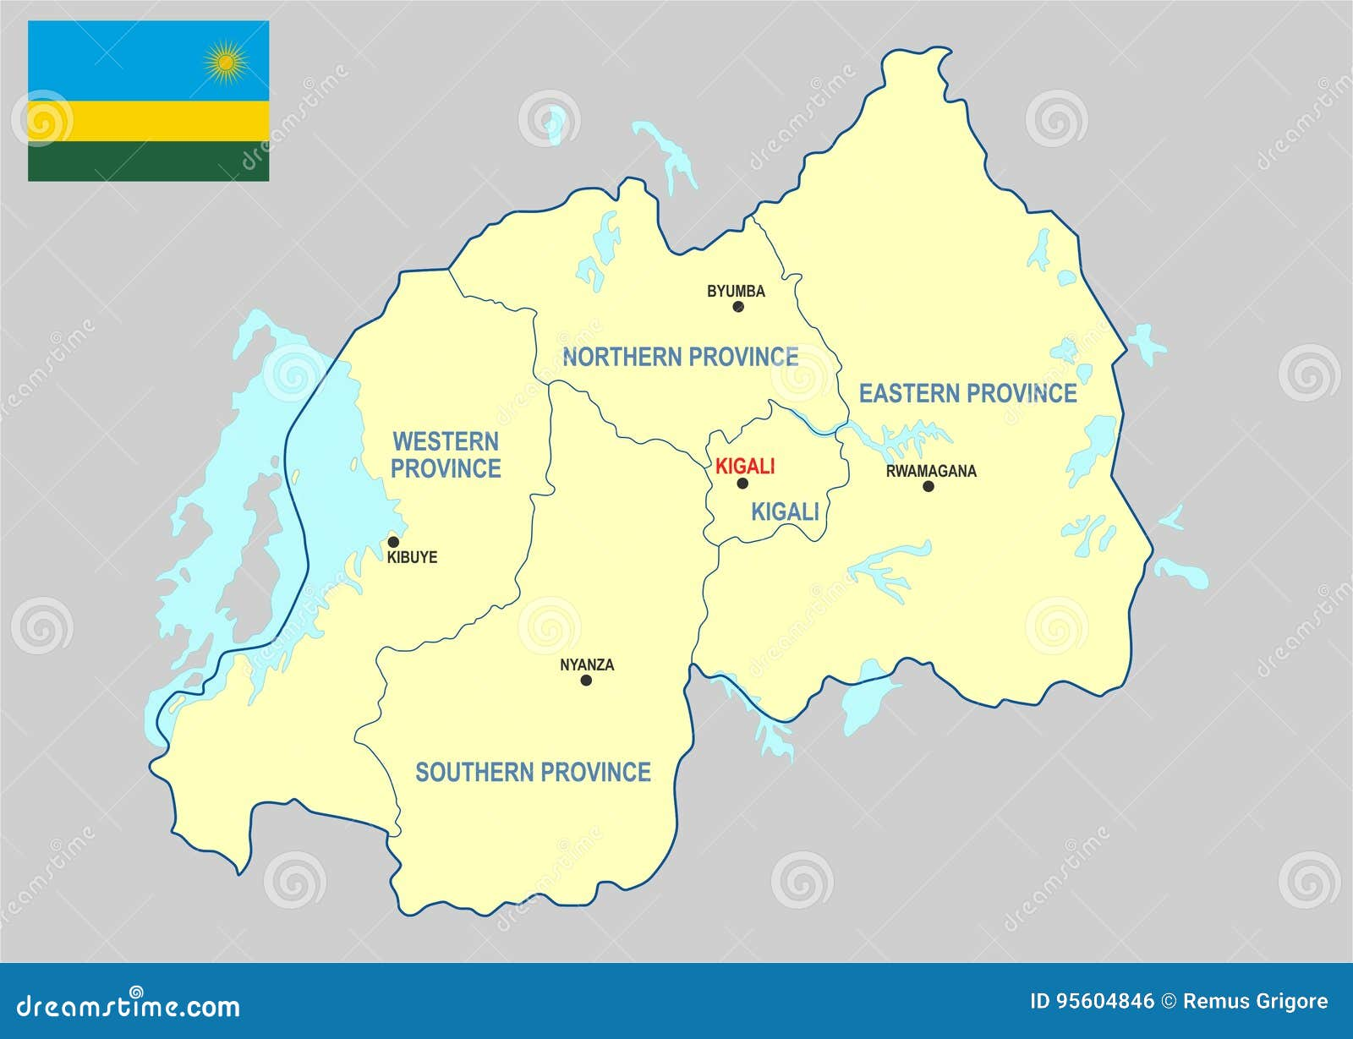
About Rwanda
Surface: 26,388 Km sqd.
Population: 13.2 m (Aug 2022)
Population density: 501 inhabitants/Km sqd.
Annual pop. growth rate: 2.3%
63% of the HHs are engaged in (subsistence) crop farming
76% of the HHs use firewood as source of energy for cooking

Slide 3
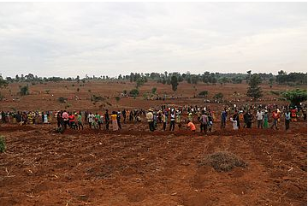
Context
Agriculture in Rwanda suffers from land degradation (Austin et al., 2020; Maniriho et al., 2022).
Agroforestry is recognized to be one of the worthwhile strategies for landscape restoration (Muneza, 2022).
However, the adoption of agroforestry remains low in the eastern region compared to other regions of the country (MoE, 2019).
The low adoption rate often results from inadequately planned interventions as they do not incorporate farmers’ preferences for agroforestry in their design.

Slide 4
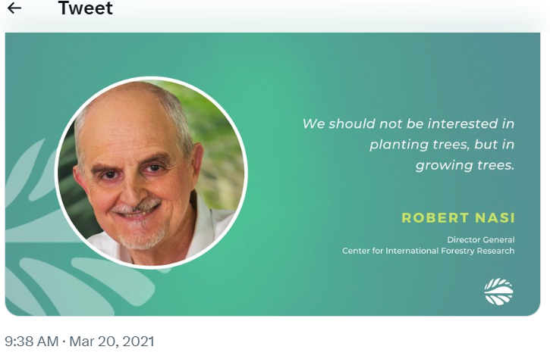
Research questions
Are smallholder farmers willing to participate in agroforestry?
What are their preferences for agroforestry?
Do farmer preferences vary across plot characteristics?

Slide 5
Next
Methodology
Results
Conclusion

Slide 6
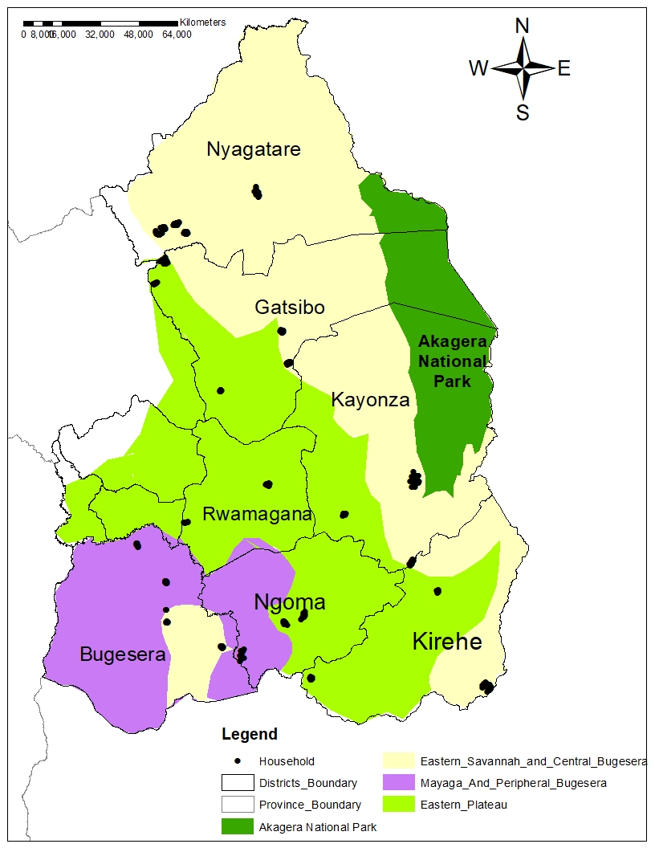
Methodology (1)
Fig. 1: Map of the study area
Study area: Eastern Province of Rwanda
Choice experiment (CE) survey
Plot level analysis using econometric models: Mixed logit (MXL) and Latent Class (LC) models
406 plots from 248 random HHs (Oct.- Nov. 2021).
DCE Approach with 28 choice cards split into 7 blocks - 4 choice cards per plot, and 3 plots per HH at max.
Each card: 2 alternatives + opt-out

Slide 7
Methodology (2)
Table 1: Attributes and attributes levels
Attribute | Attribute Levels
Total number of AF trees (per are¹) | 4, 8, 12, 16
Fraction of fruit trees | 0%, 25%, 50%, 75%, 100%
Root system & canopy | Deep roots, Small canopy Deep roots, Wide canopy Shallow roots, Wide canopy Shallow roots, Small canopy
Change in maize yield (Kg per are) | -10, -5, -2.5, 0, +2.5, +5, +10
Extension assistance | One visit (at the AF implementation) Two visits per year (Semesterly visit)
Additional labour (person-day per are) | 0, +1, + 2, + 3
Distance (plot-tree nursery, in Km) | 0, 4, 8, 16
Seedling cost (FRW) | 0, 500, 1000, 2000, 4000
¹ 1 are= 100 m. sqd

Slide 8
Results (1)
Table 2: Parameter estimates of the MXL and LC models
Fig. 2: Relative importance of attributes
Attributes | MXL Model |  | LC Model
 | Coef. | Std. Dev | Class 1 | Class 2
ASC (dummy coded)¹ | 6.283*** | 3.012*** | 2.281*** | 3.822***
Non-fruit trees | 0.059** | 0.078* | -0.049 | 0.283***
Fruit trees | 0.100*** | 0.175*** | 0.007 | 0.455***
Deep roots, small canopy | 0.475** | 0.815 | -0.079 | 2.177***
Deep roots, wide canopy | -0.051 | 0.285 | 0.582*** | -3.014***
Shallow roots, small canopy | 0.569* | 0.035 | 0.711*** | 2.256***
Shallow roots, small canopy [base]
Two extension visits per year | 0.307* | 1.045** | -0.008 | 0.125
One extension visit [base]
Extra labour (days/are) | 0.003 | 0.212 | 0.160** | 0.160
Distance [plot-tree nursery] | 0.007 | 0.117** | 0.015 | -0.146***
Change in maize yield | 0.326*** | 0.212*** | 0.137*** | 0.350***
Cost per tree seedling | -0.057*** |  | 0.0003 | -0.232***
Log likelihood | -846.40 |  | -867.49
Class size (% Plots) |  |  | 34.5 | 65.5
Obs. | 4,872
*** p<0.01, ** p<0.05, * p<0.1; ¹ASC takes 1 if agroforestry system is chosen, 0 if opt-out is chosen

Slide 9
Results (2)
Table 2: Plot characteristics by latent class
Characteristics | Full sample | Class 1 | Class 2 | Chi2/t-test
Number of plots | 406 | 140 | 266
Plot location (% in Eastern Plateau) | 41.4 | 45.0 | 39.5
Size of arable land (ha) | 0.28 | 0.27 | 0.28
Distance from home to plot (Km) | 0.92 | 1.19 | 0.78 | **
Existence of at least 1 (% Yes)
Non-fruit tree | 69.5 | 63.6 | 72.6 | *
Fruit tree | 58.4 | 52.9 | 61.3
Non-fruit/ fruit tree | 85.7 | 82.9 | 87.2
Tree density (trees/ha)
Non-fruit trees | 35.2 | 42.5 | 31.3 | *
Fruit trees | 20.5 | 14.9 | 23.4 | ***
Non-fruit & fruit trees | 47.3 | 50.1 | 45.8
Maize proportion on plots (>75%) | 24.4 | 28.6 | 22.2
*** p<0.01, ** p<0.05, * p<0.1

Slide 10
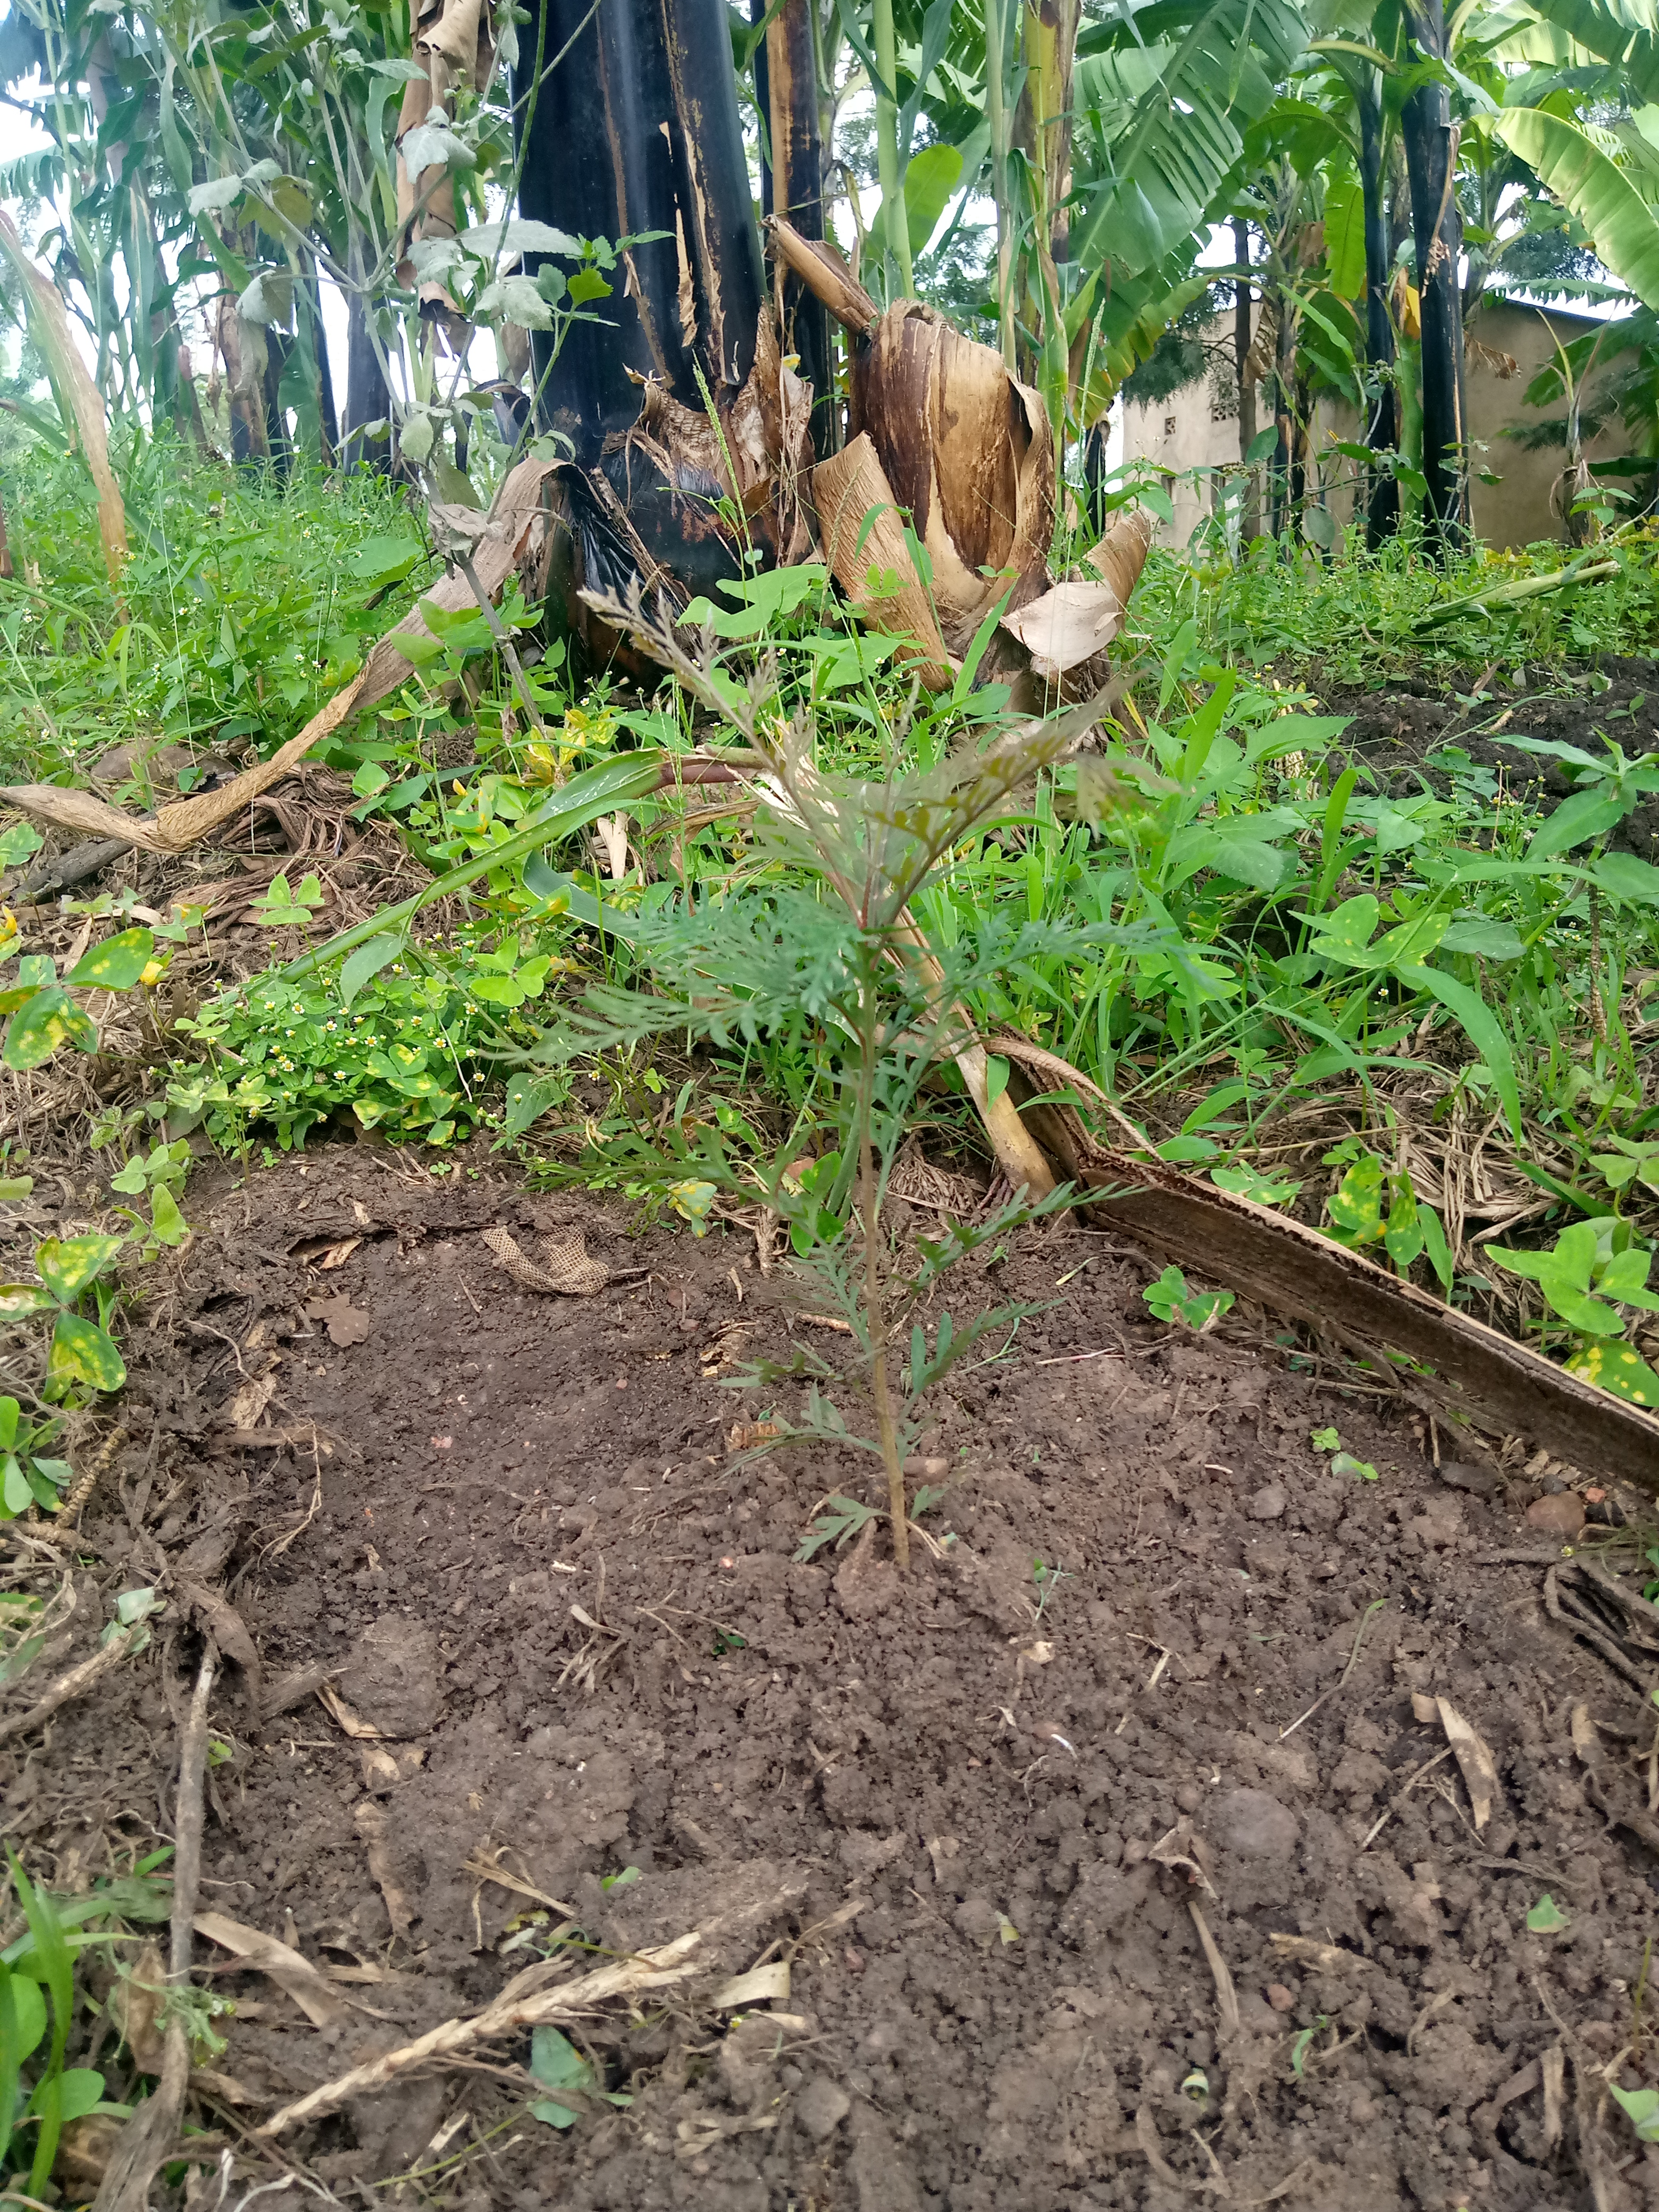
Conclusion
Farmers are interested in adopting agroforestry on their croplands.
But there is heterogeneity in their preferences:
On 34.5% of the plots, farmers prioritize increasing maize yields; while
On 65.5%, there is high interest to plant more trees (mostly fruit trees).
Agroforestry adoption in hampered by high cost of tree seedlings.

Slide 11
THANK YOU!
Questions and inputs are welcome
e-mail: jeanbosco.nkurikiye@kuleuven.be

